Slide 1
Fact Check
@google.com
Corinna Cortes, Head Google Research, NYC
Notes:
Corinna Cortes and I am happy to be here today to tell you about some of Google’s initiatives in tackling Fake News and active disinformation.

Slide 2
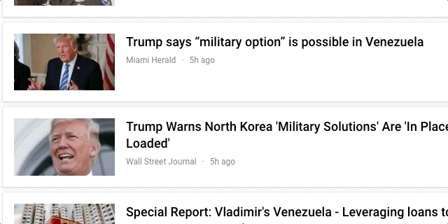
The Way We Experience News Today is Complex
Overwhelming
48K new documents every minute
Notes:
The internet has put a printing press in the hands of everyone and News has evolved from being a carefully edited paper landing on your doorstep in the early morning hours to be an onslaught of tweets, videos and articles.

Slide 3
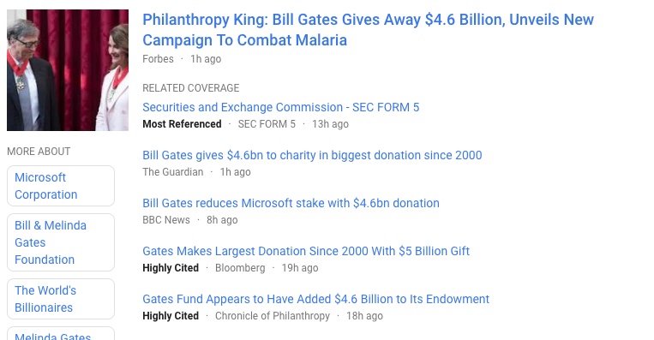
The Way We Experience News Today is Complex
Overwhelming
Repetitive
48K new documents every minute
News has been commoditized
Notes:
Mere mortals easily give up, but should we brave the storm to read up on a topic we may quickly get frustrated and resign as all the articles appear to repeat the same 5 lines.

Slide 4
The Way We Experience News Today is Complex
Overwhelming
Repetitive
Polarizing
48K new documents every minute
News has been commoditized
Filter bubbles abound
Notes:
We stick to a single version from a preferred publisher and get blissfully stuck in our filter bubbles. Google should be there for us, read and summarize all the articles and present a fair and balanced view highlighting the important and controversial questions.

Slide 5
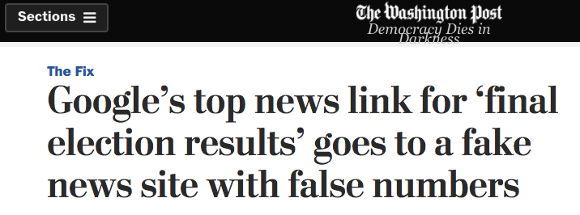
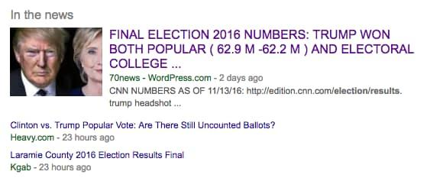
Bad Actors Targeting High-Interest Events
Notes:
But we are in for a tough job. We try to present only high-quality credible information, but especially for hgh-interest events we have over the last years experienced a number of unfortunate episodes as this one -- the day after the election where Google’s top lnk for the query “Final election numbers’ pointed to a site with fake numbers.

Slide 6
Let’s start with this: Google Search is a search tool, not an oracle of absolute truth.
Notes:
How does this happen. Allow me to spend a few minutes on what you may think is completely well known, but there is an important philosophical message.
The guiding principle behind Google is that it is a search engine. On google you should be able to find all digital information that is indexed. That is the good, the bad, and the stuff we don’t agree on.
Google is not an oracle. Very often I hear people saying: ”I read it on Google”, meaning that “this is the truth”.
But two things: Google does not create content. We serve back content written by others. And we don’t know what the truth is.
In many instances our users will found material that is not authoritative -- and they should. It is our hope to educate our users to tell the difference.

Slide 7
Notes:
When we present search results, we particularly pay attention to two dimensions relevance and authoritativeness.
As a proxy for relevance we use keyword search, and it works really well. We look for all pages that contain the keywords of our query. Let me give you an example. You cannot remember the title of a movie, but it is about a person being on an island with a volleyball.
So you turn to Google and enter the keywords “Movie, volleyball, island”. And magic seems to appear as the movie CastAway appears at the top.
But is is not that fantastic. Google doesn’t know the meaning of any of these words. However there are tons of pages with those words on them and 99% of them are about the movie CastAway, so it is easy to get one of them to the top.

Slide 8
Notes:
Authoritativeness is the second dimension. Originally it was pagerank, a measure of the graph structure on the web. A page had high authoritativeness if many other sites point to it. Today we have refined the metric, but the idea is the same.
We use both metric in our search result for CastAway as all the returned results are equivally relevant. We bring one of the more authortiative sites to the top, and I would not be surprised it it were wikipedia.

Slide 9
Notes:
The balance between relevance and authoritativeness varies depending on the type of query. For a common query like the CastAway we use authoritativeness a lot, but if we get to a more narrow query like “Table saw for sale” the best search result may be a blog post with very little authoritative score.
Our algorithms take the scores and the distribution of the scores into account when presenting the ranking of the results.
This technique works pretty well when everybody is playing nice and trying to help each other with informative information.

Slide 10
Surfacing more authoritative content
Notes:
But breaking news can be very different and present a new challenge where BAD actors targeting these high-interest events with an intention to mislead.
In the heat of a breaking news event, speculation often outruns facts. While we are waiting for quality journalism to provide thorough reporting, we may be misled by seemingly relevant stories on the topic. Lately we have seen many conspiracy theories by bad actors publishing malicious content to grab the attention of those who are rushing to find trusted information.
It is an arms race where we need to develop systematic approaches so we don’t just solve for the single instance, but all the future instances as well.
It is important that we develop good tools in order for us to improve credibility and trust of the Web in society.

Slide 11
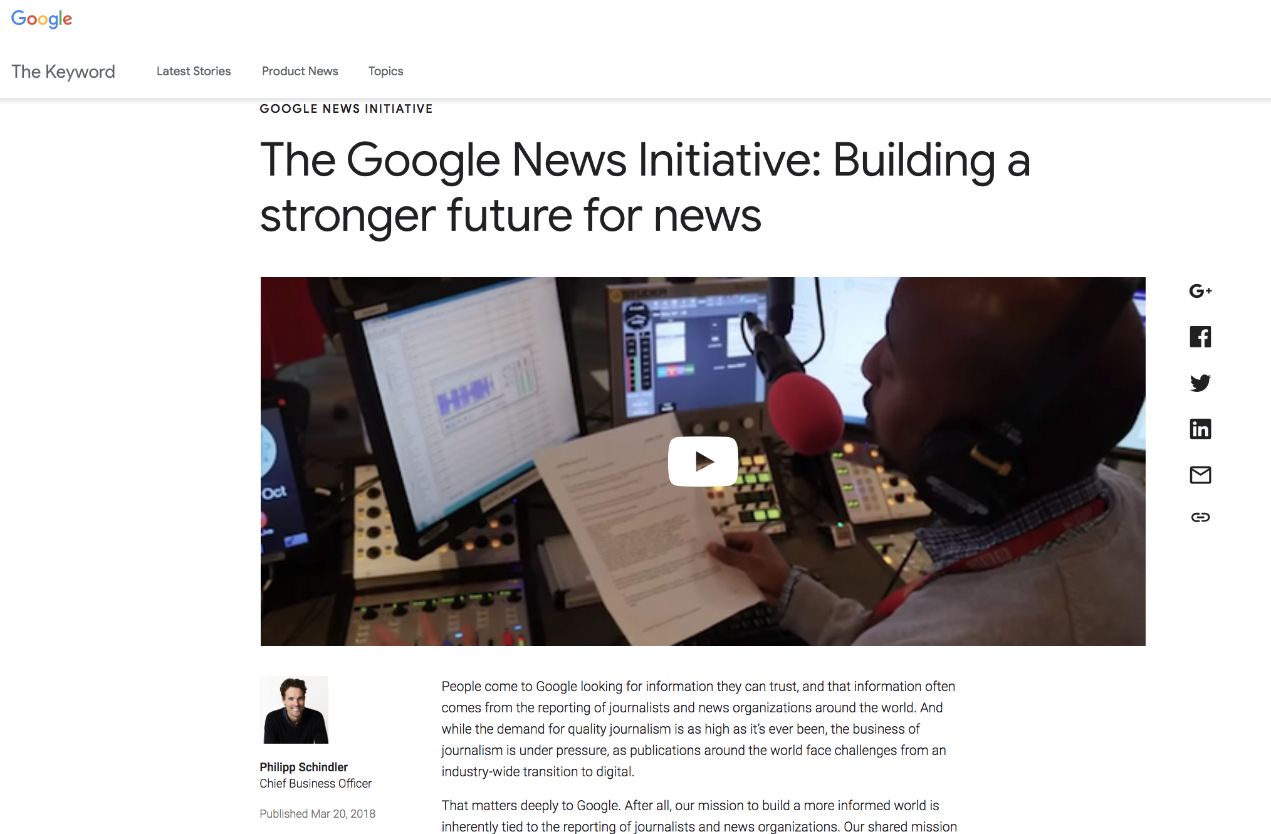
Google New Initiatives Launched 3/20/2018
Notes:
To that end we launched a big initiative exactly one week ago. I encourage you to go and read more about it.

Slide 12
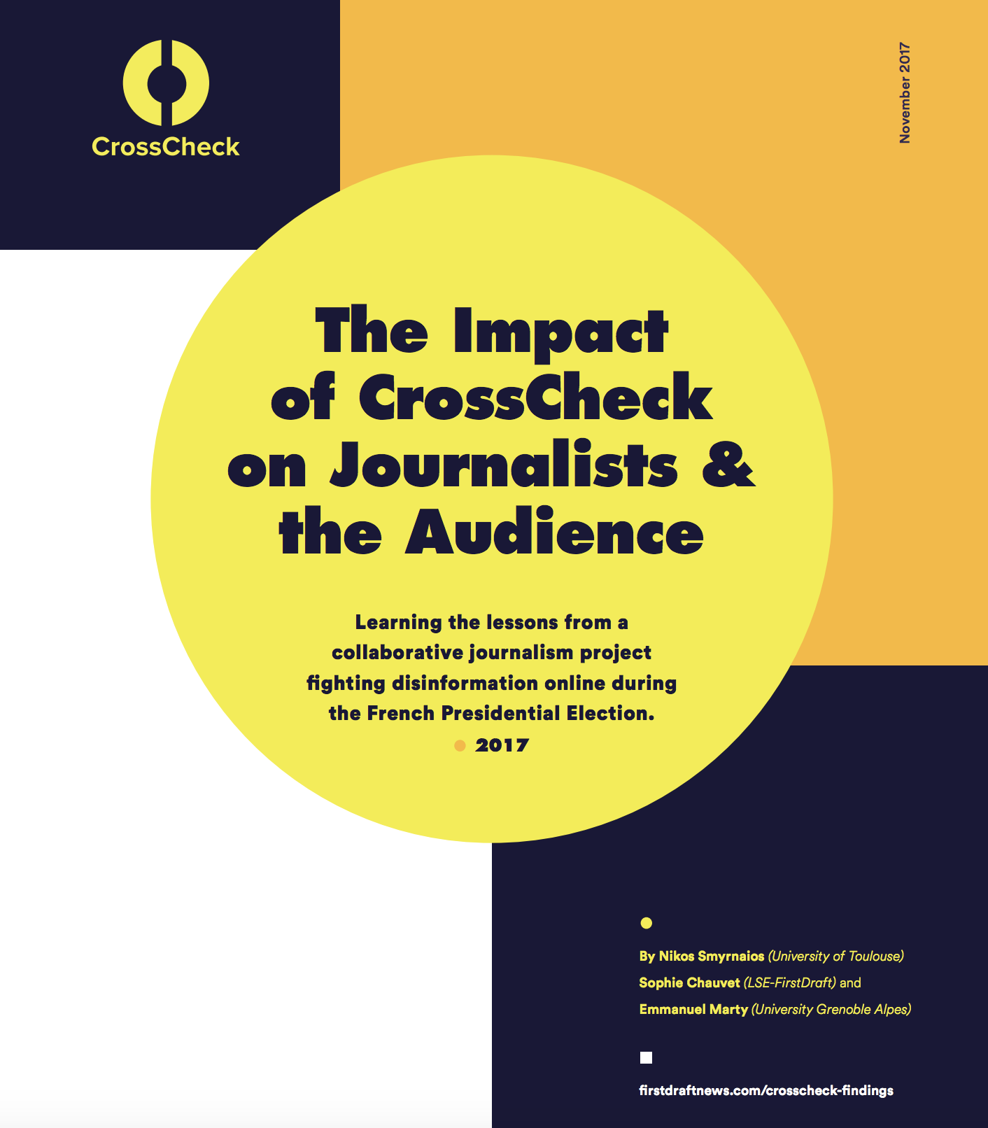
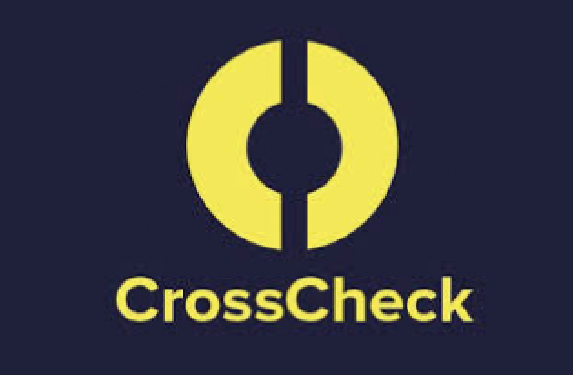
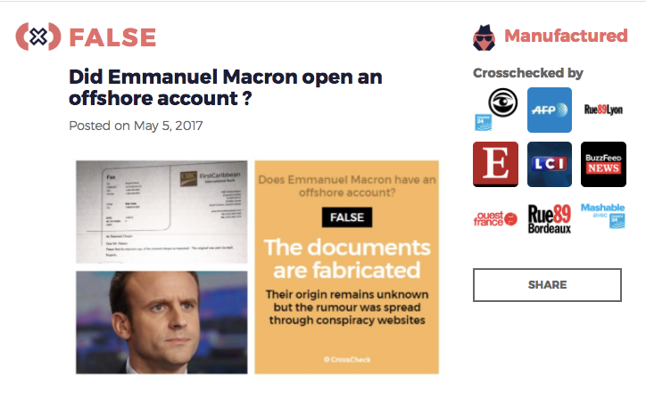
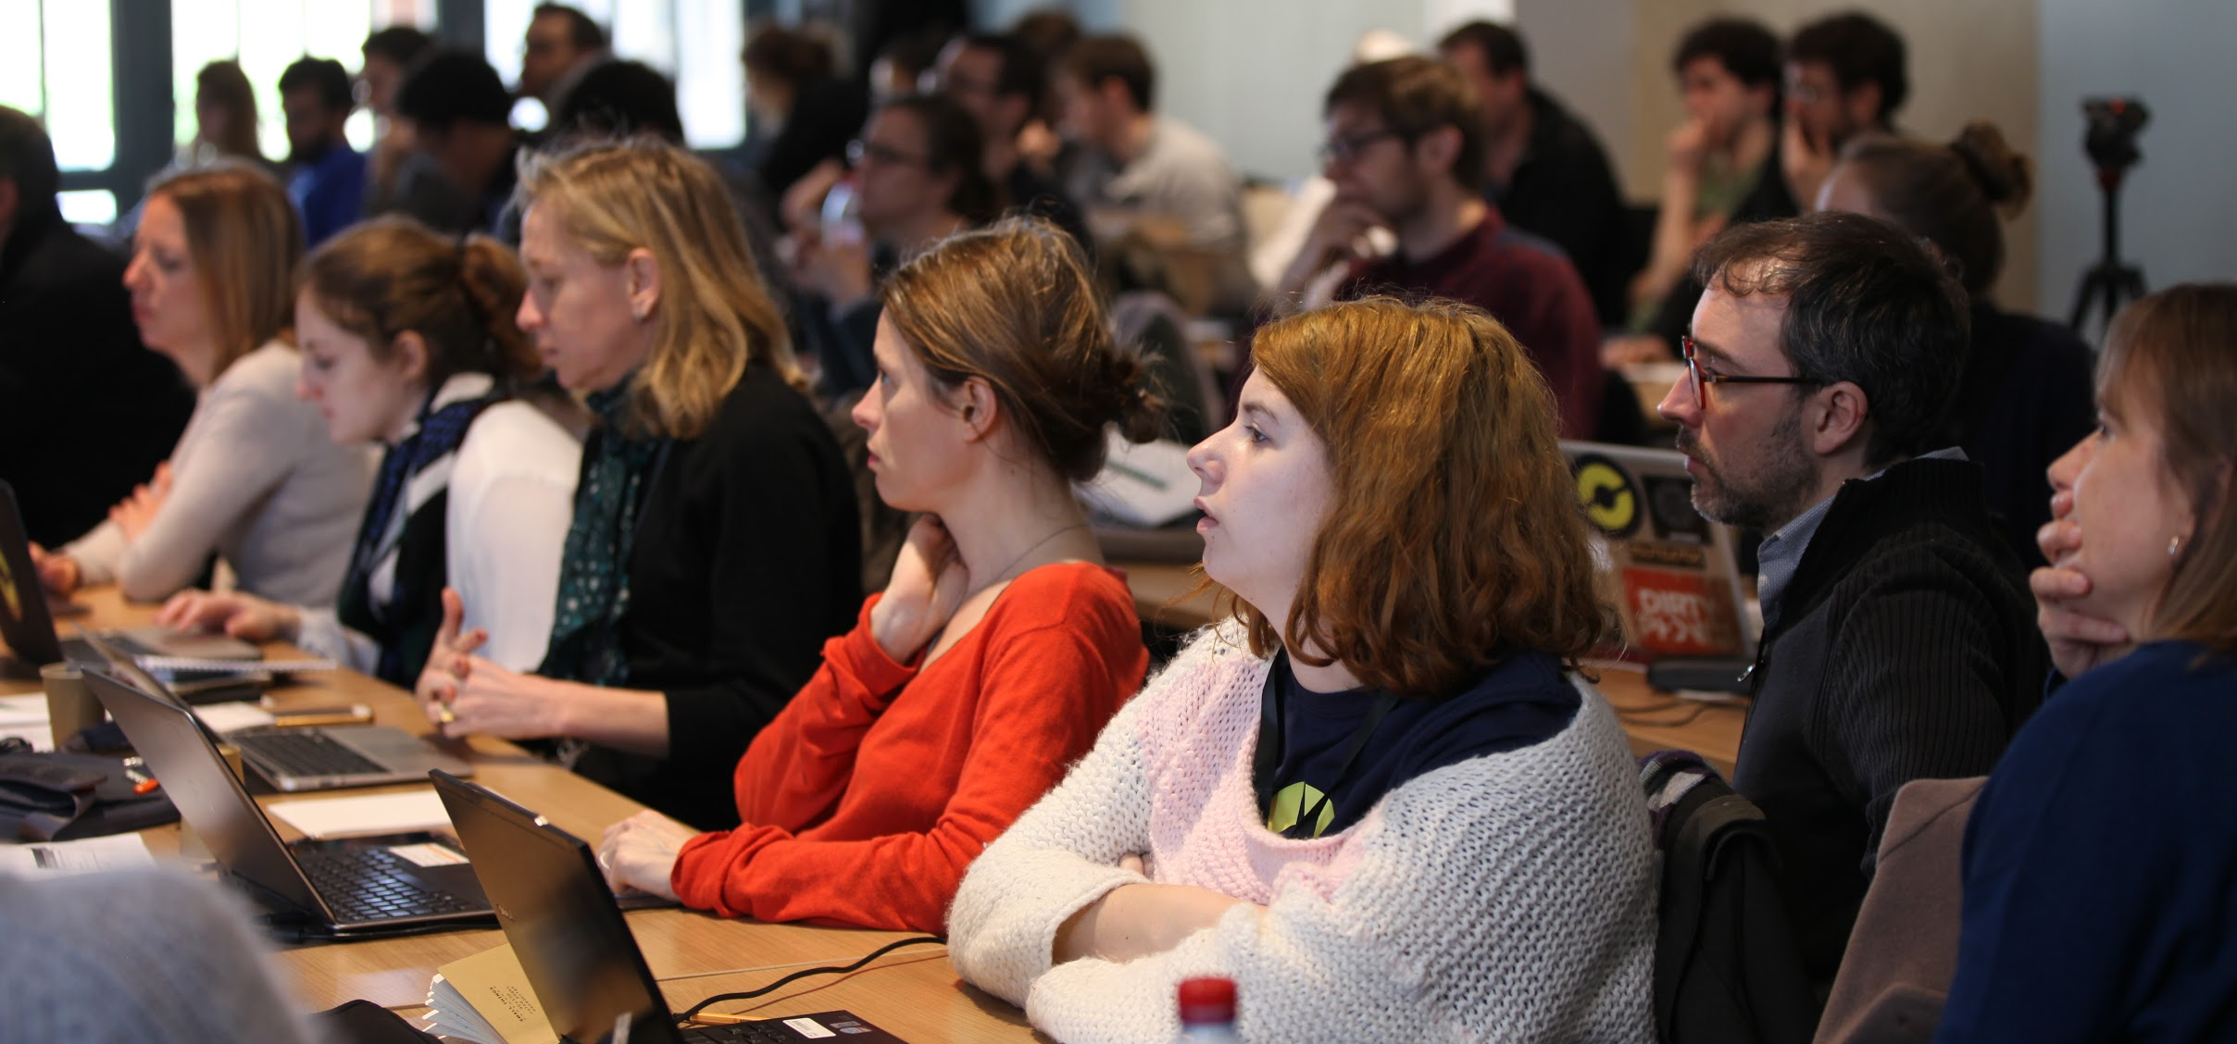
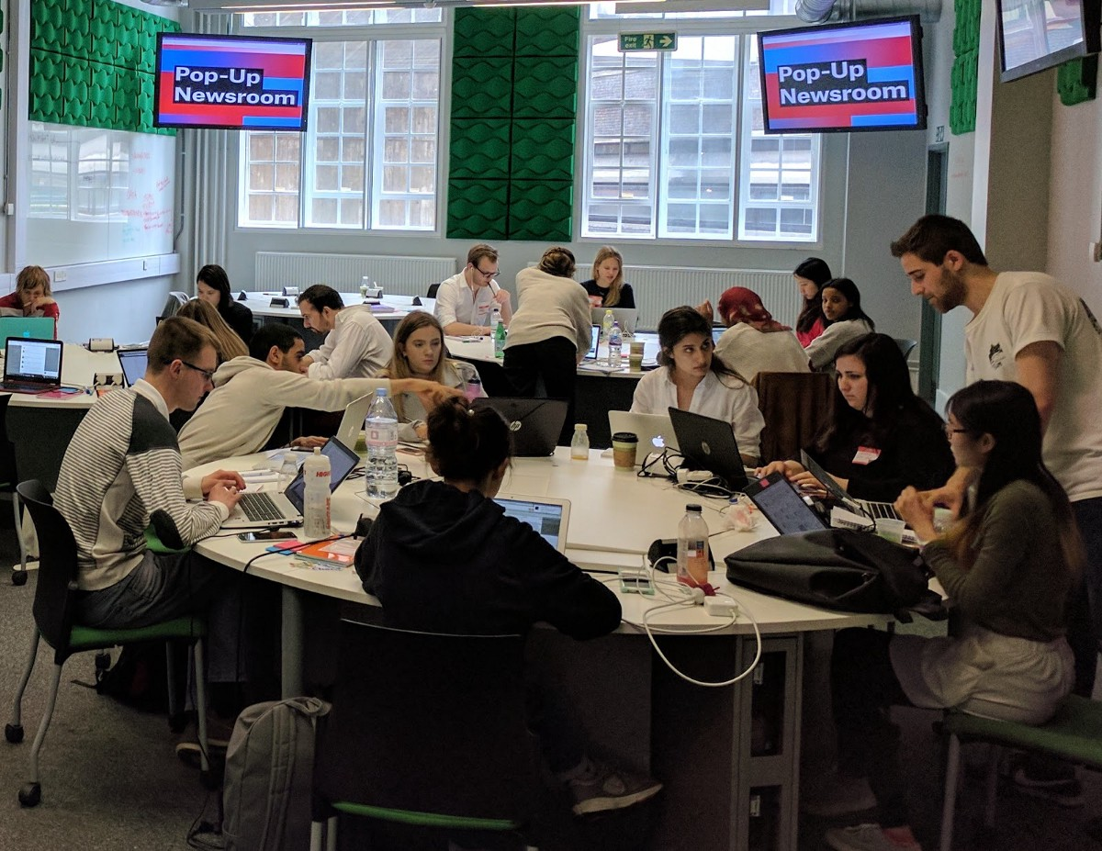
3/20/2018 Announcement
We are excited to announce the Disinfo Lab
Notes:
It includes the Disinfo lab formed in connection with FirstDraft and Harvard University. It will employ journalists, computational tools and editorial insight to monitor mis and disinformation during elections and breaking news moments.

Slide 13
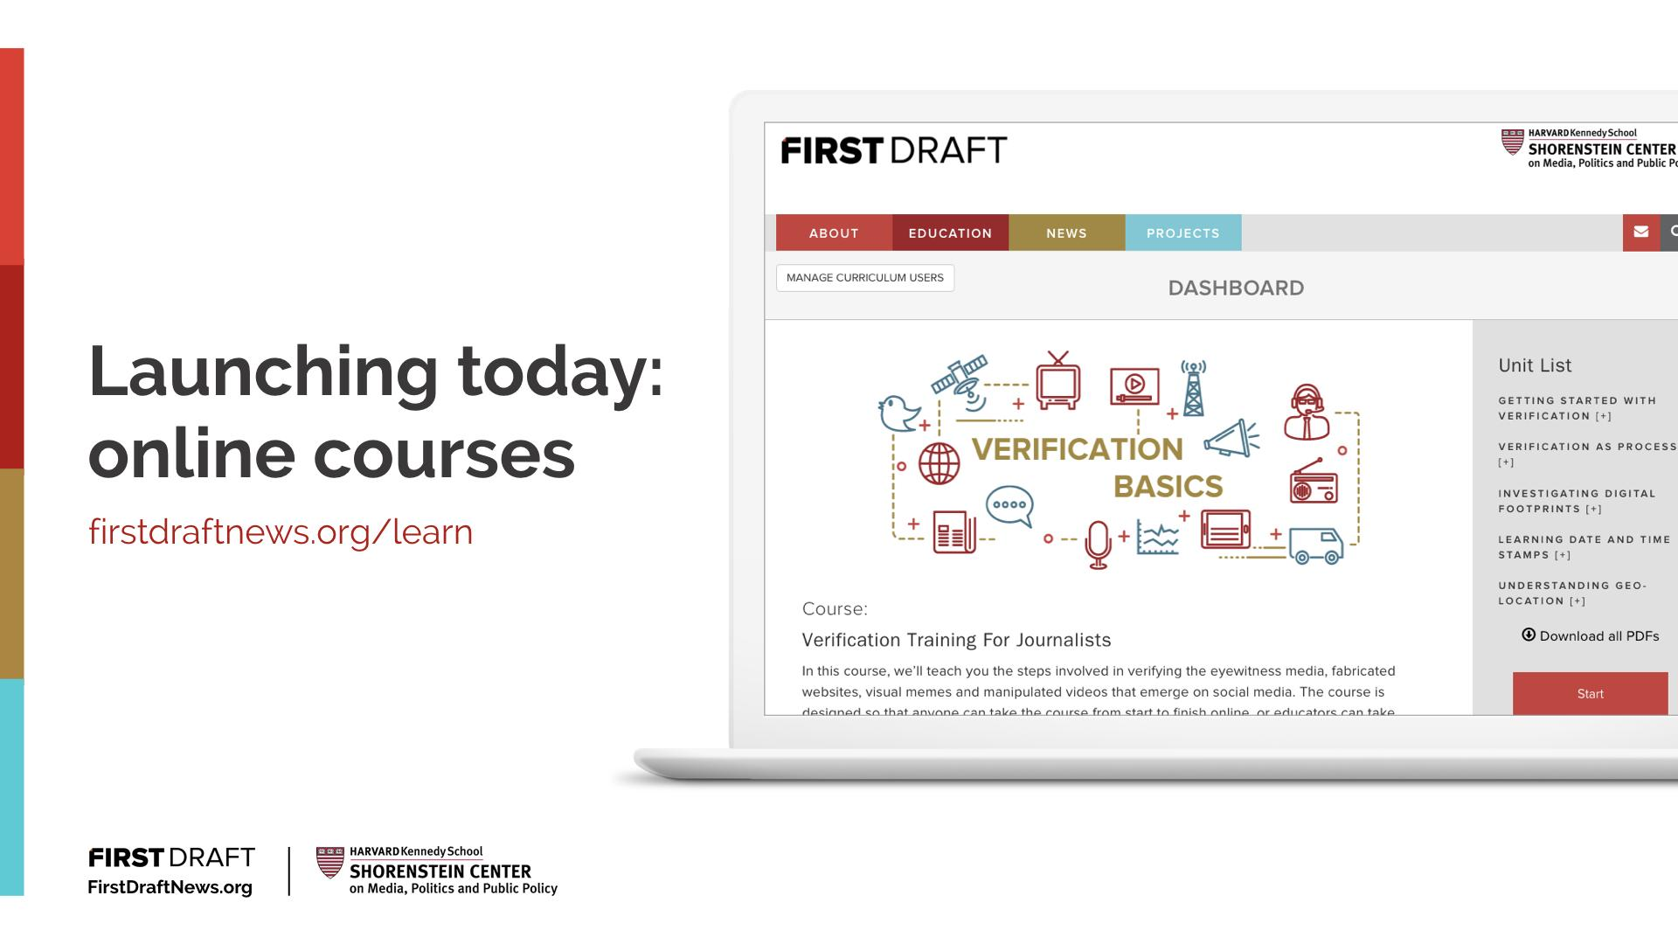
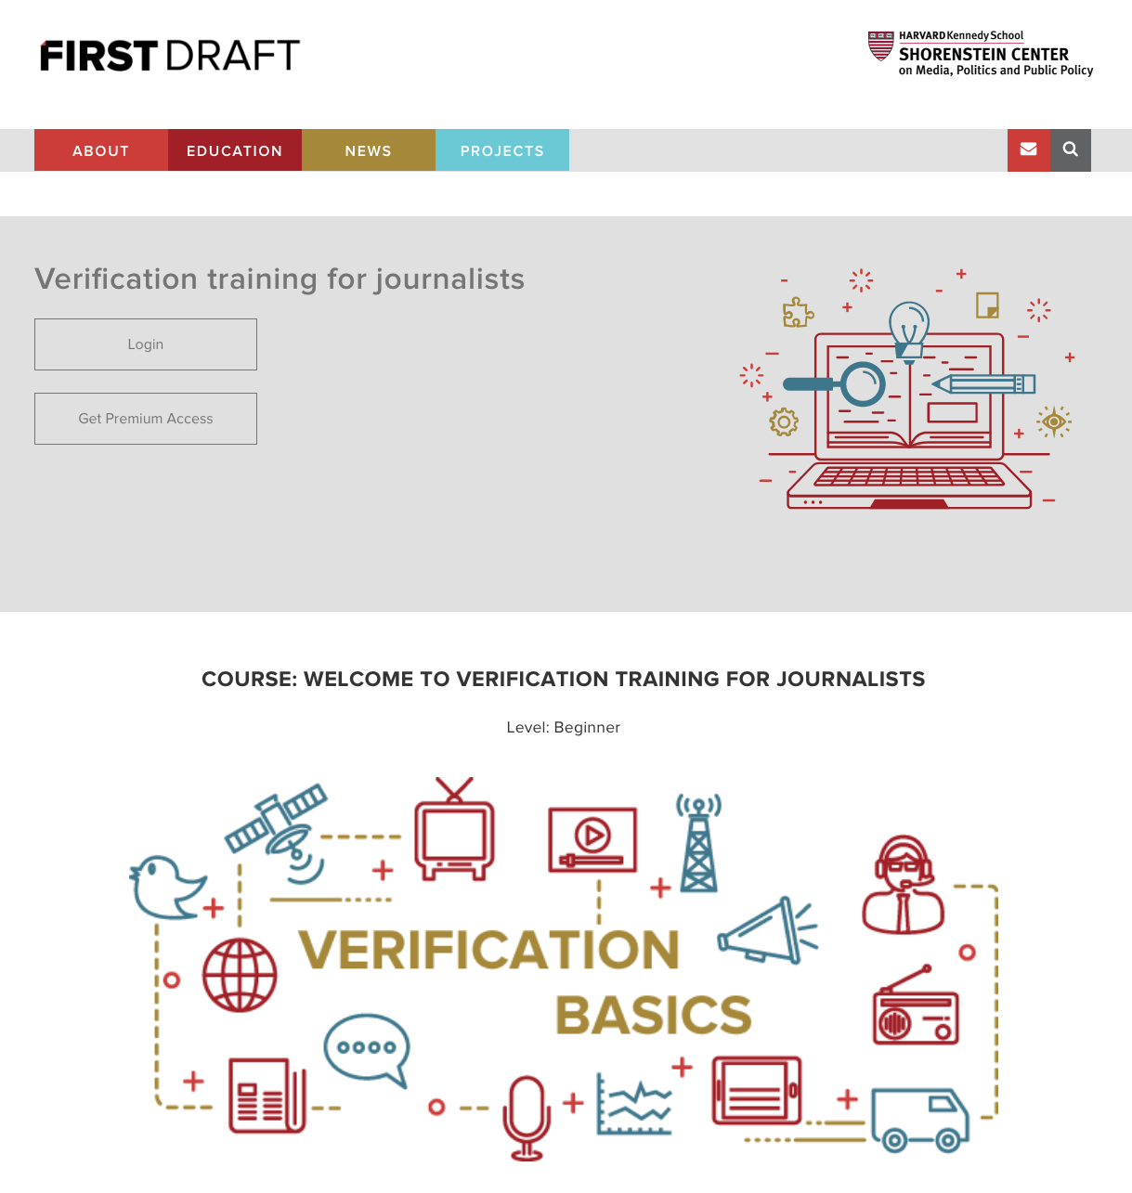
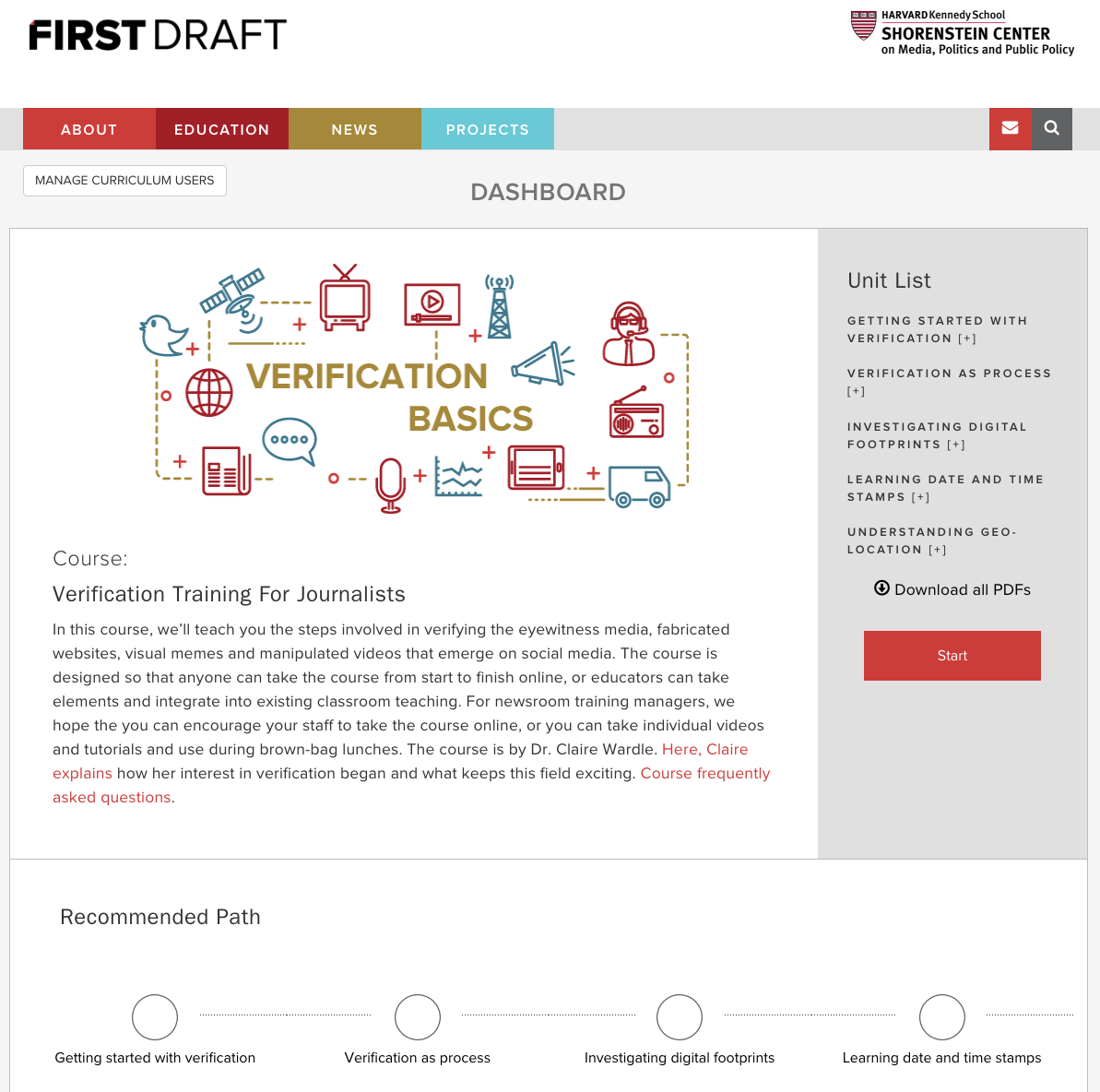
Launching today: Online Course
3/20/2018 Announcement
firstdraftnews.org/learn
Notes:
First Draft has also launched an online course to help journalists learn and develop skills to become an expert at verification of online content.
By this time next year, we will have trained over 10,000 journalists around the world.

Slide 14
3/20/2018 Announcement
Notes:
Today we’re announcing a $3 million Google.org investment in a coalition of partners to launch a two year nationwide media literacy campaign. It will equip 1 million teens in the United States with the skills needed to assess fact from fiction online.
What % of the teens is that? Alfred do you know how many say 18 year old we have in the US? About 4M. So this will only give us 16%, but it is something.

Slide 15
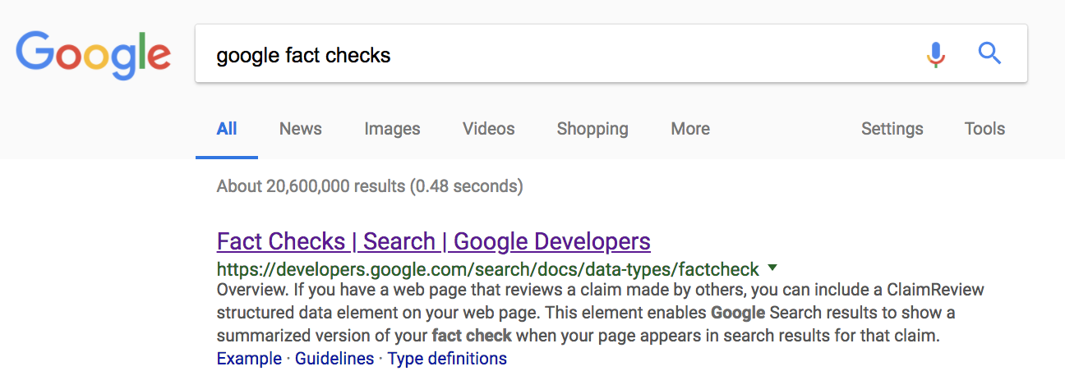
Outline
1
2
3 ”Finding Claim Documents for Fact-Checking Articles”, WWW 2018
Xuezhi Wang, Cong Yu, Simon Baumgartner, Flip Korn,Google Research NYC
4
Notes:
Anyway, I hope I have set the stage now.
Google is a search engine
We don’t know what truth is
We use relevance and authoritativeness
We need markers to filter out bad content

Slide 16
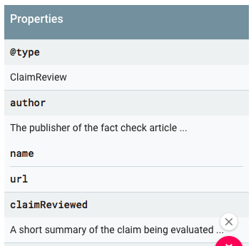
The Fact Checking Schema
ClaimReview from schema.org
Fields: claim, claimant, verdict
Collaboration with the Fact Checking
Community, e.g., Bill Adair
Research, Jigsaw, and Google News
Surfaced by Google and Bing
Notes:
In connection with FakeNews a whole industry of factcheking organizations have emerged. They write factchecking articles where they contradict, support or discuss a claim. In order for Google to make good use of such debunking articles, we need to be able to extract the claim, the claimant, and the verdict. Anybody working in NLP, know how exceedingly difficult that is to do reliably. So why not create markup language for the author directly to incorporate in the debunking artickle?
That is what we did.
In collaboration with Bill Adair founder of PolitiFact and with Schema.Org, in the Spring of 2016 we launched a Fact Checking Schema. When writing the Fact Checking article the journalists can add markup for the claim, the verdict, and a number of other fields.
One field that is there but is not often populated is where on the internet the claim can be found.
-- don’t want to link
-- can be many places
-- can be written after the claim was checked

Slide 17
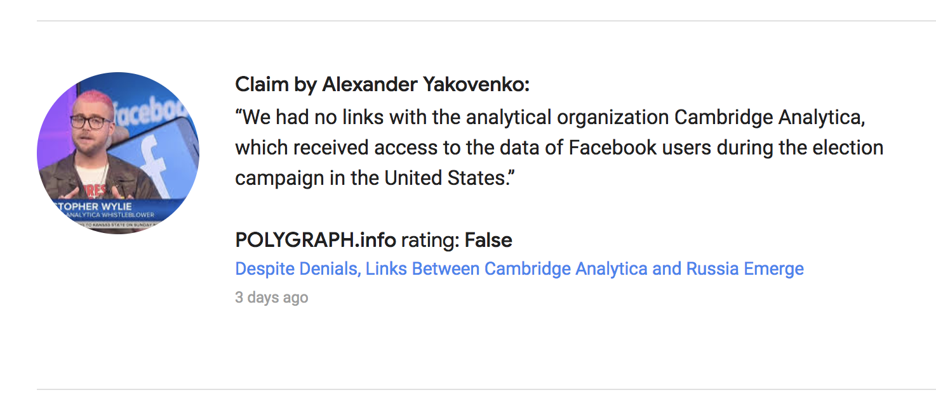
ClaimCheck Markup
March 25, 2018
Notes:
Ambassador of Russia to the United Kingdom since January 2011

Slide 18
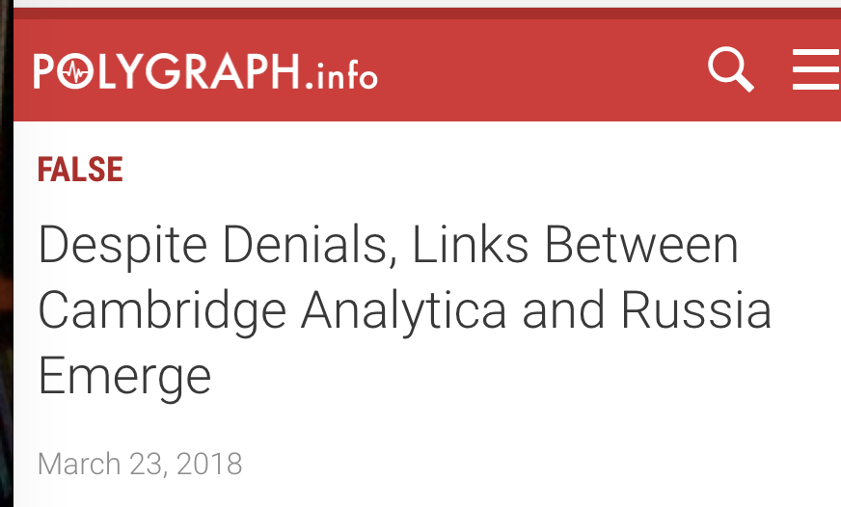
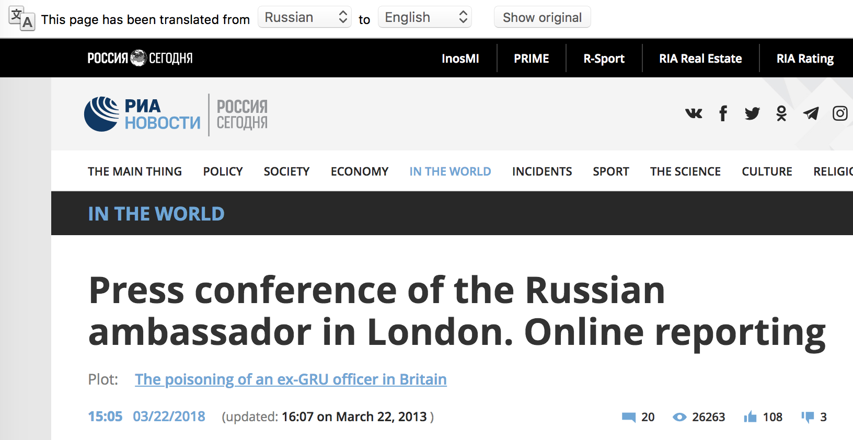
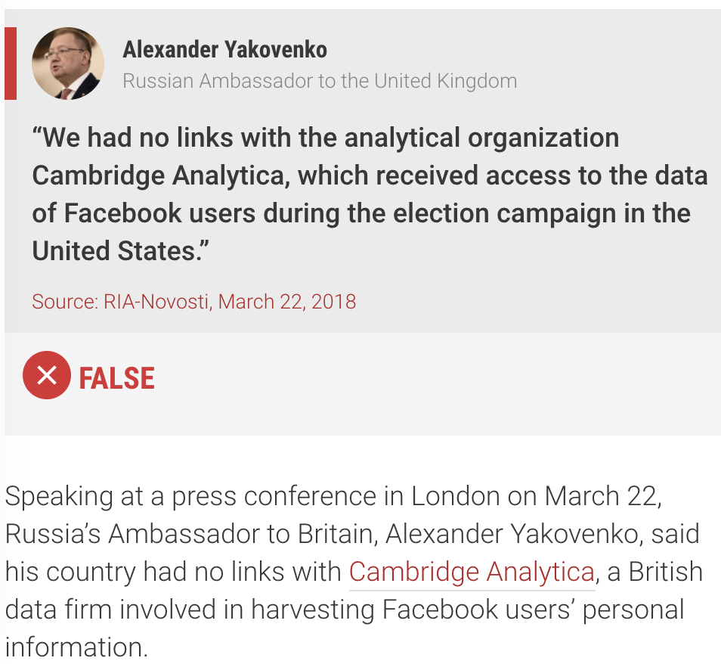
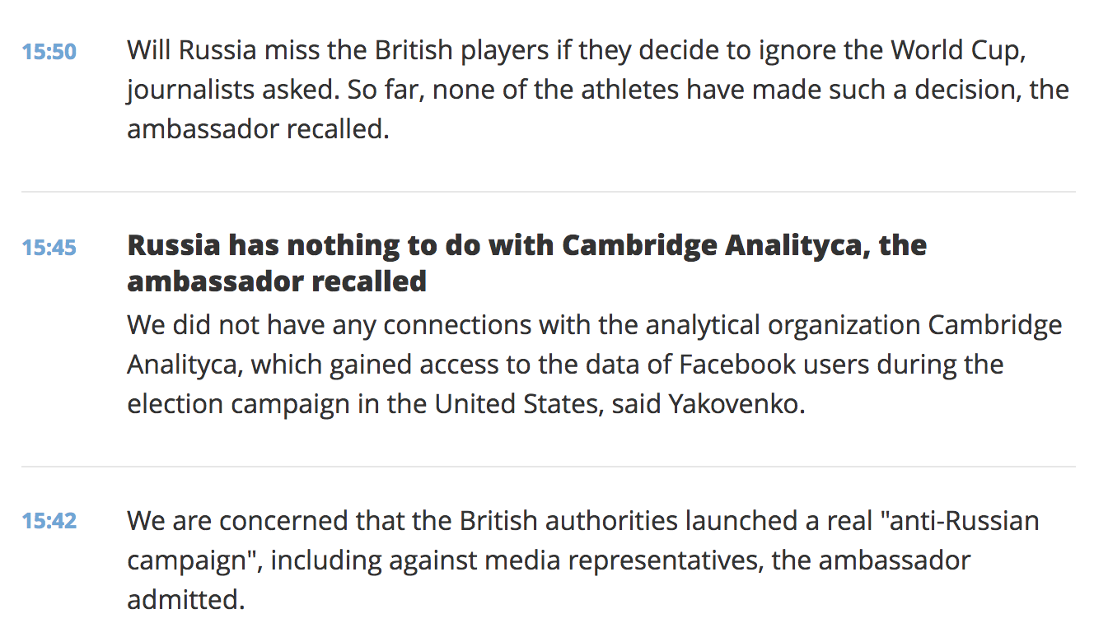
Fact Check Pair (FC-ing Article, FC-ed Claim)
Notes:
The Polygraph article itself actually points to the site that is spreading this false claim: The claim is featured on the Russian newspaper RIA Novosti, and with the help of Google translate you can read everything the ambassador said at the news conference.

Slide 19
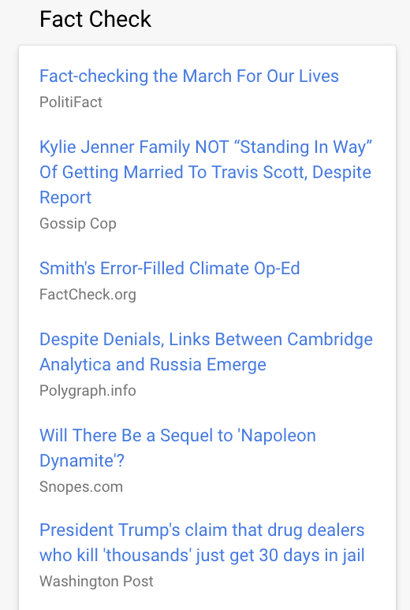
Fact Check in Google Products
Fact Checking Corpus
Tens of thousands of articles
50+ publishers
Surfaced in News and Search
Notes:
Google picks up this ClaimCheck when we scrape the pages and we can give it special priority. Since the launch it has been used in 10s of thousands of articles and we surface it in both News and Search. We have launch in the US, in Argentina, Brazil, and Mexico. France and Germany were also added. In general we tried to reach out to countries with important elections.

Slide 20
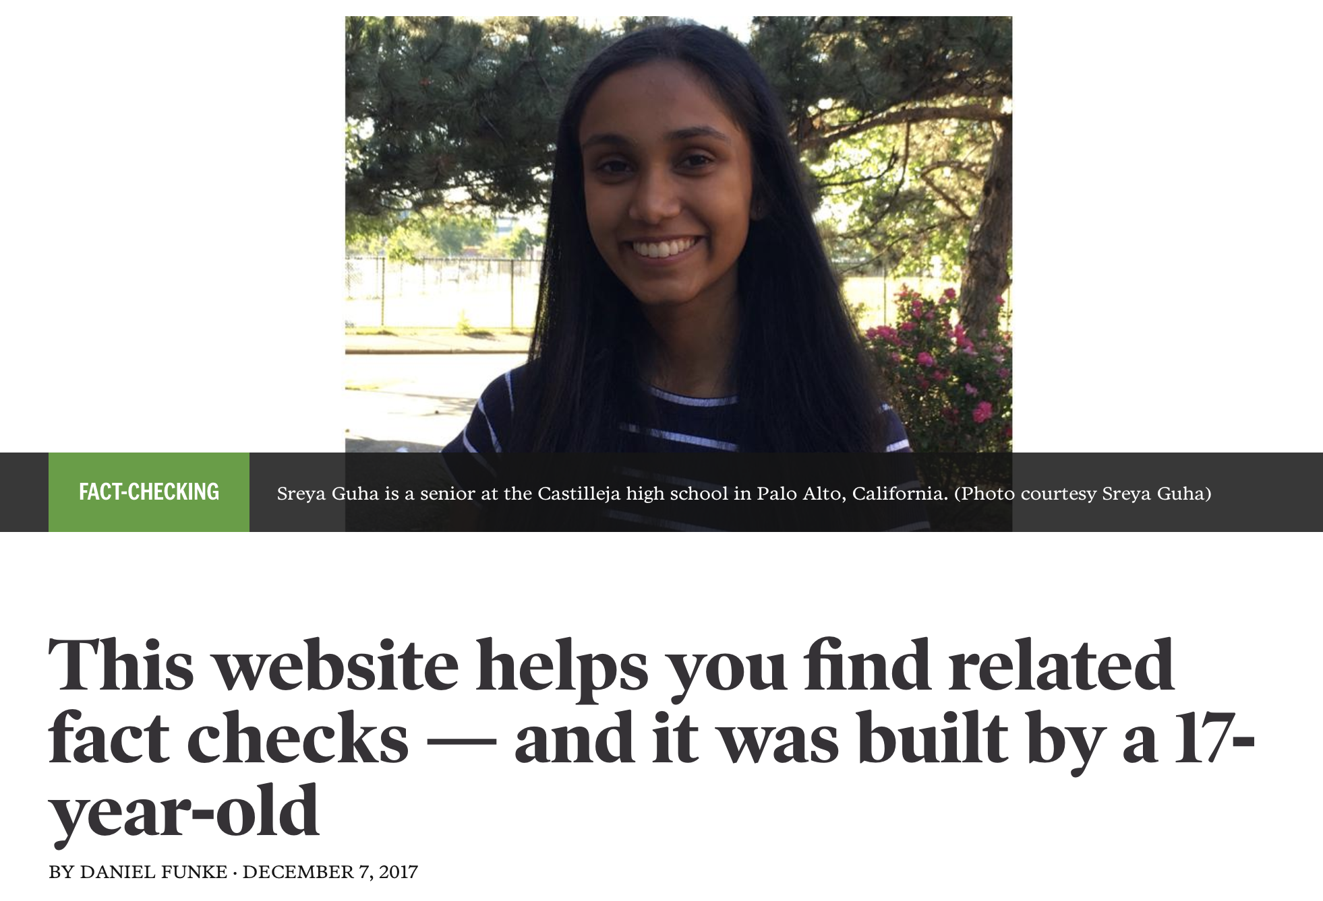
Search Over Claims Corpus
https://www.poynter.org/news/website-helps-you-find-related-fact-checks-and-it-was-built-17-year-old
Sreya Guha, a senior at the Castilleja high school in Palo Alto, California
Search Engine

Slide 21
Outline
1
2
3 ”Finding Claim Documents for Fact-Checking Articles”, WWW 2018
Xuezhi Wang, Cong Yu, Simon Baumgartner, Flip Korn,Google Research NYC
4
Notes:
Anyway, I hope I have set the stage now.
Google is a search engine
We don’t know what truth is
We use relevance and authoritativeness
We need markers to filter out bad content

Slide 22
How Do We Find More Claim-Relevant Documents?
Claim-relevant discovery process to help identify online misinformation:
Retrieve candidate documents;
Score for relevance;
Stance detection: contradict, support, discuss the claim.
Notes:
So maybe with the fact check we find one bad story to demote in our search results, but how do we find them all?
Note, that for this problem we are not looking to find the identical claim, but an article that addresses the same claim in spirit.
Stance detection challange Fake News Challenge (FNC) 2016/2017

Slide 23
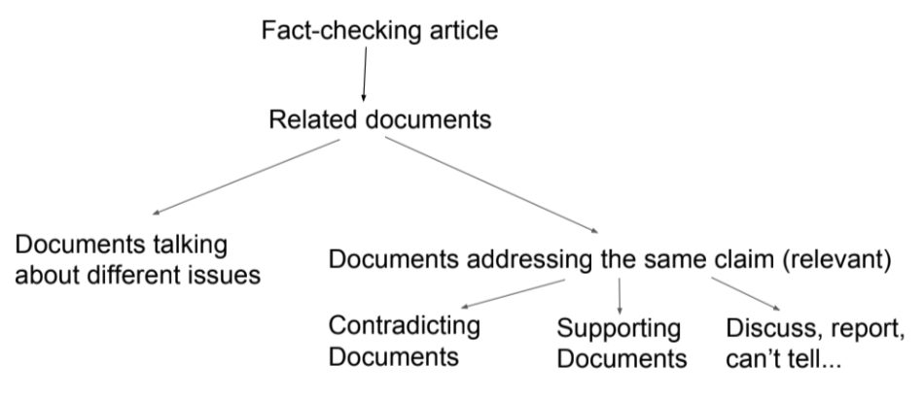
How Do We Find More Claim-Relevant Documents?
What can be automated? What needs a human in the loop or can be possibly be crowdsourced?

Slide 24
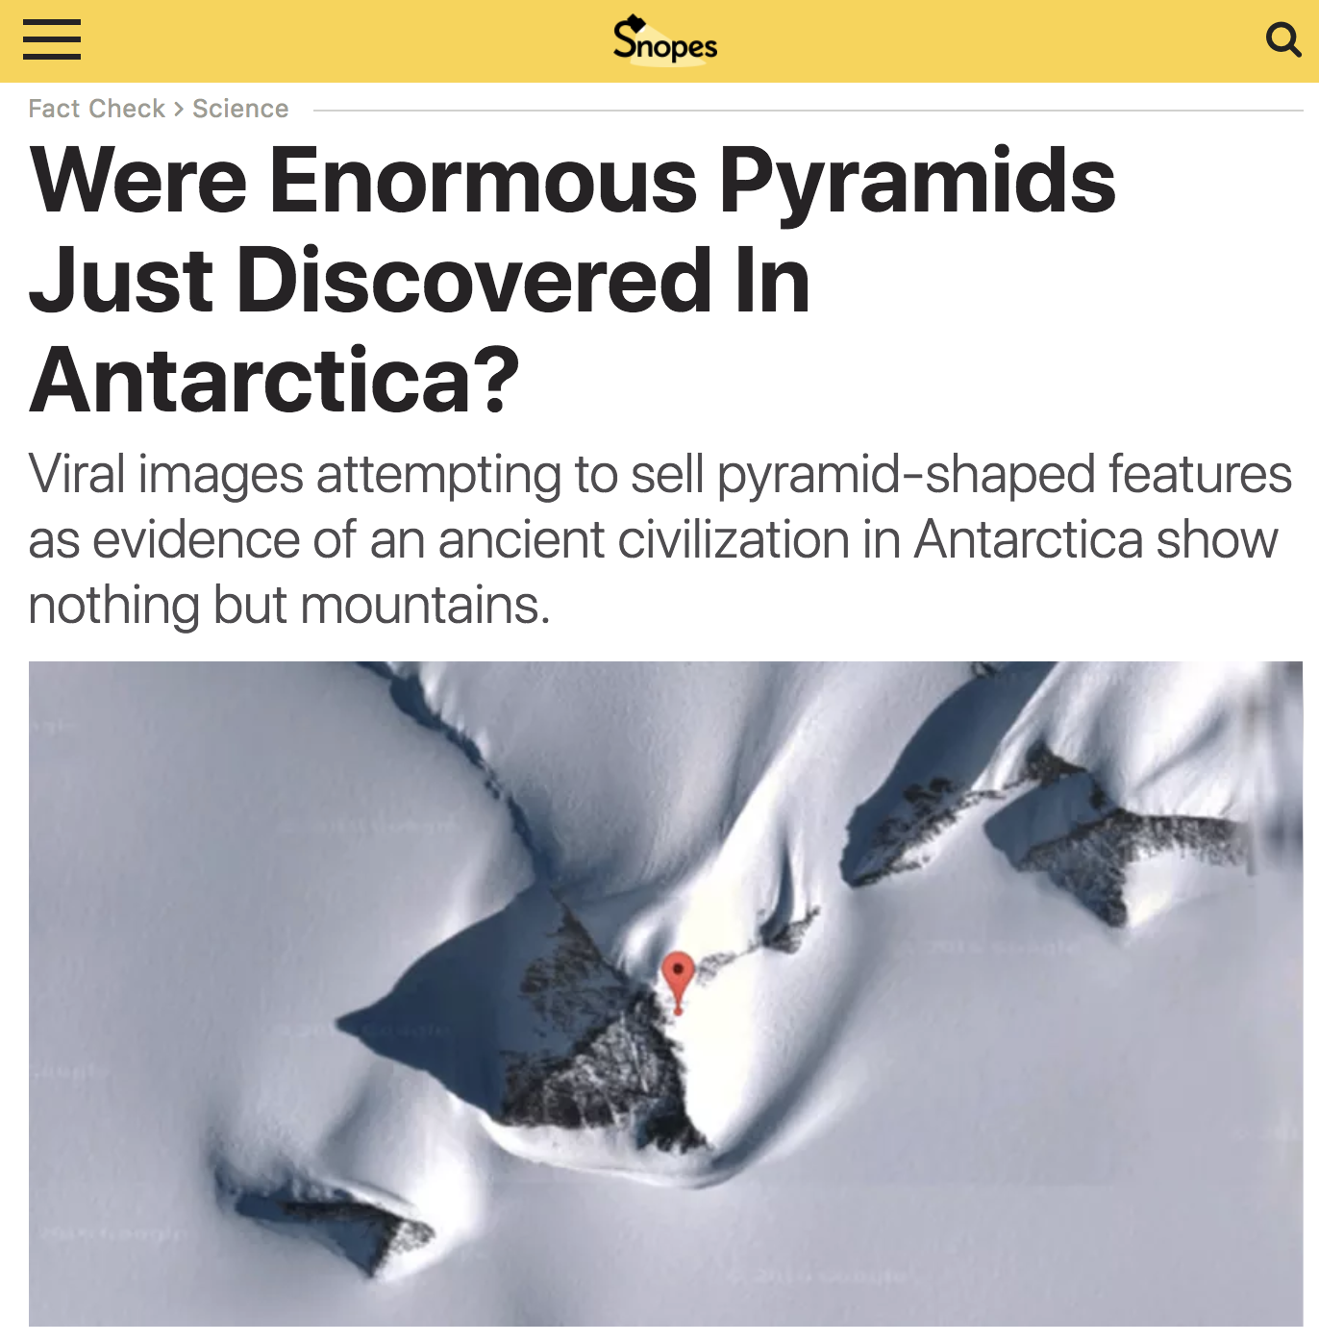
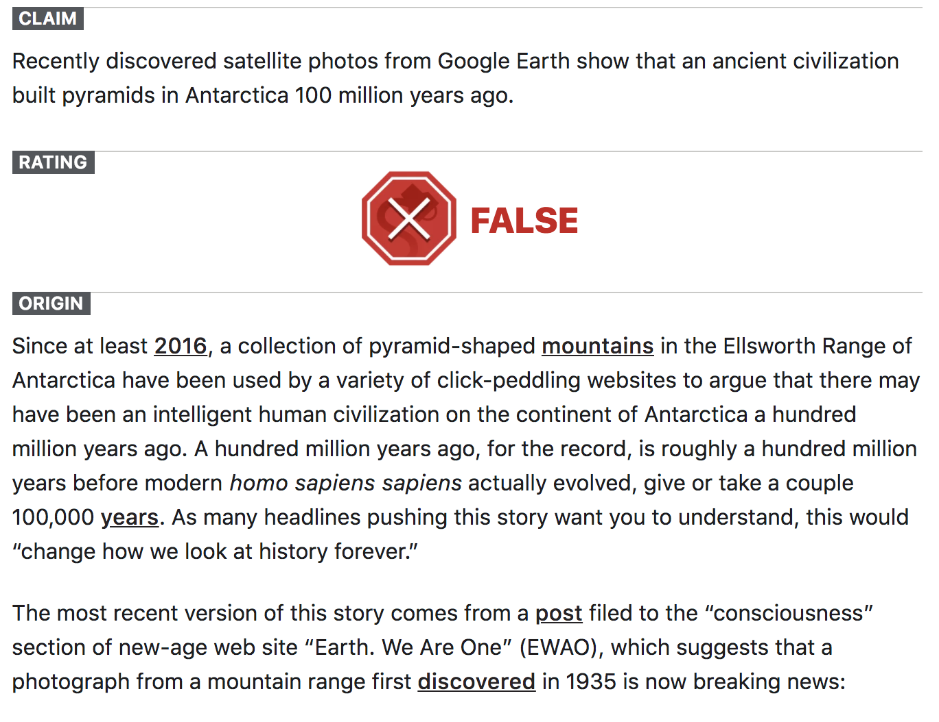
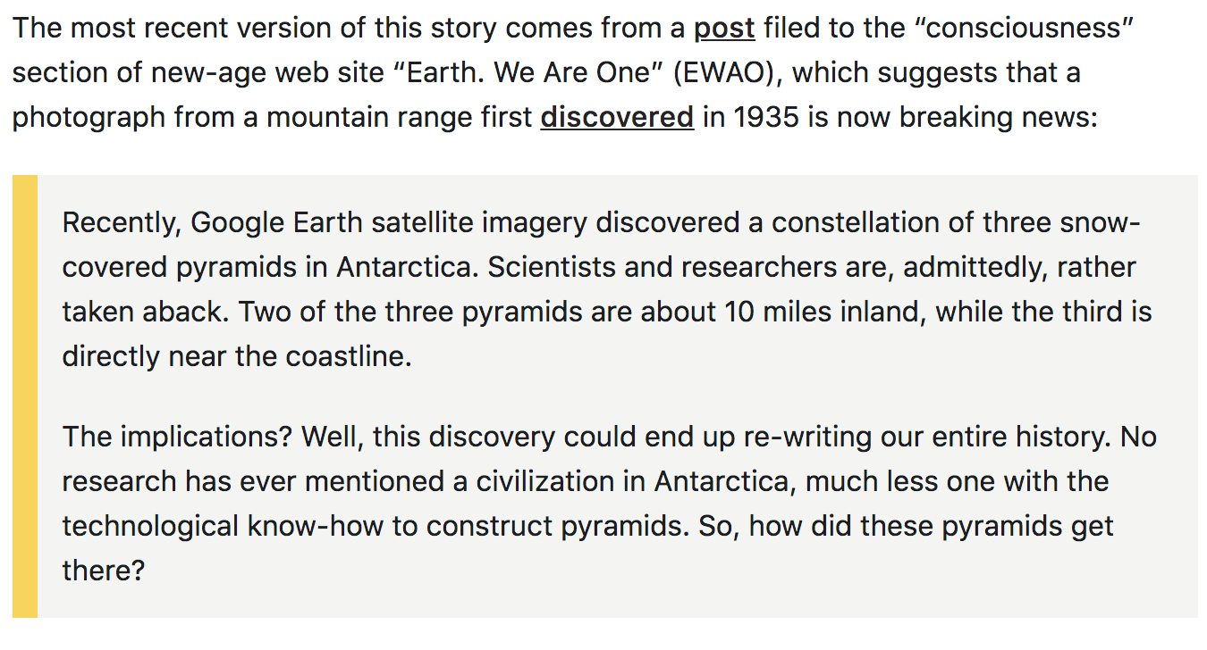
Retrieve Candidate Documents
24 August 2017

Slide 25
Retrieve Candidate Documents: Collect Candidates
Automation:
Links from fact checking article - often not relevant.
Search Google with
Title and claim text
Entities from title and claim text
Queries from click-graph, top 50
Top 100 search results
Total of 2,000+ candidates per claim.
Human research, skilled workers: Automation gets 80% recall.
Notes:
We can do this but we get a lot of crud.
Let us look at the example

Slide 26
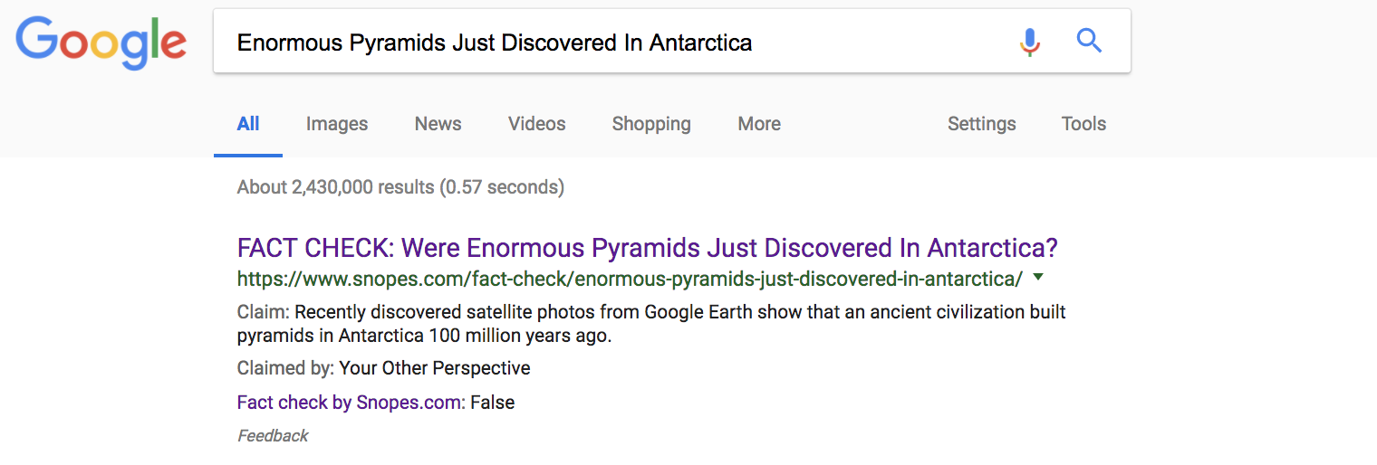
Retrieve Candidate Documents

Slide 27
https://www.google.com/search?
q=Enormous+Pyramids+Just+Discovered+In+Antarctica
Same claim, opposite stance
Different claim
Different claim ???
Same claim, same stance

Slide 28
How Do We Find More Claim-Relevant Documents?

Slide 29
Relevance Classification
Date difference
Cosine similarity measure:
Entity extraction, (e₁, e₂, ...e_{K}), with confidence scores, c:
Claim document: claim text (c₁, c₂, …, c_{K})
Candidate document: title, heading, paragraphs, sentences (c’₁, c’₂, …, c’_{K})
Repeat for all pairs (claim, title), (claim, heading), (claim, paragraphs), (claim, sentences). Keep max score.
Gradient boosted decision tree.
Notes:
(e₁, e₂, ...e_{K}) union of entities in claim and the full candidate document

Slide 30
How Do We Find More Claim-Relevant Documents?

Slide 31
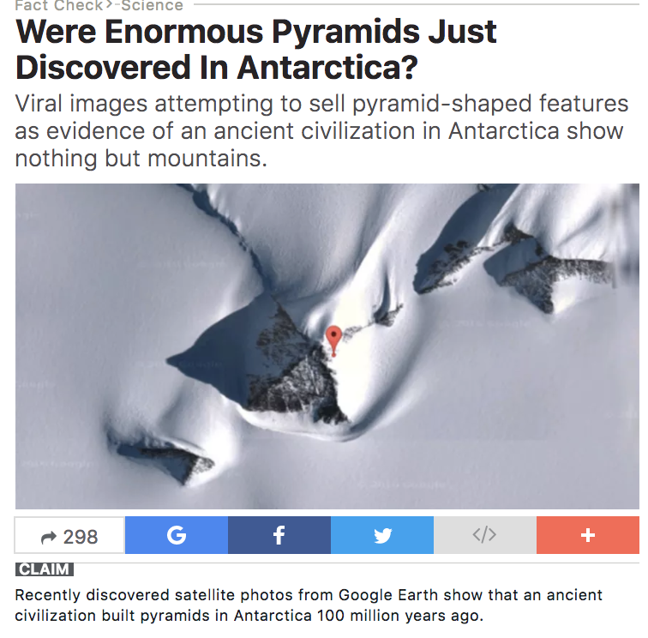
Stance Detection: Contradicting, Supporting, Discussing?
Bag of words do not easily capture contradictions
Look for patterns
Notes:
A single ‘not’ is hardly detected

Slide 32
Stance Detection: Contradicting, Supporting, Discussing?
Extract unigrams and bigrams, 900-dim vocabulary
Unigrams: "fake", "purportedly", "hoax", "actually", "rumor", "satirical", "false", "fabricated", "misleading", "inaccurate", "manipulated", "fictional", "incorrectly", ...
Bigrams: "made up", "fake news", "fact check", "not true", "no evidence", ...

Slide 33
Stance Detection: Contradicting, Supporting, Discussing?
Document key components: Find the most similar sentences in the candidate. Add one sentence before and after
Claim +e.g., "Does ... really happen? No, it turns out to be false.").
900-dimensional vector based on the union of the key components.
Gradient boosted decision tree: supporting/contradicting

Slide 34
Experiments
All quality articles with ClaimCheck markup: 14,731 articles
2,000+ related documents per article, 33.5M pairs
Crowdsourcing for relevance labels:
“Does the candidate document address the claim?”
3 labels per document, positive if 2+ raters say ‘yes’. Subsampled to 8,000 pairs for training and testing.

Slide 35
Results, Relevance
Notes:
We examined mis-classification cases and found they were gen-
erally due to the following:
• Incorrect extractions resulting in poor titles, incorrect publi-
cation dates, etc.
• UGC pages such as online video pages, social network posts
and forum pages.

Slide 36
Experiments
Stance detection: 1,200 positively relevant documents.
Crowdsourcing for contradict/support/neither/can’t tell.
3 labels per document, label according to majority.
12% disagreement, those documents removed.

Slide 37
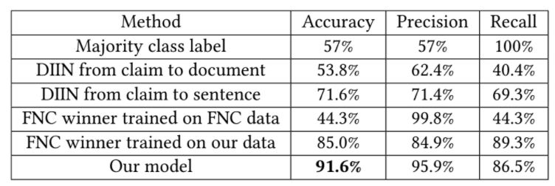
Results, Stance Detection
Notes:
[13] Yichen Gong, Heng Luo, and Jian Zhang. 2017. Natural Language Inference over
Interaction Space. In arXiv:1709.04348.
Densely Interactive Inference Network
Stanford Natural Language Inference (SNLI

Slide 38
Smearing Claims to Articles
Much stricter algorithm than WWW submission. Looking for exact match of claim, not just the spirit of the claim.

Slide 39
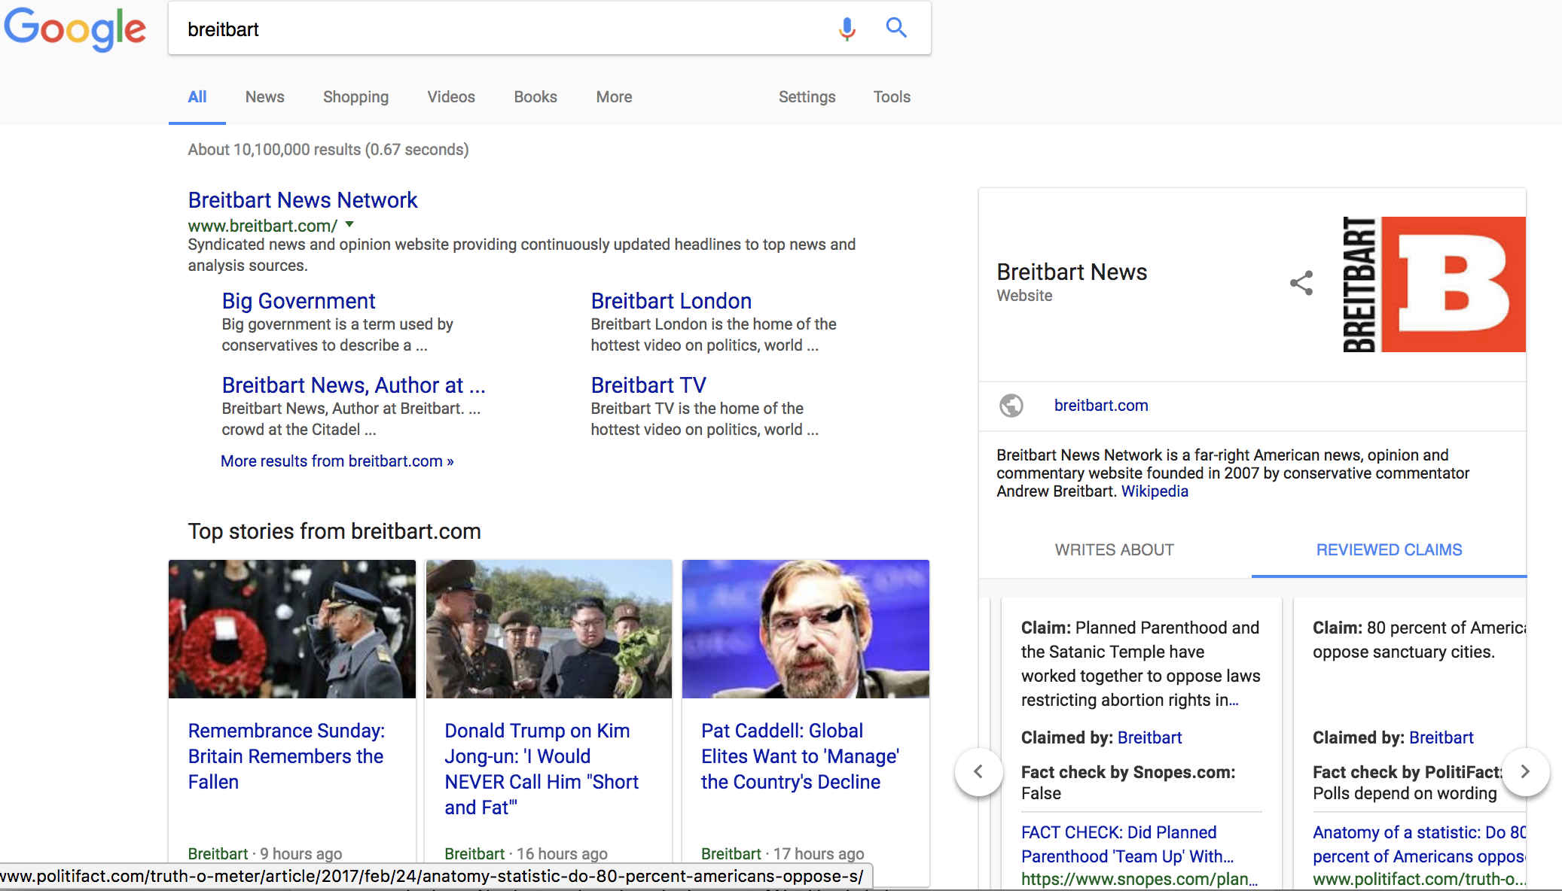
Fact Checking Part of KPs for Publishers

Slide 40
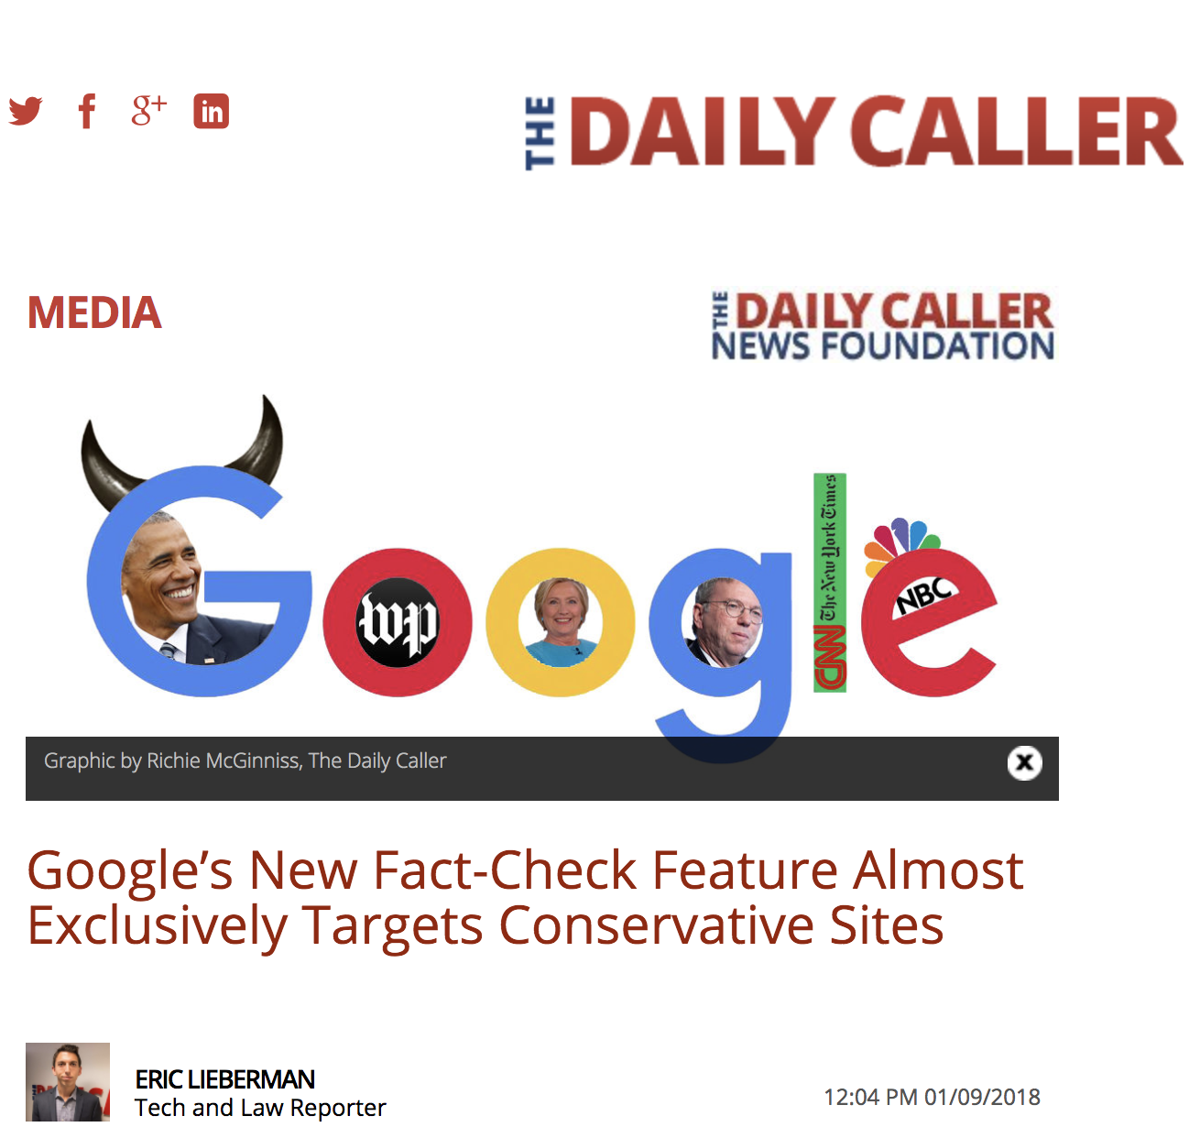
Fact Checking Part of KPs for Publishers
Fact checking primarily done on one side of political spectrum
Claims can have small but crucial differences

Slide 41
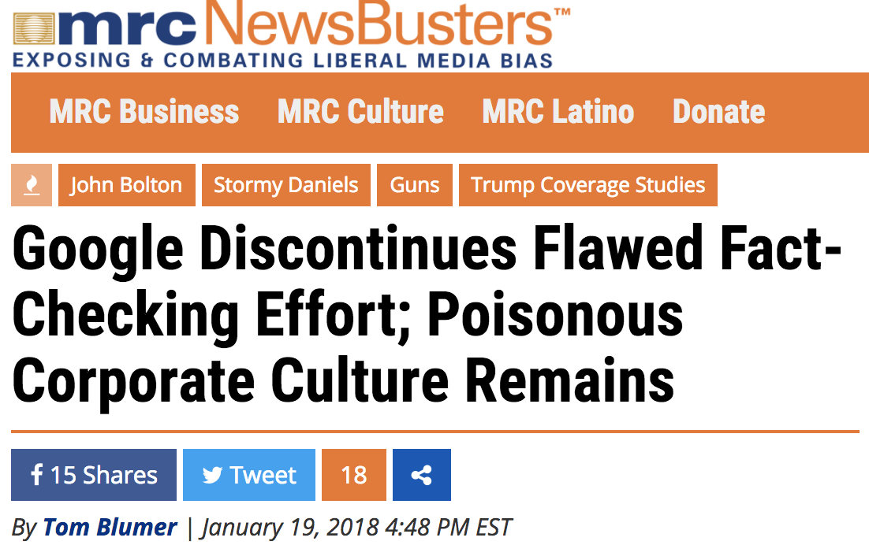
Fact Checking Part of KPs for Publishers

Slide 42
Notes:
For more than four years Google has worked to enable and grow the fact check ecosystem in collaboration with hundreds of publishers and fact checking organizations around the world.
We believe the fact check model shows promise. And are now expanding that effort to improve the integrity of health information that can be found on the web.
We know users come to “Dr. Google” everyday for health information. We want to do more to be sure they’re getting information that is indeed healthy for them.
So today, we are announcing partnerships with the National Academies of Sciences, Engineering, and Medicine, the New York Times Health team and Memorial Sloan Kettering Cancer Center to help provide high-quality information on these important subjects.

Slide 43
Notes:
(1 of 2)Media that has been digitally altered is on the rise, and often used for nefarious purposes. Many call it synthetic media.
We want to work with researchers to dig deeper on better detection models as we seek address such forms of misinformation.
Today, we are announcing our plan to make datasets available so that researchers and the journalism community can train new models and develop better methods for detecting synthetic expression.
Stay tuned for more. This won’t solve the problem. But the more brains we put behind this the more progress we all can make.
As much as we want our machines to better detect the qualities of content, we also want to help consumers in how they evaluate those qualities -- how they might better assess the expertise and motivation behind the information?

