Slide 1
Website Relaunch
Katie Naum
NEBigDataHub.org | @NEBigDataHub

Slide 2
Context
2019: Phase 2!
June 2020: Strategic Plan up at nebigdatahub.org
Existing site required a refresh
Opportunity to create an improved experience
NEBigDataHub.org | @NEBigDataHub #BDHubs #NEBigData

Slide 3
What was missing?
Clear disambiguation between thematic areas, projects, Spokes…
COVID Information Commons (TBC)
Links to many active projects we engage with, like the Open Storage Network
Timely project updates and success stories
Collaborators page
Seed Fund Page
Intuitive calendar
Consistent call to action throughout

Slide 4
Goals
Highlight success stories
Demonstrate tangible impact
Seamless integration of thematic areas and projects
Intuitive UX
NEBigDataHub.org | @NEBigDataHub #BDHubs #NEBigData

Slide 5
Highlighted Improvements
Clear visualization of focus areas and related projects, drawn from strategic plan and mapped onto site design
Featured Success Stories and guidelines for submission
Collaboration form: call to action echoed throughout site along with multiple channels for engagement
Reorganization of page structure and menu design, making linkages clearer
NEBigDataHub.org | @NEBigDataHub #BDHubs #NEBigData

Slide 6
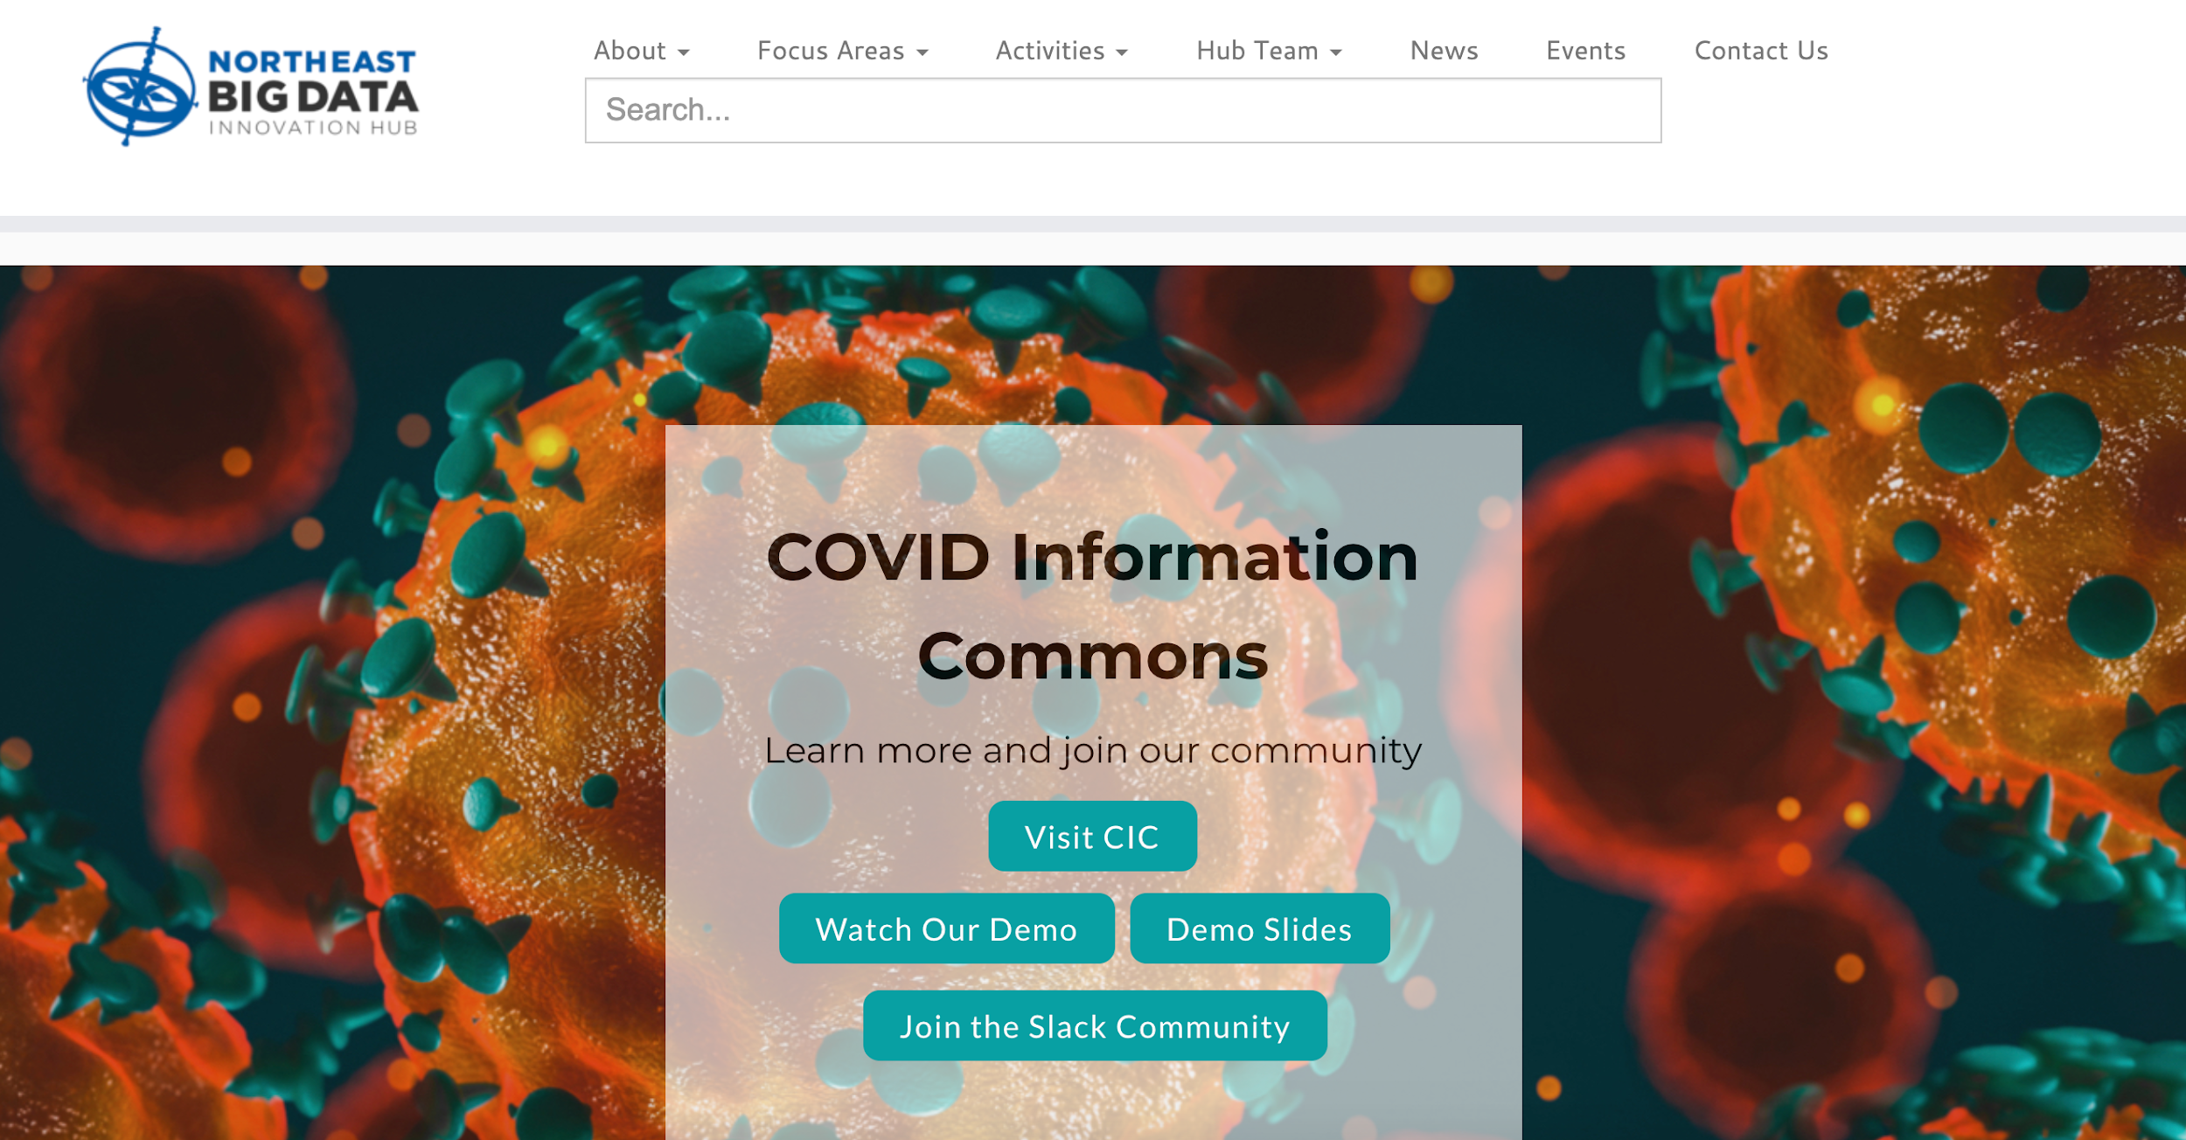
Homepage
http://nebigdatahub.org/
NEBigDataHub.org | @NEBigDataHub #BDHubs #NEBigData

Slide 7
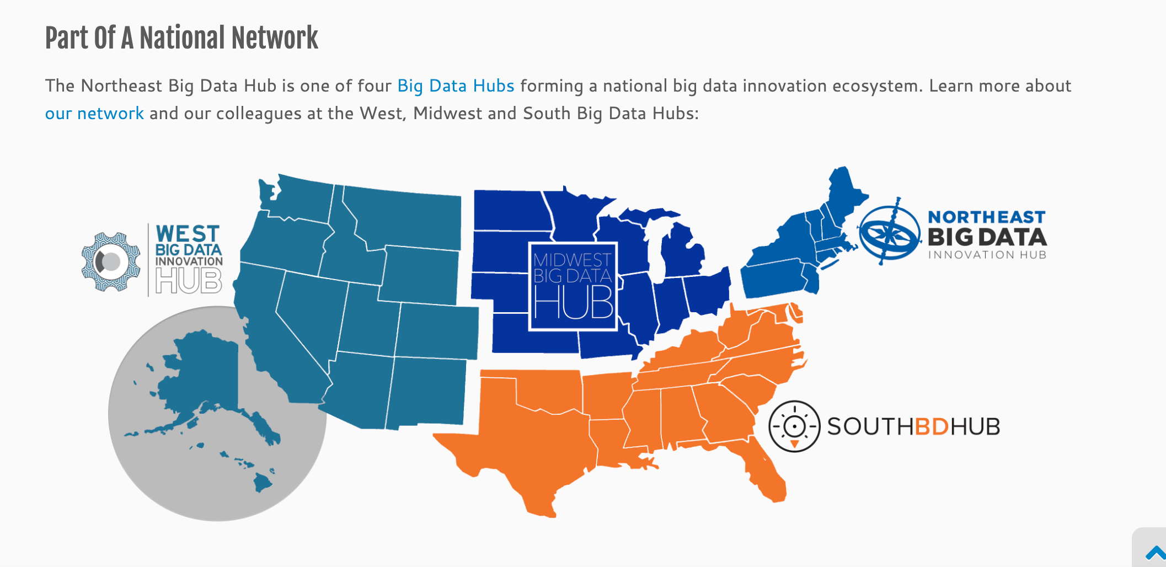
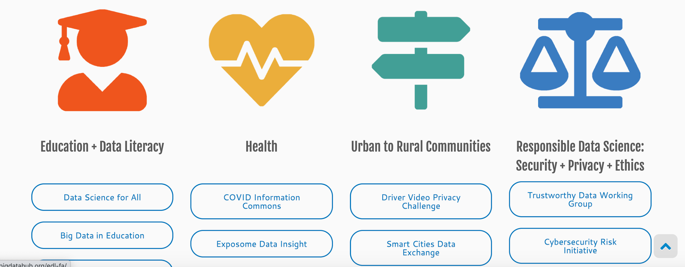
About
http://nebigdatahub.org/about/
NEBigDataHub.org | @NEBigDataHub #BDHubs #NEBigData

Slide 8
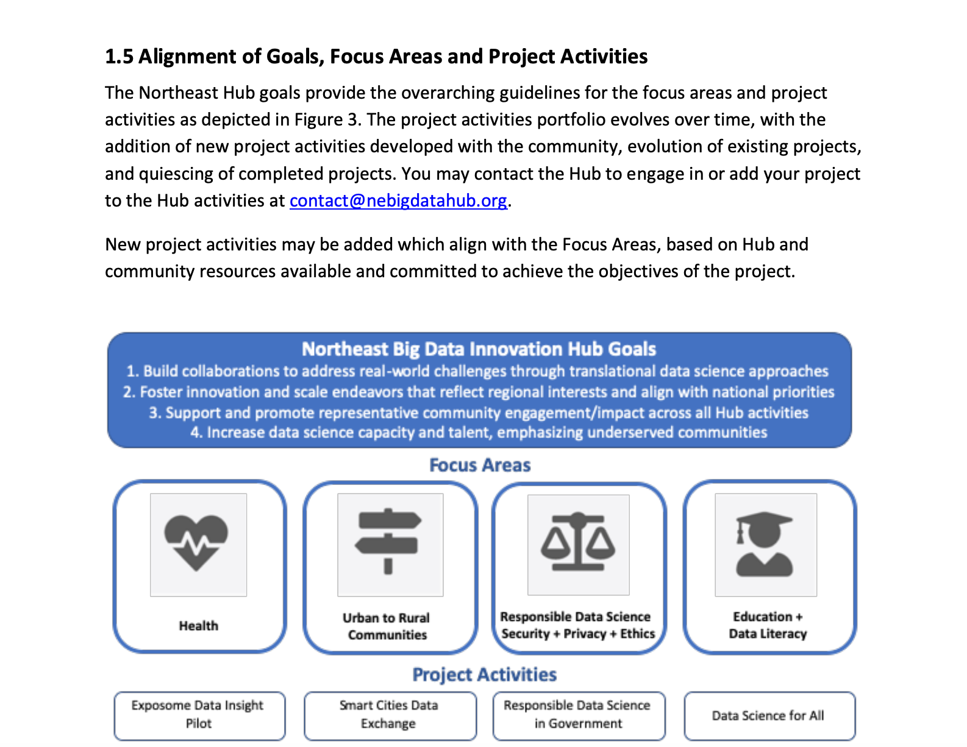
http://nebigdatahub.org/wp-content/uploads/2020/06/NEBDHub-Strategic-Plan-6.1.2020.pdf
Strategic Plan
NEBigDataHub.org | @NEBigDataHub #BDHubs #NEBigData

Slide 9
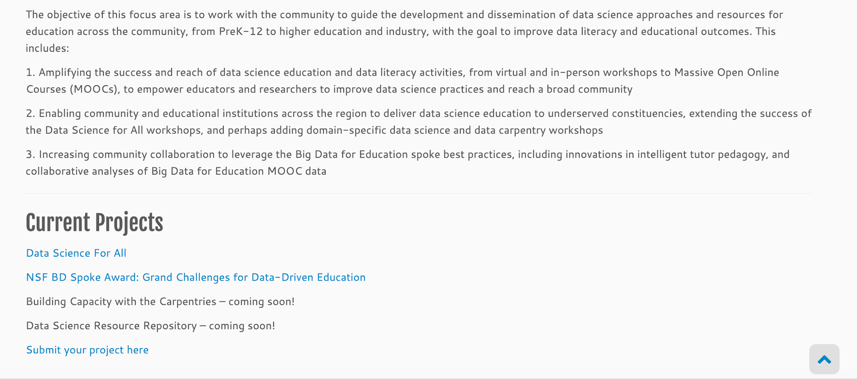
Focus Areas
http://nebigdatahub.org/about/#priority-areas
NEBigDataHub.org | @NEBigDataHub #BDHubs #NEBigData
Notes:
PI, Co-PIs, Steering Committee, ED, and Katie Naum, Manager of Operations

Slide 10
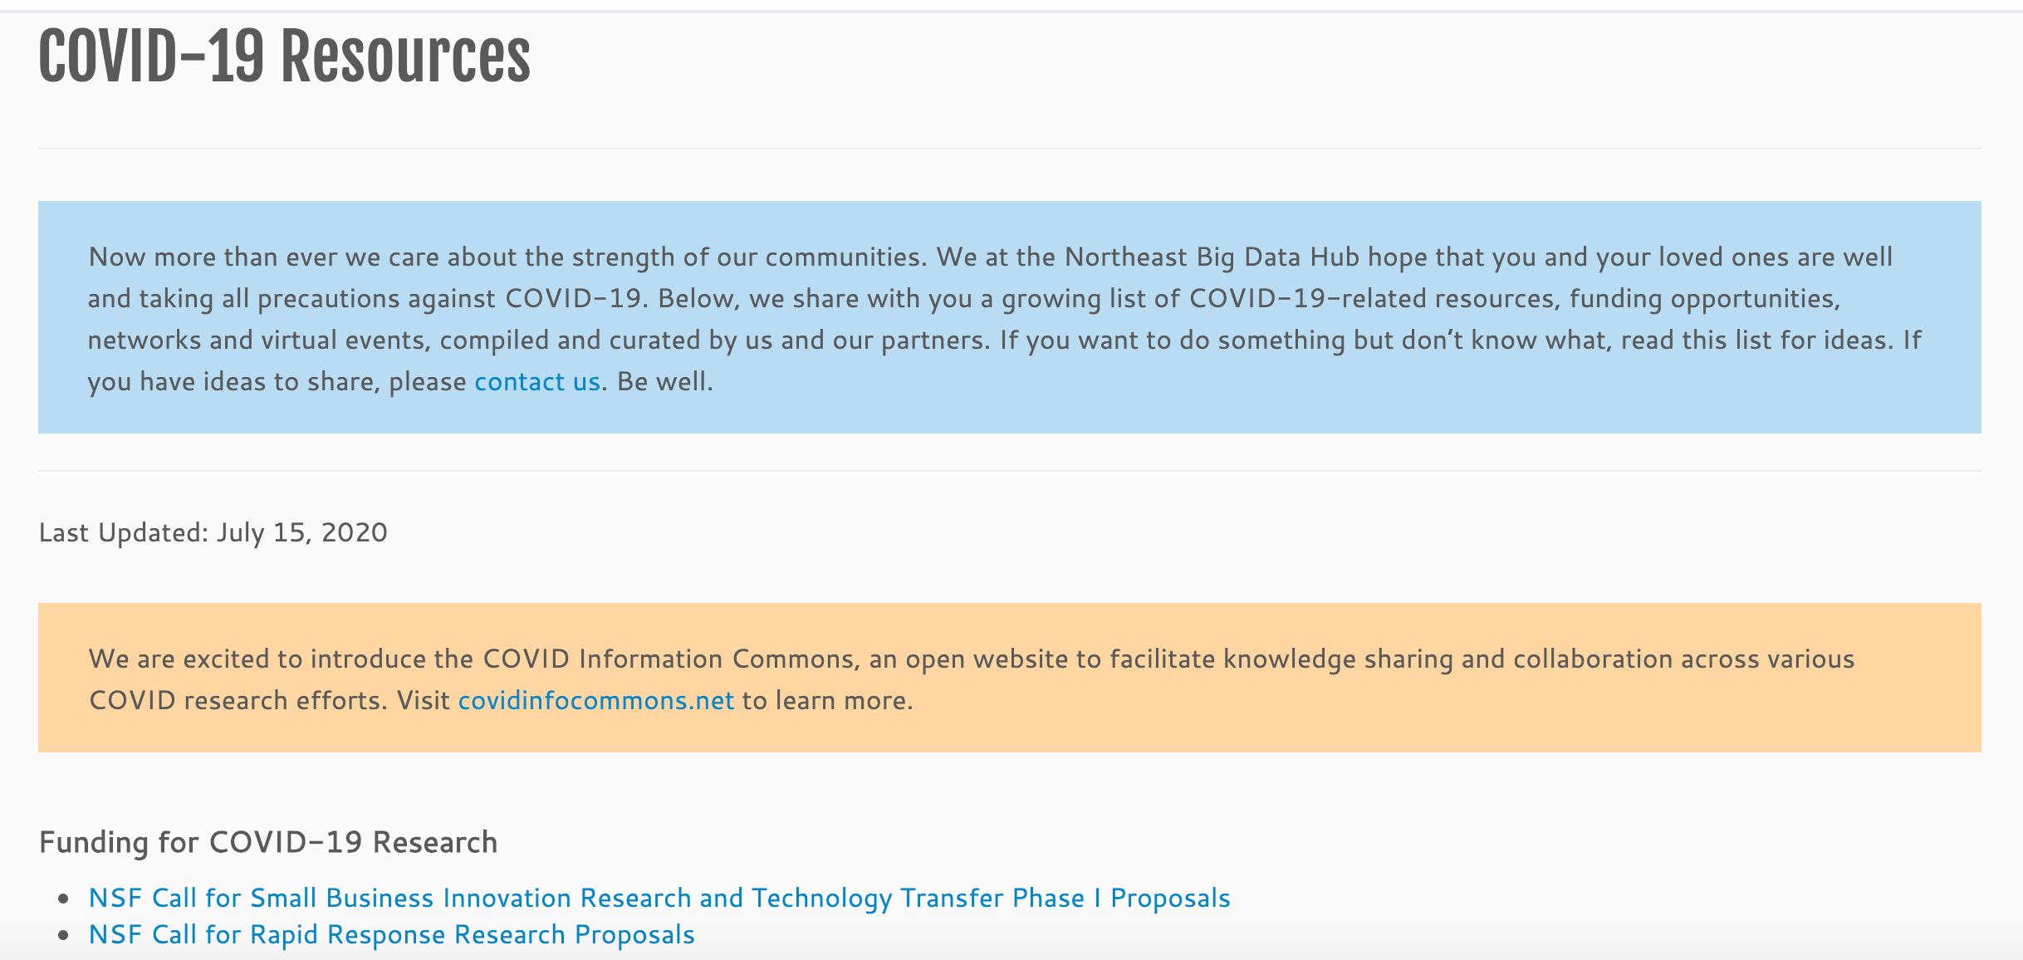
COVID-19 Resources
http://nebigdatahub.org/covid19/
NEBigDataHub.org | @NEBigDataHub #BDHubs #NEBigData

Slide 11
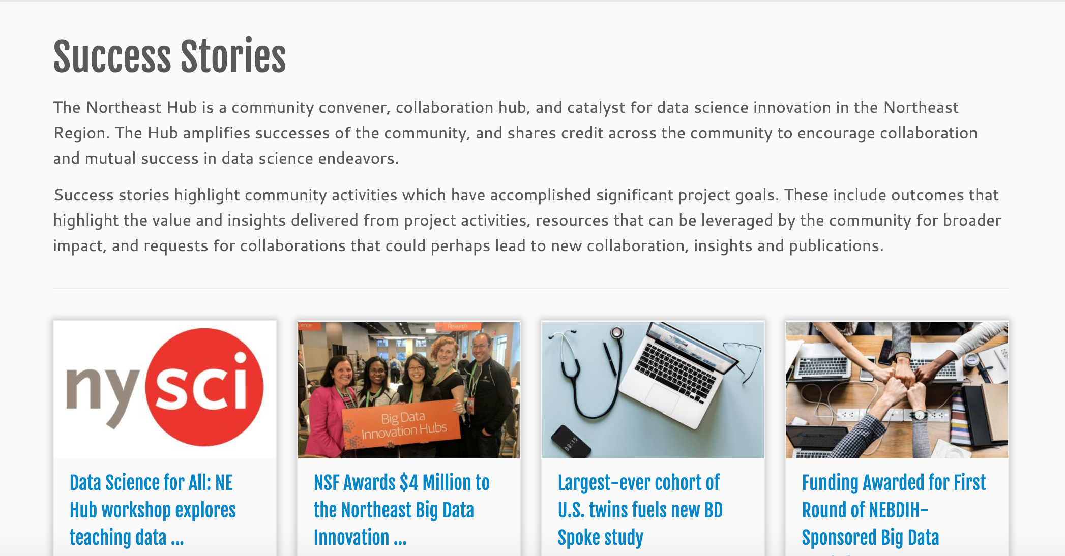
Success Stories
http://nebigdatahub.org/category/success-stories/

Slide 12
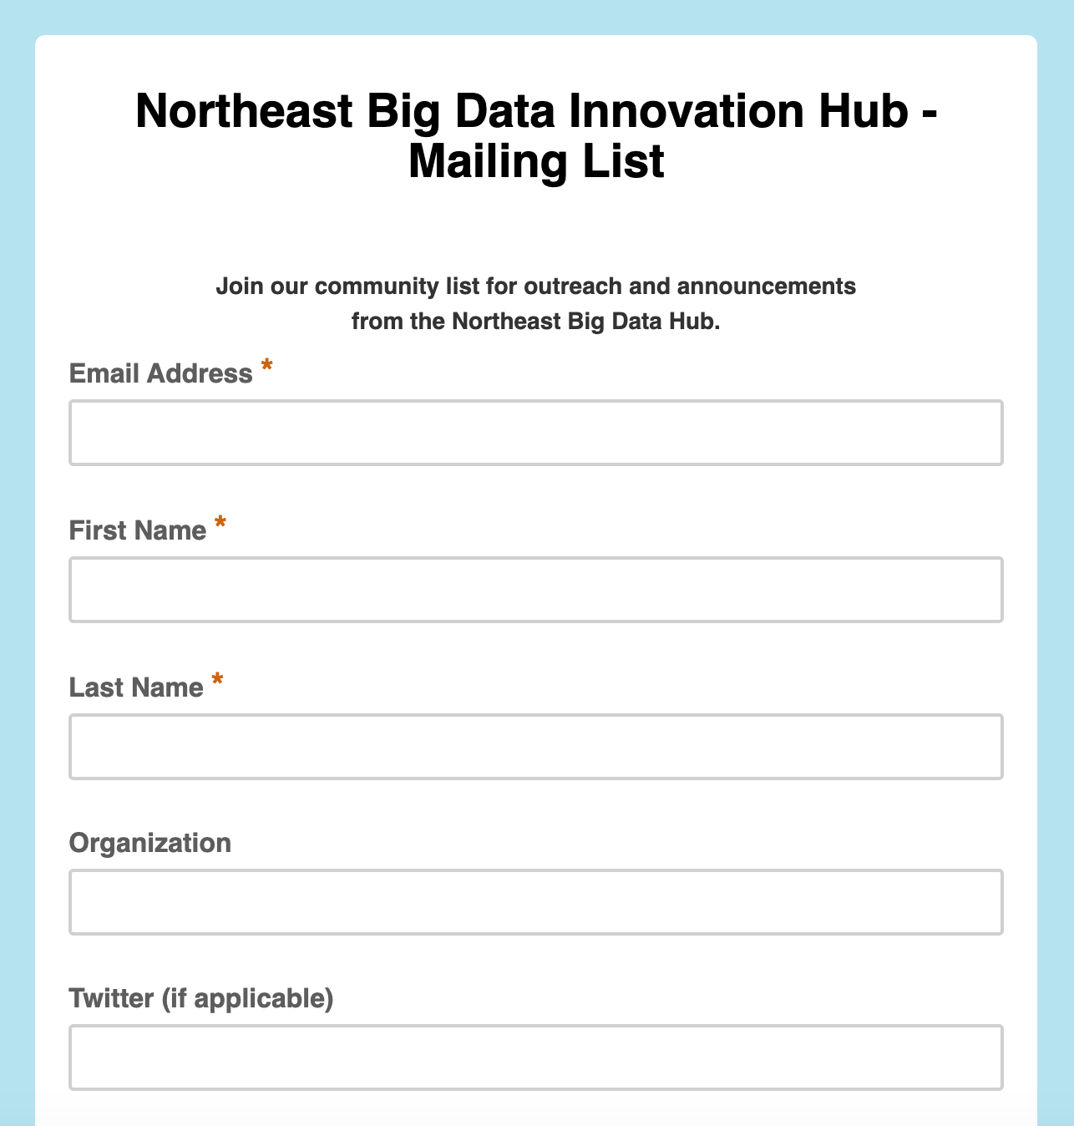
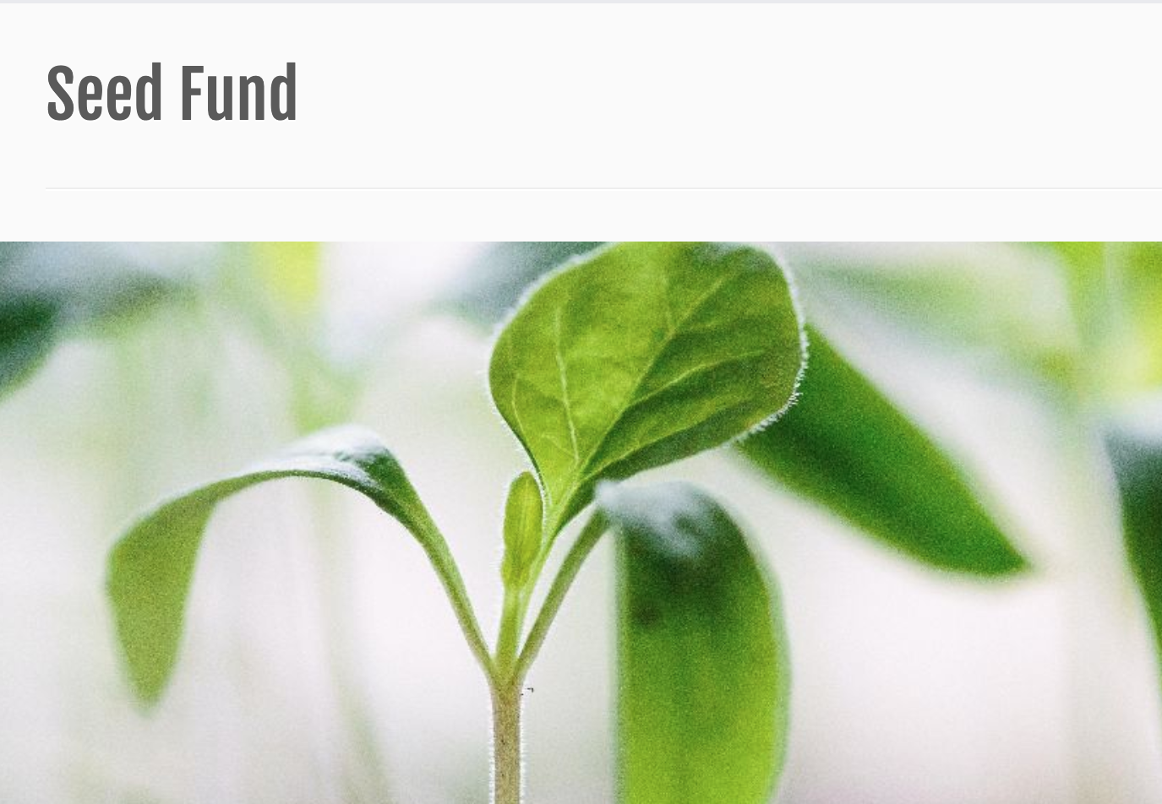
Seed Fund
http://nebigdatahub.org/seedfund/

Slide 13
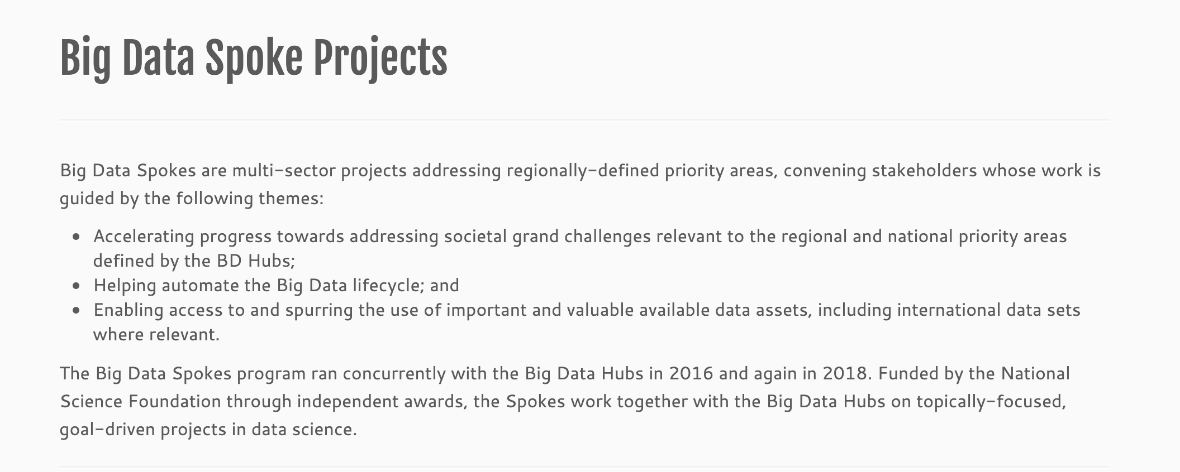
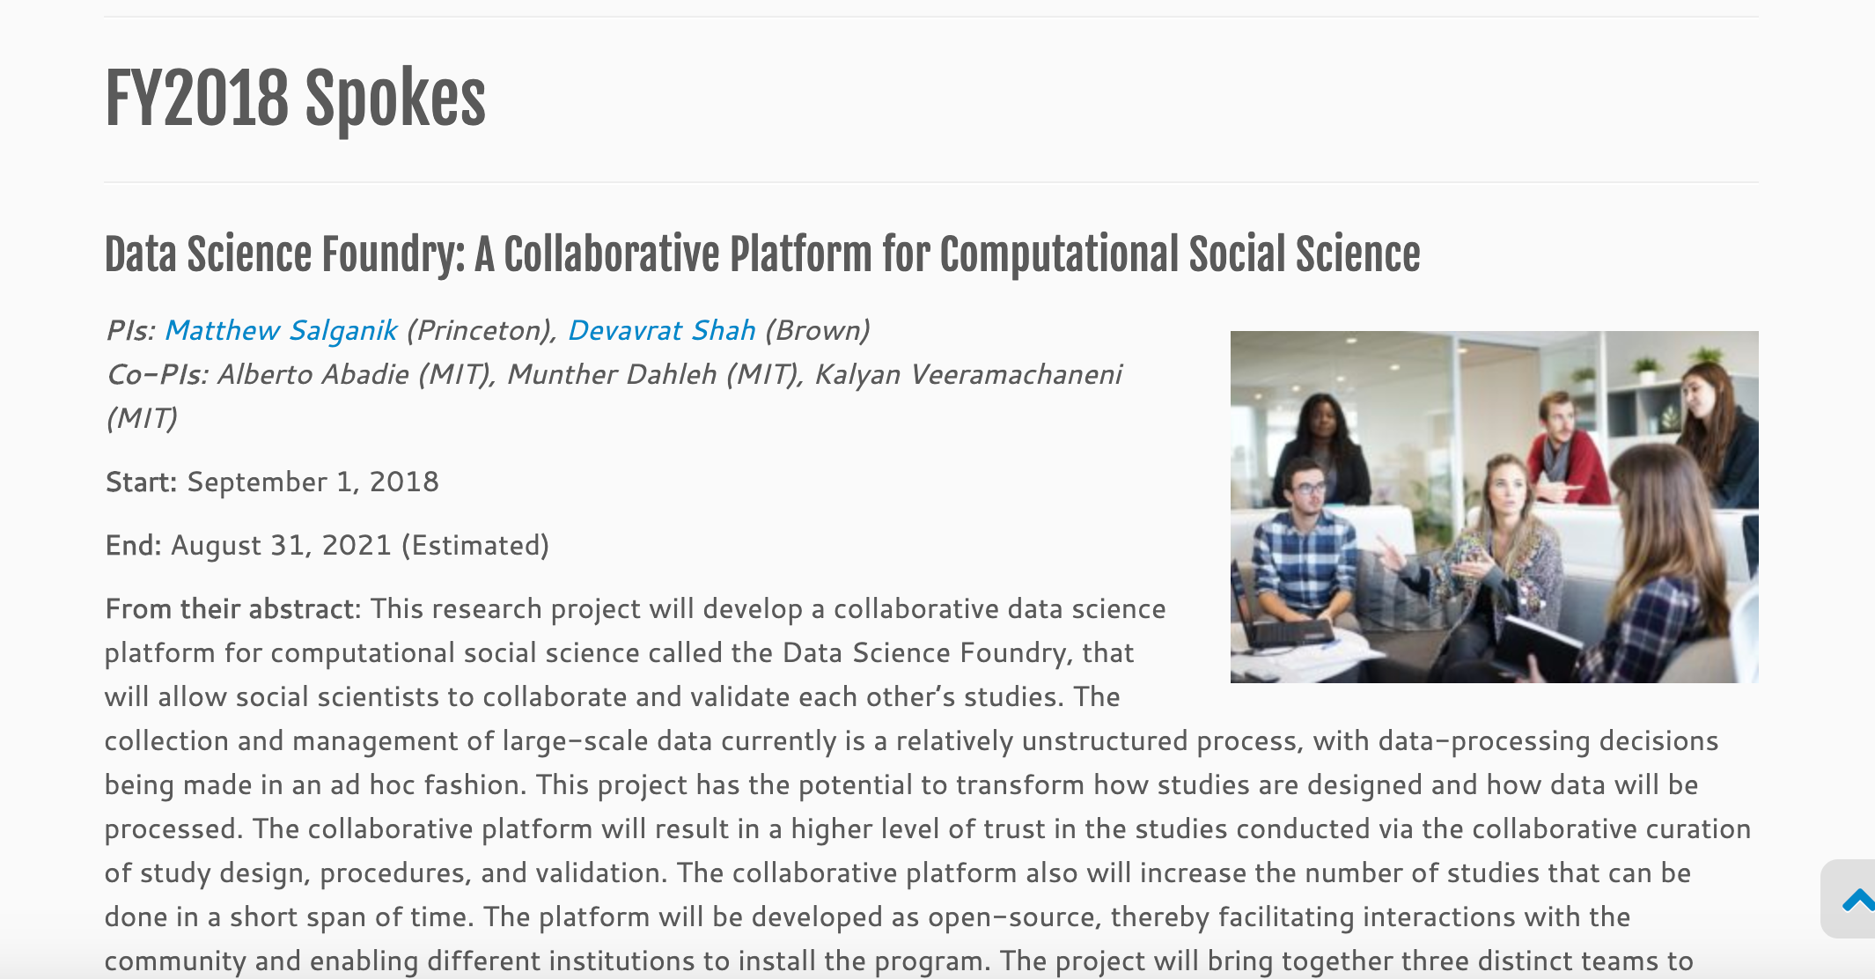
Big Data Spoke Projects
http://nebigdatahub.org/big-data-spoke-projects/

Slide 14
Legacy Work
http://nebigdatahub.org/legacy/

Slide 15
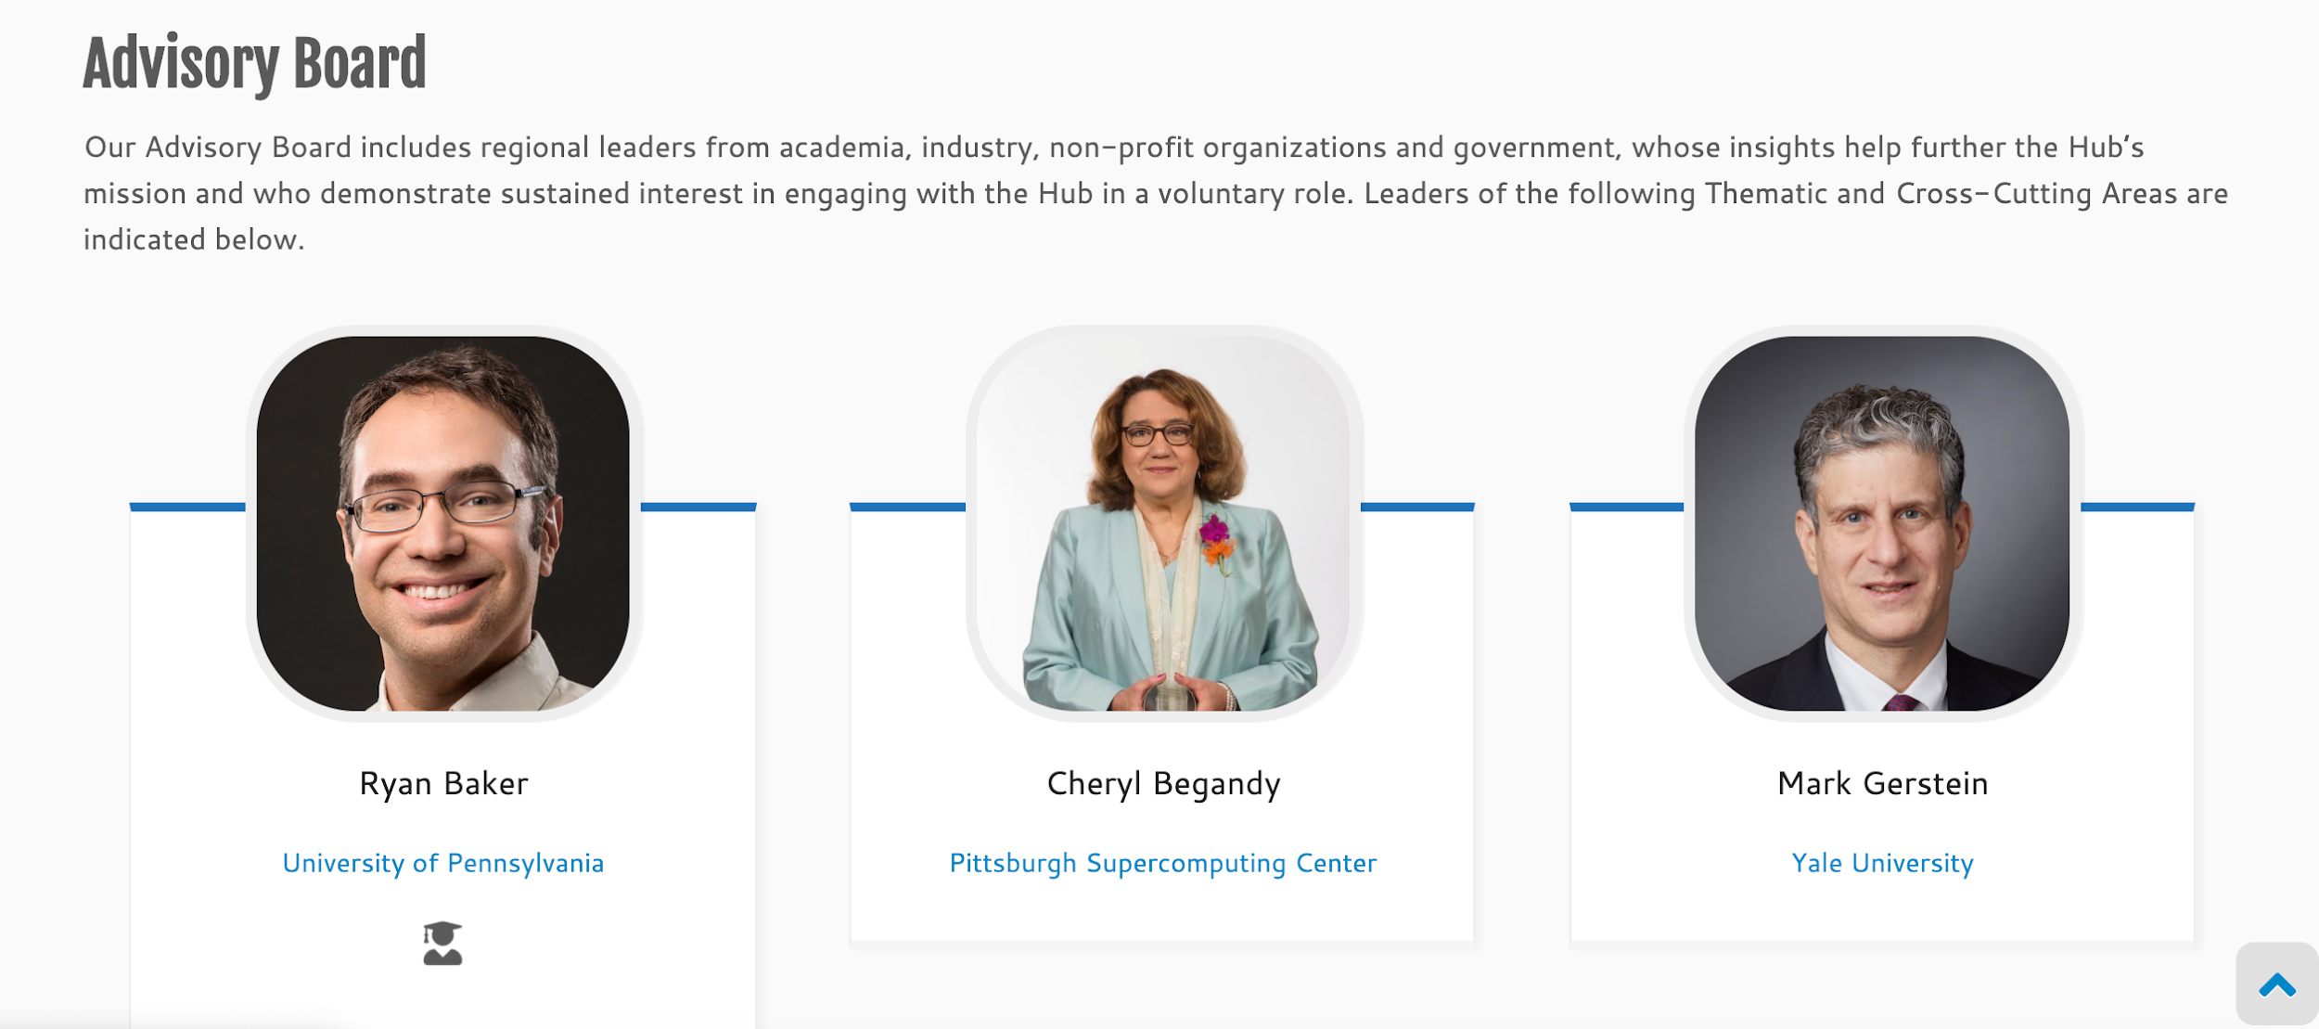
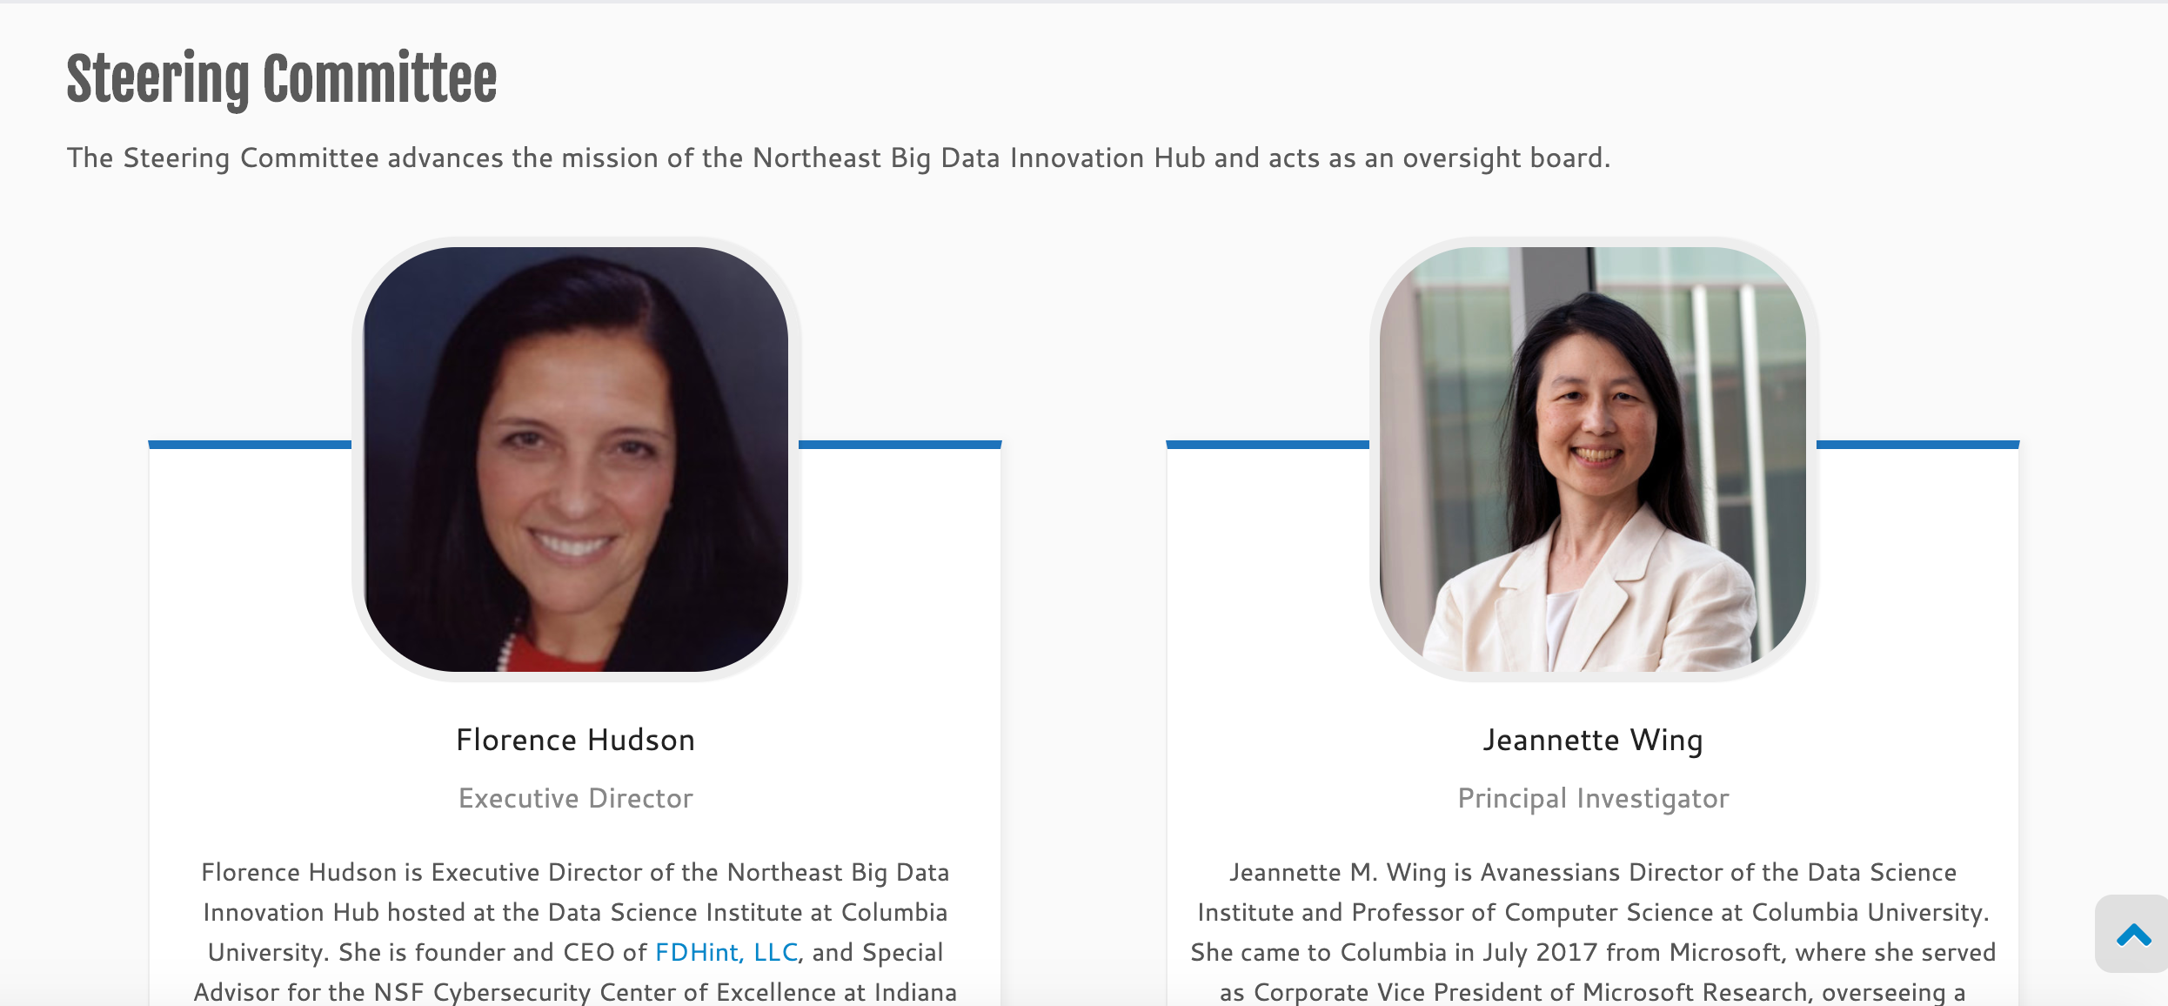
Leadership Team
http://nebigdatahub.org/leadership/

Slide 16
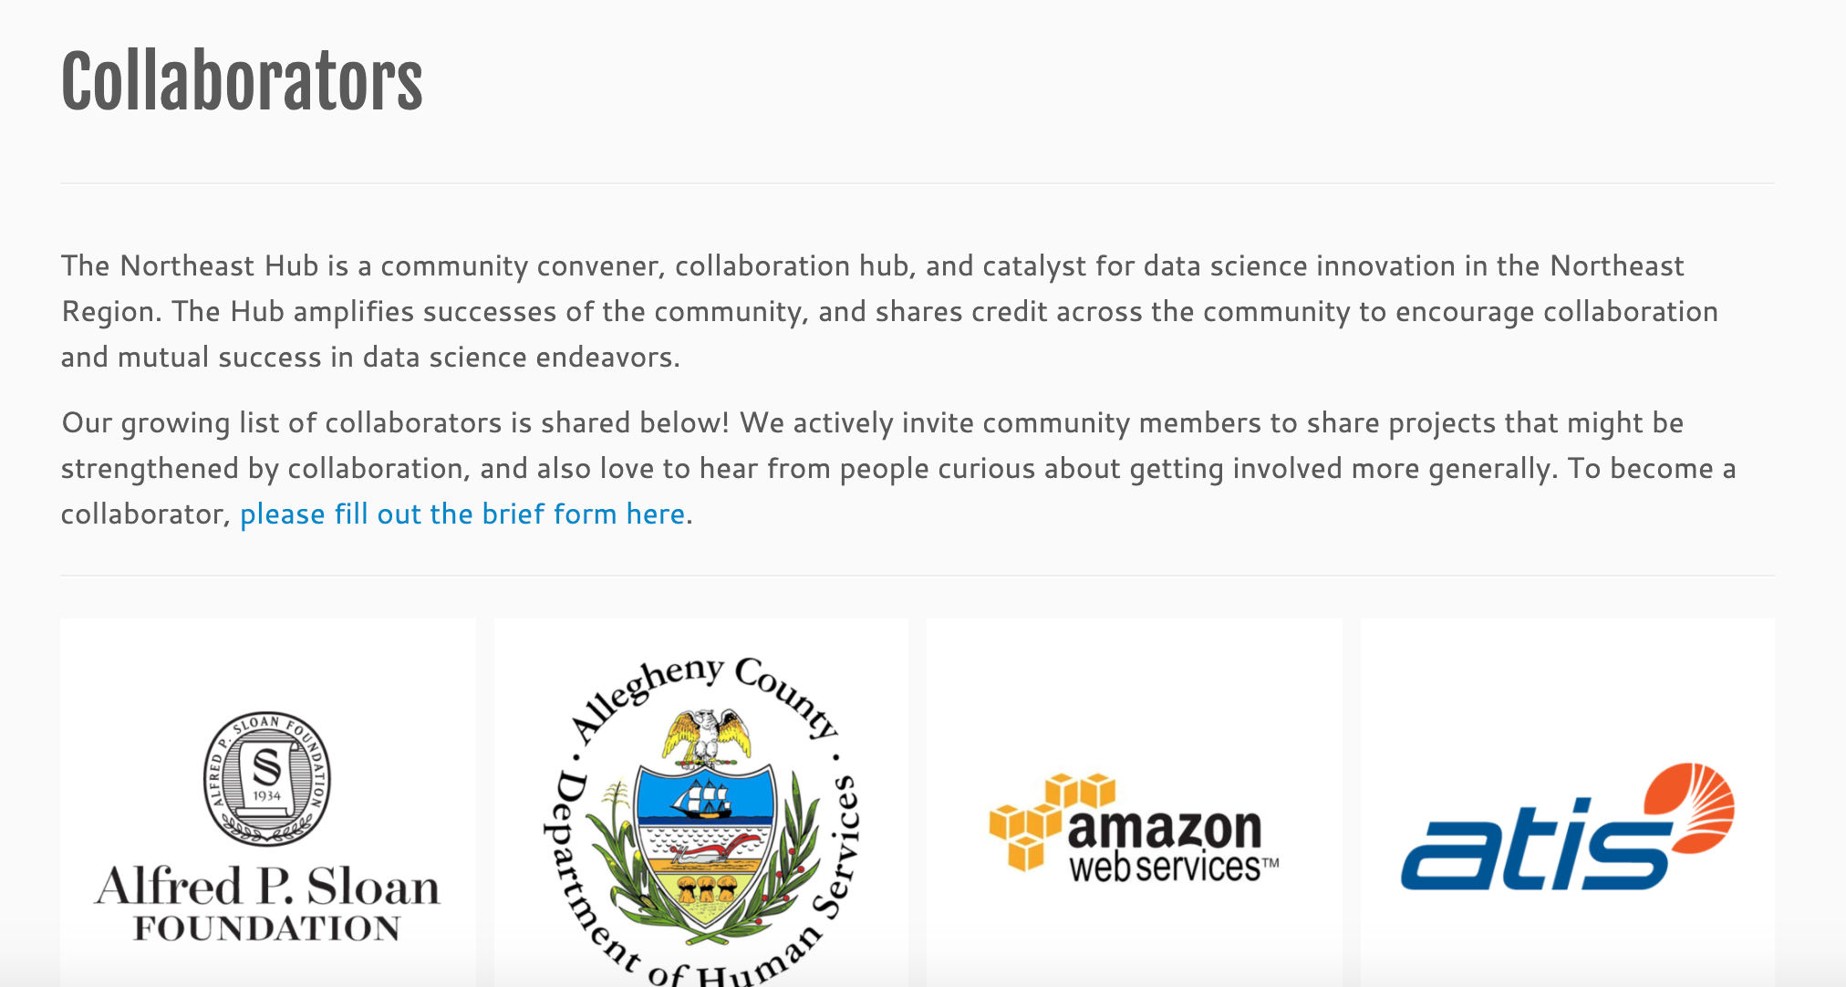
Collaborators
http://nebigdatahub.org/collaborators/
NEBigDataHub.org | @NEBigDataHub #BDHubs #NEBigData

Slide 17
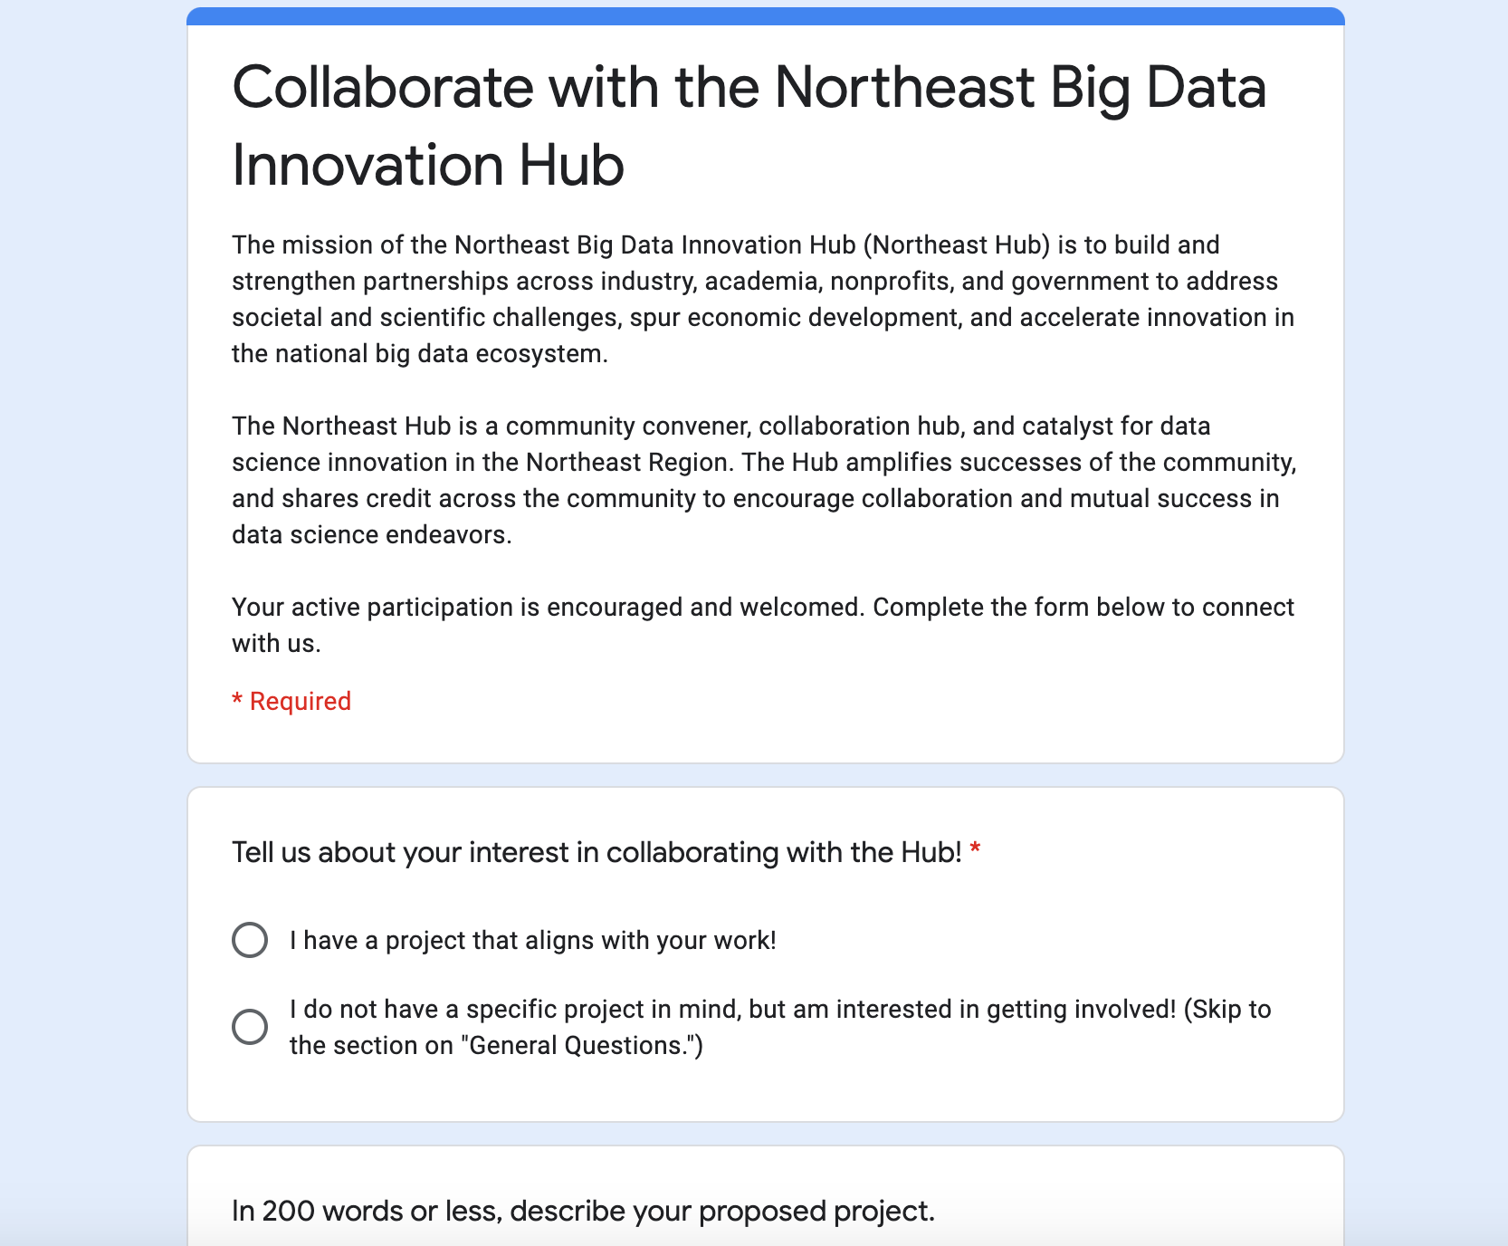
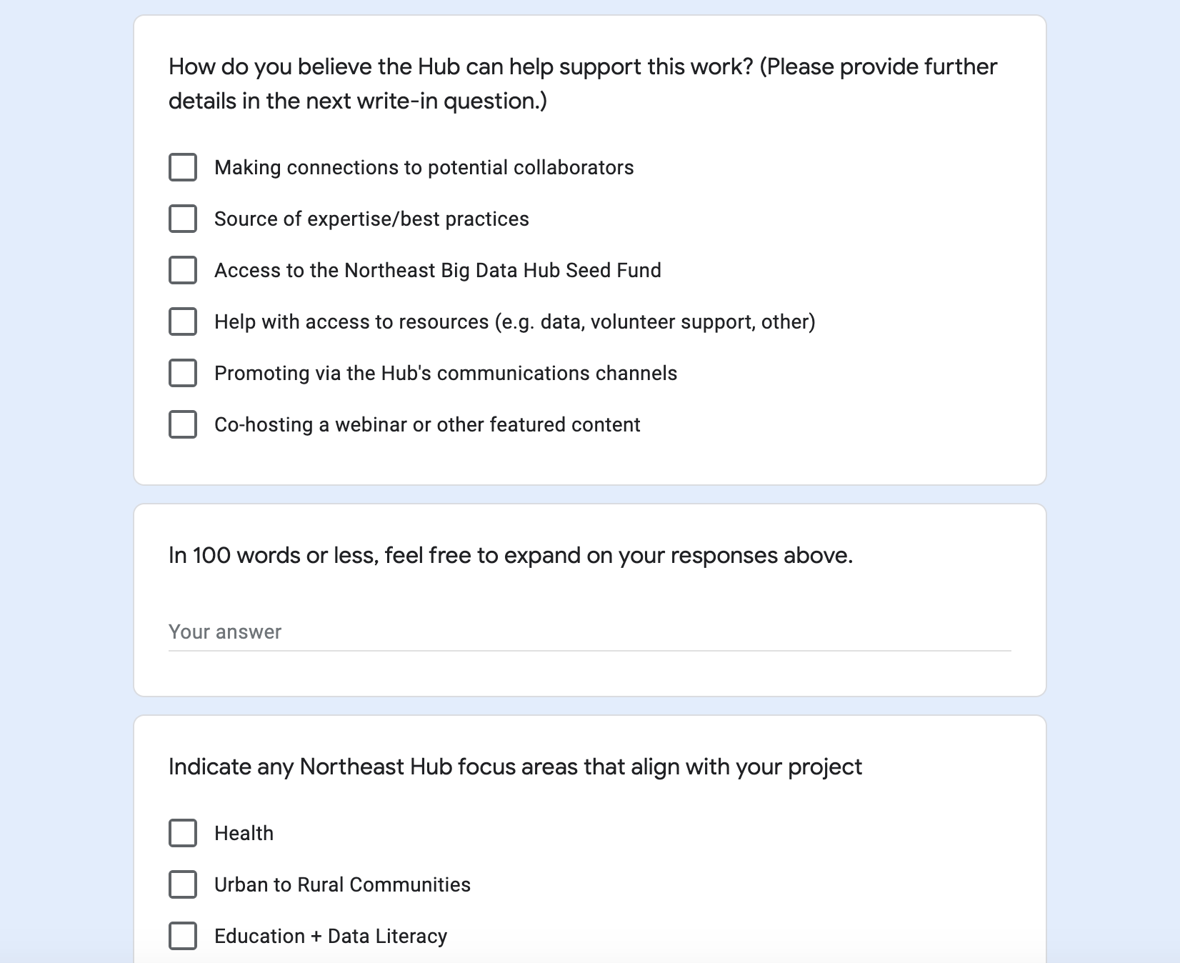
New Collaborator Form
https://docs.google.com/forms/d/e/1FAIpQLSdOYu5OMDo669n0SpE6IRnzJiFjJ7gn7Rq1_w79X11SnHquQg/viewform
NEBigDataHub.org | @NEBigDataHub #BDHubs #NEBigData

Slide 18
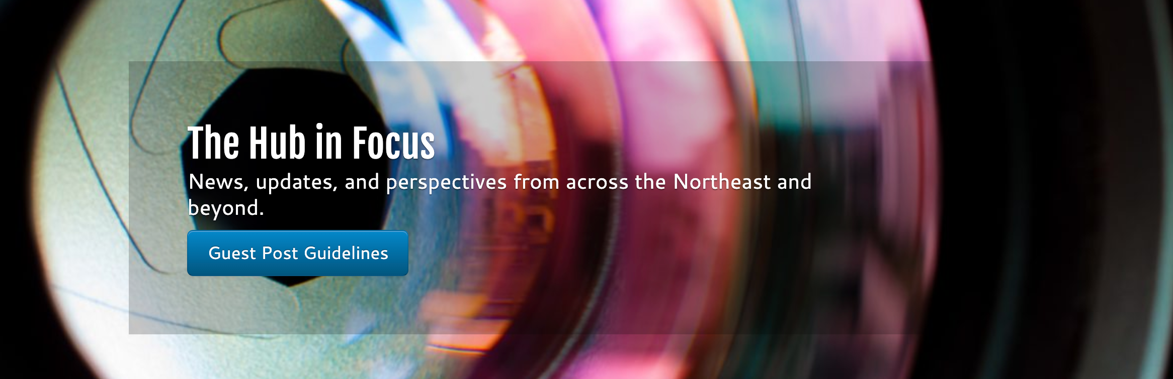
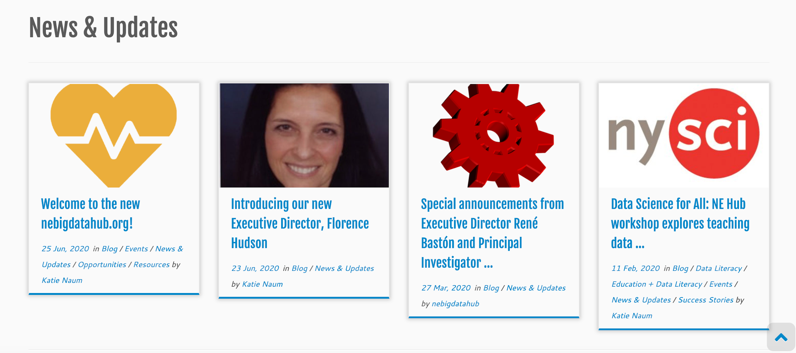
News
http://nebigdatahub.org/news-updates/
NEBigDataHub.org | @NEBigDataHub #BDHubs #NEBigData

Slide 19
Events
http://nebigdatahub.org/events-calendar/
NEBigDataHub.org | @NEBigDataHub #BDHubs #NEBigData

Slide 20
Contact Us
http://nebigdatahub.org/connect/
NEBigDataHub.org | @NEBigDataHub #BDHubs #NEBigData

Slide 21
Deepest gratitude to Helen Yang for collaborating on technical workthroughs and creative thinking, and to our leadership team for providing a strategic structure that informed this design!
NEBigDataHub.org | @NEBigDataHub #BDHubs #NEBigData

