Slide 1

Community Challenges with Data: How do we show our impact and value.
Presenters:
Saeeda L. Dunston, Executive Director
Leyla Bermudez, Director of Youth Services
Elmcor Youth & Adult Activities Presentation

Slide 2
Mission statement
Our Mission is to foster positive life changes for individuals and families through skills development leading to self-sufficiency, a sense of accountability, and a strong, empowered community.

Slide 3
ELMCOR Values
Excellence
Cultural Competency
Determination
Adaptability
Transparency
Team Work
Accountability
Integrity
Professionalism
Enthusiasm

Slide 4
Our Community
We are a Queens-Based, multi-service community based organization that has been providing essential services for families in our communities for over 53 years; with the understanding of the importance of providing resources and services that are transformative and life-changing.
On a daily basis over 600 people receive vital services at our Senior Centers, Youth Programs, Rehabilitation programs and Economic Development programs.

Slide 5
Who we Serve
Providing services through-out the borough of Queens at schools, courts, home visiting, hospitals, churches; and very soon through our mobile treatment clinic.
Participant Demographics
Ages
0-17 21%
18-25 14%
26-35 18%
36-45 15%
46-59 10%
60+ 22%
Gender
Male 58%
Female 42%
Race
Latino 53%
Black 31%
Asian 10%
White 6%

Slide 6
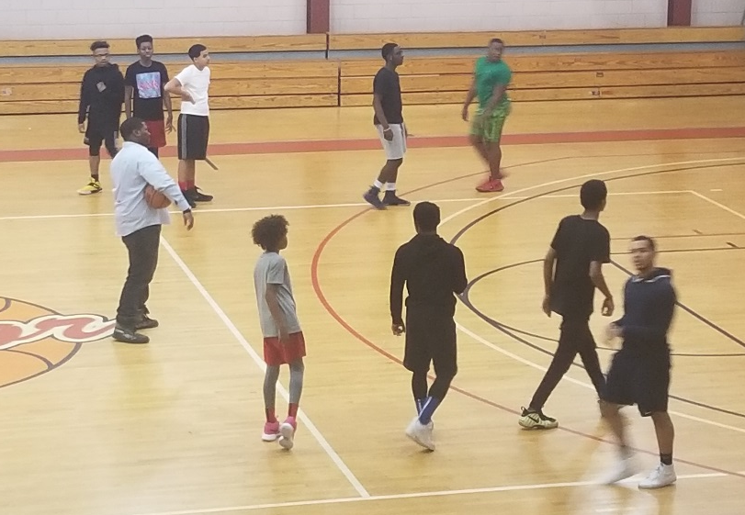
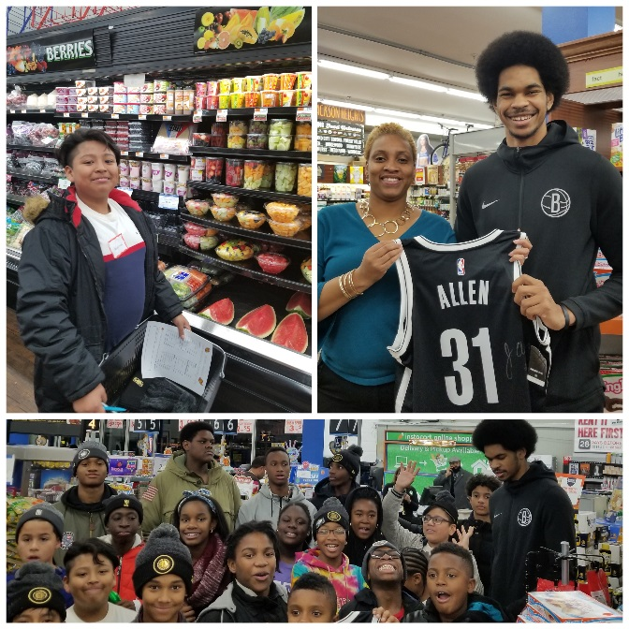
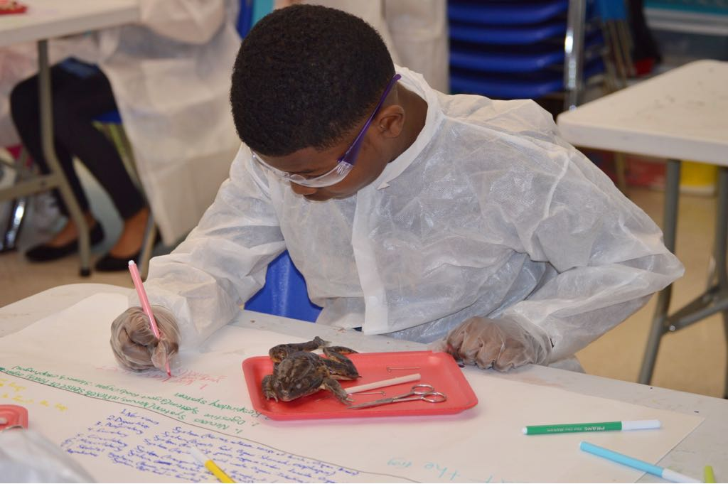
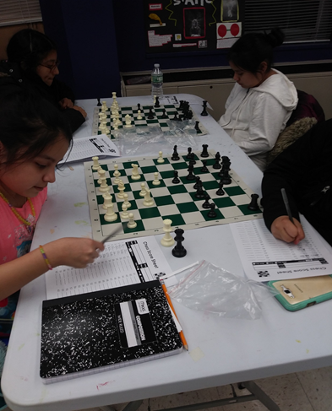
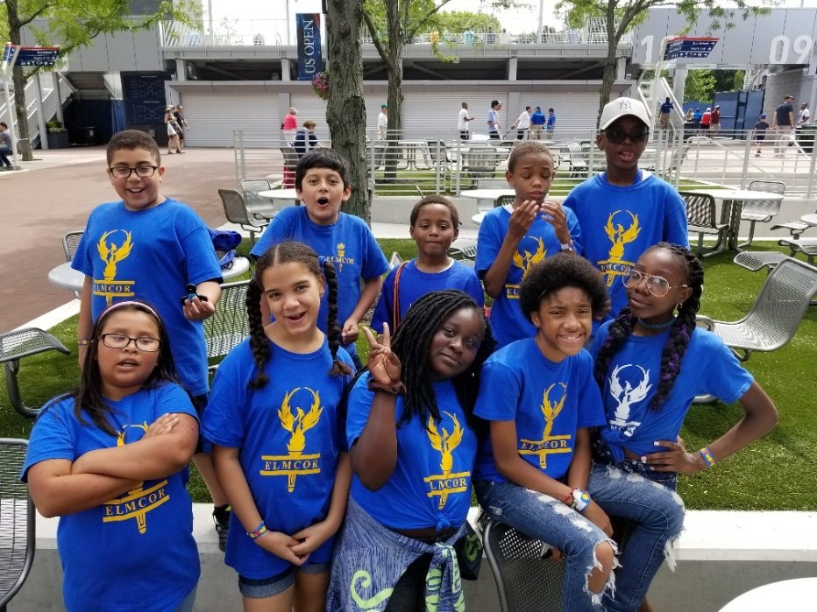
Community at work and Play

Slide 7
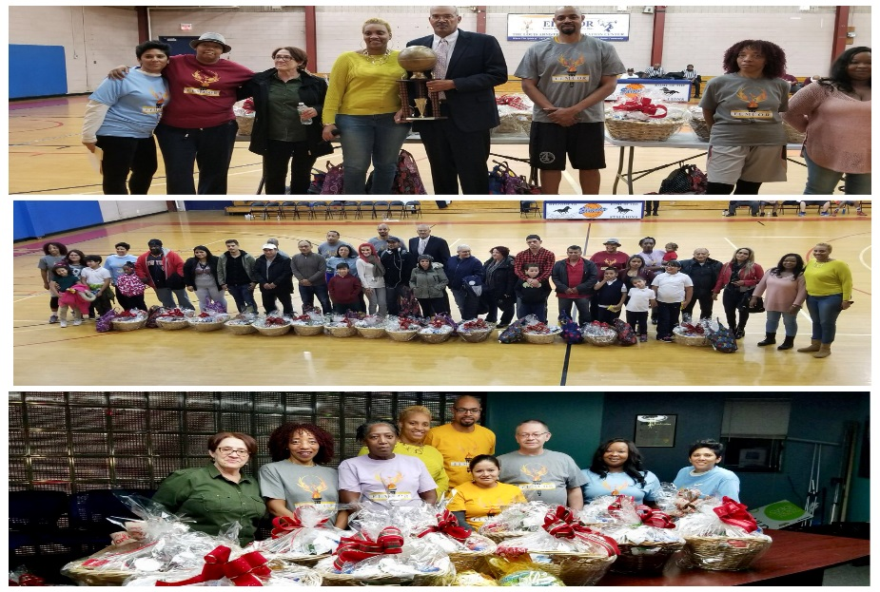
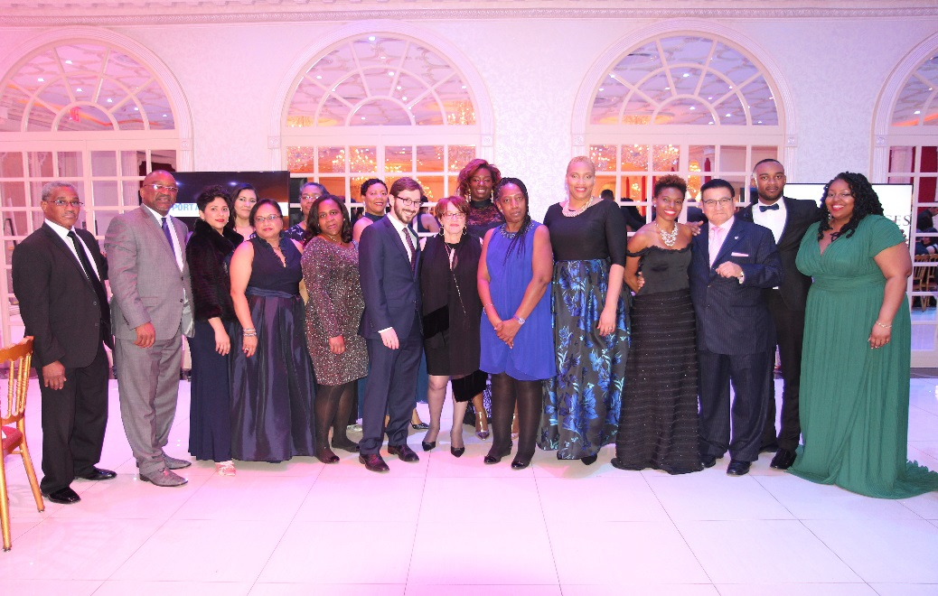
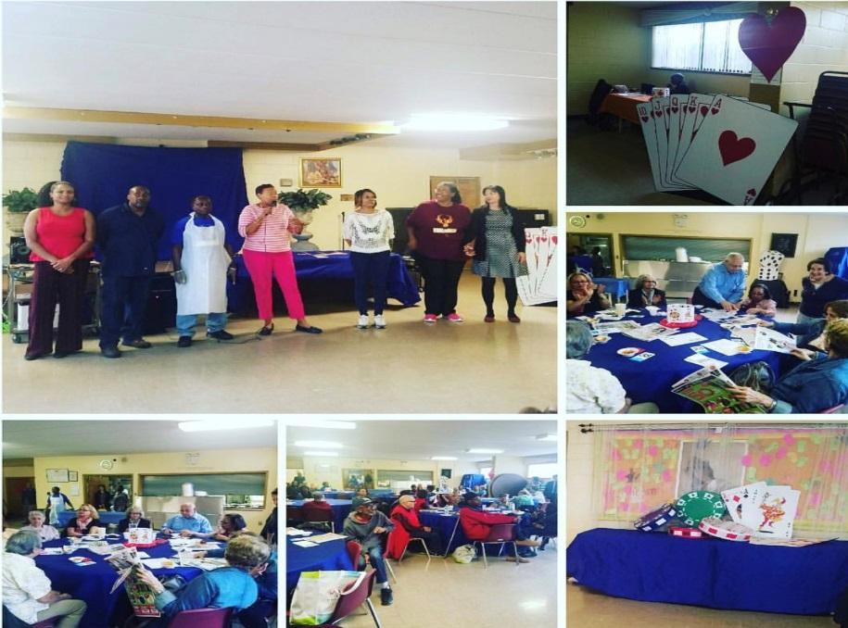
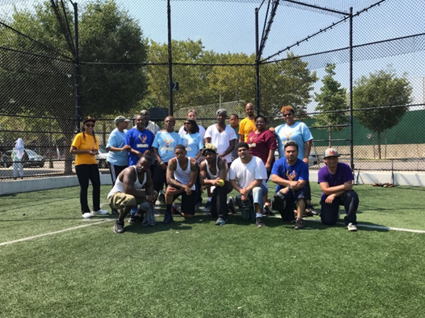
Community at work and Play

Slide 8
Youth Services
R.I.S.E.U.P (Resiliency Inspired Self-Empowerment creates Unlimited Possibilities)
Prevention Program
5-20 years of age
Evidence based and Positive Youth Development Interventions
Today’s Champion
Summer Camp
5-12 years of age
STEM, Educational supports and trips.
Youth Recovery Clubhouse (*NEW*)
Teen Center
12-17 years of age
Safe drug free space to support recovery and reduce risks for all youth.
Recreation
Fitness Program
5-24 years of age
Positive Alternatives, AAU Basketball, Boxing and Soccer.

Slide 9
Recovery Services
Outpatient Program
Article 32 Medically-supervised Rehabilitation Treatment
13 and older; Evidence-Based approaches that are Person Centered, Family Focused and Trauma-Informed Care.
Intensive Residential Program
Co-Ed 51-bed facility for people with chronic substance use disorders.
18 and older; Relapse Prevention, Mental Health, vocational training and housing placement.
Center of Treatment Innovation (*NEW*)
Telehealth medication assessment and medication management through mobile health clinic.
Utilizing Certified Recovery Peer Advocates (CRPA) to outreach connect Queens residents to treatment.

Slide 10
Recovery outcomes
81% of participants achieved their goals to reduce and/or discontinue drug use
94% of Court mandated DWI offenders completed the program
49% of participants increased their social support systems within the community upon completion of the program.
47% of participants engaged in social support groups (AA/NA) for continued community support
60% of participants completed their court/legal mandated obligations
85% are employed at completion

Slide 11
Senior and Economic Development Services
Golden Phoenix Clubs
60 and older, senior centers.
Socialization, Healthy Meals, Active Living and transportation.
Inter-generational activities and Case Assistance.
Food Pantry and Community Closet (*NEW*)
Individuals, families and seniors dealing with food insecurities.
Pre-employment interview clothing.
Career counseling services
SUNY ATTAIN Lab at Elmcor
24-station computer
Microsoft Word, Excel, PowerPoint, and Outlook, Specialist certifications
Industry focused computerized training

Slide 12
DATA Challenges
1. R.I.S.E U.P utilizes EBPs for skill development using worksheets, hands on activities, and discussions that are to be measured by pre and post tests. The program has faced the following challenges with data collection:
Analyzing and compiling accurate data after EBP completion to share with school administration
Using data to measure impact of services
Using data to evaluate EBP effectiveness in addressing our distinct youth population
2. Creating a data-driven culture agency-wide has been a challenge. Identifying agency-wide data points and a system that will assist in creating a value-proposition that will speak to impact of all our services. In the ever-changing business and financial models needed to support our theory of change framework, data analysis is critical to measuring the impact of our work with families and individuals in our communities.

Slide 13


