Slide 1
Northeast Big Data Hub Seed Fund
Webinar and Q&A
David A. Bader, Chair Distinguished Professor, New Jersey Institute of Technology
10 August 2020
Seed Fund Grants: nebigdatahub.org/seedfund
Northeast Student Data Corps: nebigdatahub.org/nsdc-seedfund
contact@nebigdatahub.org

Slide 2
(Inaugural) Seed Fund Steering Committee
David A. Bader, New Jersey Institute of Technology (chair)
Jenni Evans, Penn State
Josh Greenberg, Alfred P. Sloan Foundation
Christopher Hill, MIT
Jill Jemison, University of Vermont
Dan Lopresti, Lehigh University
Gideon Mann, Bloomberg
Renee Miller, Northeastern
Florence Hudson, NE Big Data Hub / Columbia University (ex-officio)

Slide 3
Northeast Hub Goals
The Northeast Hub is a community convener, collaboration hub, and catalyst for data science innovation in the Northeast Region. The Hub amplifies successes of the community and shares credit across the community to encourage collaboration and mutual success in data science endeavors.
The goals of the Northeast Hub are to:
Build collaborations to address real-world challenges through translational data science approaches
Foster innovation and scale endeavors that reflect regional interests and align with national priorities related to data science
Support and promote representative community engagement/impact across all Hub activities
Increase data science capacity and talent, emphasizing underserved communities

Slide 4
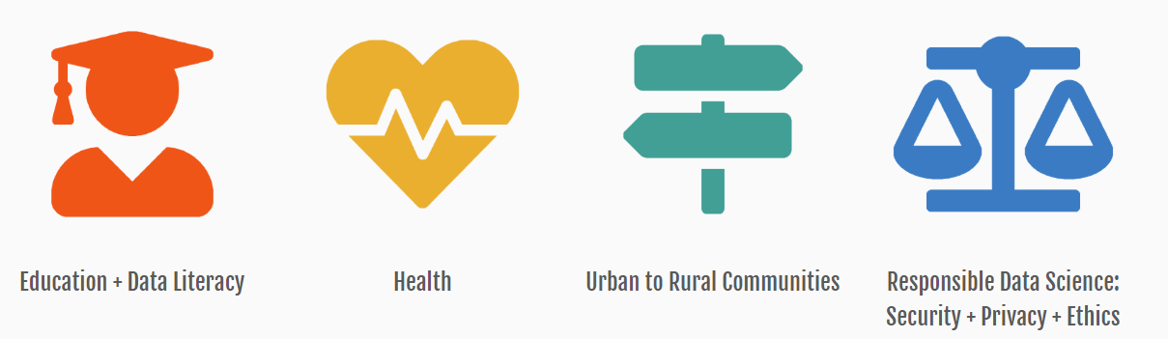
Seed Fund Steering Committee (SFSC) Purpose
The SFSC’s principal responsibility will be to administer the seed fund and to define the policies and processes for allocating the $250,000 available annually for the benefit of competitively selected pilot projects, in alignment with the Hub’s focus areas, in promising new scientific research endeavors.

Slide 5
Two programs:
Seed Fund Grants
Northeast Student Data Corps
First Round Deadline: August 31, 2020
Second Round Deadline: October 1, 2020

Slide 6
Deadlines
Proposals will be considered with deadlines for two rounds of awards, and based on the availability of funds. Proposals submitted to the first round will receive decisions of award, no award, or remain in consideration for the second deadline. Proposals with a negative decision on the first round are ineligible for resubmission in the second round.
First Round Deadline: August 31, 2020
Second Round Deadline: October 1, 2020

Slide 7
Seed Fund Grants

Slide 8
Eligibility
Individuals or group teams led by faculty, students, or individuals from academic institutions or other non-profits within the Northeastern United States, defined as Pennsylvania, New Jersey, New York, Connecticut, Rhode Island, Massachusetts, Vermont, New Hampshire, and Maine.
Colleagues from historically black colleges and universities, minority-serving institutions, Hispanic-serving institutions and others from underrepresented groups are strongly encouraged to apply.

Slide 9
Award Information
The Seed Fund Steering Committee anticipates making approximately 12-15 seed grant awards, of up to $25,000 each.
Examples of potential funded activities include:
Funding support for student internships
Faculty or student funding support
Access to data sets
Webinar facilitation
Note: participant support travel is not allowed.

Slide 10
Application Process
Cover page:
PI name and institution
All names, roles, and institutions of project team
Northeast Hub focus areas (choose all that apply)
Scientific domain(s)
Expected start and end dates of the project’s use of funds (end date by May 31, 2021)
Project description, including:
Goal and significance toward data science [up to 500 words]
What the project is seeding? What is the longitudinal future potential? [up to 100 words]
Intellectual Merit: what is unique and innovative? [up to 500 words]
Broader Impact: what is the impact to benefit society? [up to 500 words]
You may wish to refer to NSF’s guidance on Broader Impacts in composing this section. Of particular interest to the Northeast Hub’s Seed Fund Steering Committee is the impact for students, members of groups underrepresented in this field, education and data literacy, as well as resources for public benefit.
Budget and budget justification:
Please attach a line-item breakdown of the funds requested and a brief description of their use as part of the application.
Biography or CV:
Please attach a one page bio or 2 page CV for the PI as part of the application.
Optional: URLs to professional home page, LinkedIn, research page.

Slide 11
Review Process and Selection Criteria
The Northeast Big Data Innovation Hub Seed Fund Steering Committee (SFSC) will review seed fund proposals.
Each proposal will be reviewed by 3 or more members of the SFSC with the following criteria:
Alignment with Hub mission, goals and focus areas including significance toward data science
Intellectual Merit
Broader Impact
Potential for award to seed an expected larger effort
Commitment / Ability to Execute
The SFSC will use NSF’s Conflicts of Interest policy during the review process

Slide 12
Reporting Requirements
Awardees will be expected to provide an end-of-project report summarizing activities, outcomes, and achievements enabled. These reports will be made public on the Northeast Big Data Hub web site.
The Northeast Big Data Hub also plans to publish project descriptions and project team rosters from awarded projects on its web site.

Slide 13
Northeast Student Data Corps

Slide 14
What is the Northeast Student Data Corps?
The NSDC is a community-developed initiative that will teach data science fundamentals to students across the northeastern United States, with a special focus on underserved institutions and students. To better build in community insights and perspectives from the start, the Northeast Big Data Hub invites community members to apply to join the Founding Committee of the Northeast Student Data Corps.
Read the Insight Paper: http://nebigdatahub.org/nsdc-seedfund/

Slide 15
Northeast Student Data Corps
Starting in 2020, the Founding Committee will be responsible for planning, designing, and launching Northeast Student Data Corps activities in partnership with leadership of the Northeast Big Data Hub.
This is an opportunity to contribute to the creation of a groundbreaking and inclusive new program in data science. A modest honorarium is offered to Founding Committee members in recognition of their service to the community and as part of the Northeast Big Data Hub’s seed fund program.

Slide 16
Eligibility
The Northeast Big Data Hub welcomes applications from undergraduate and graduate students, postdoctoral researchers, faculty, and leaders from academia and non-profit organizations based in the Northeastern United States, defined as Pennsylvania, New Jersey, New York, Connecticut, Rhode Island, Massachusetts, Vermont, New Hampshire, and Maine.
Colleagues from historically black colleges and universities, minority-serving institutions, Hispanic-serving institutions and others from underrepresented groups are strongly encouraged to apply.

Slide 17
Application Process
For consideration, all NSDC Founding Committee applications must include:
Individual’s name
Institution
Role
Statement of interest in joining the Founding Committee [up to 200 words]
Areas of Expertise [checklist]
Overview of Areas of Expertise [up to 500 words]
Please provide your thoughts on how the Founding Committee might plan and launch one or more of the three activities the Northeast Student Data Corps will engage in [up to 500 words]
Resume or CV (up to 2 pages)

Slide 18
Review Process and Selection Criteria
The Northeast Big Data Innovation Hub Seed Fund Steering Committee (SFSC) will review applications.
Each application will be reviewed by 3 or more members of the SFSC. The SFSC will use NSF’s Conflicts of Interest policy during the review process.

Slide 19
Service Requirements
Founding Committee members will be expected to carry out their service of planning, designing, and launching the Northeast Student Data Corps in conjunction with Northeast Big Data Hub leadership, starting in fall 2020. The Northeast Student Data Corps is expected to launch initial activities by 2021.

Slide 20
Submission Walk-Through

Slide 21
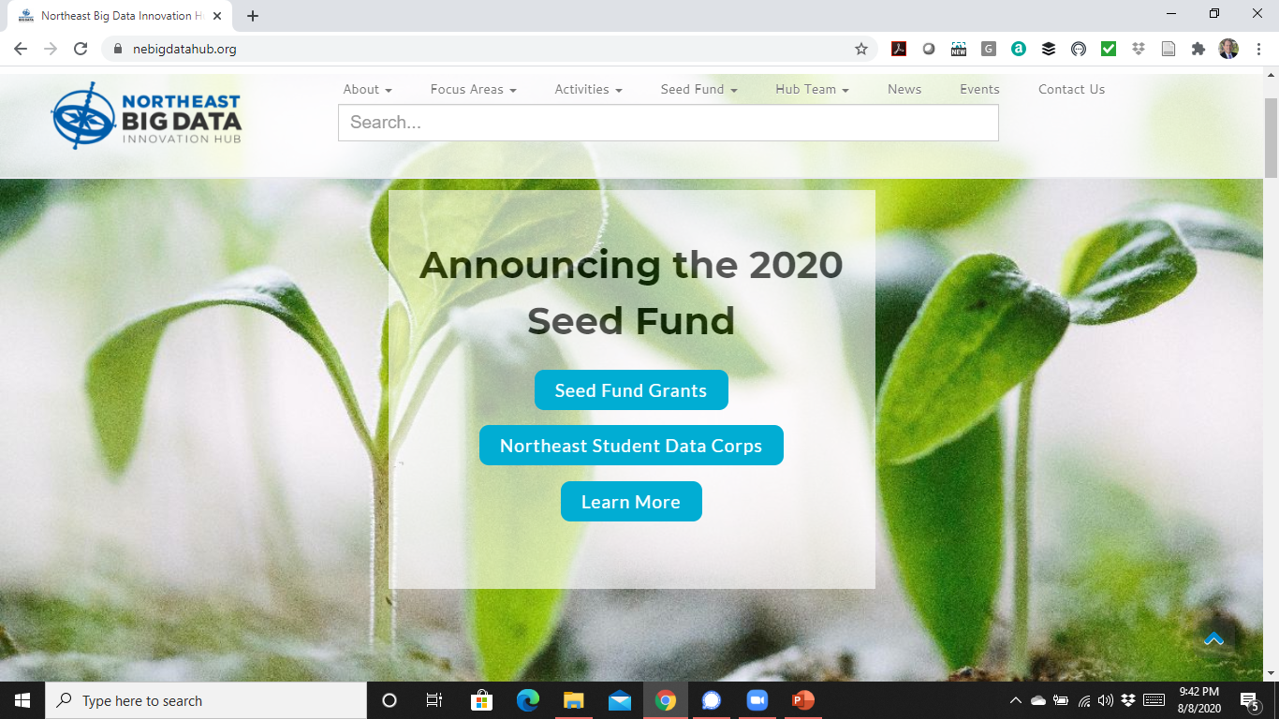

Slide 22
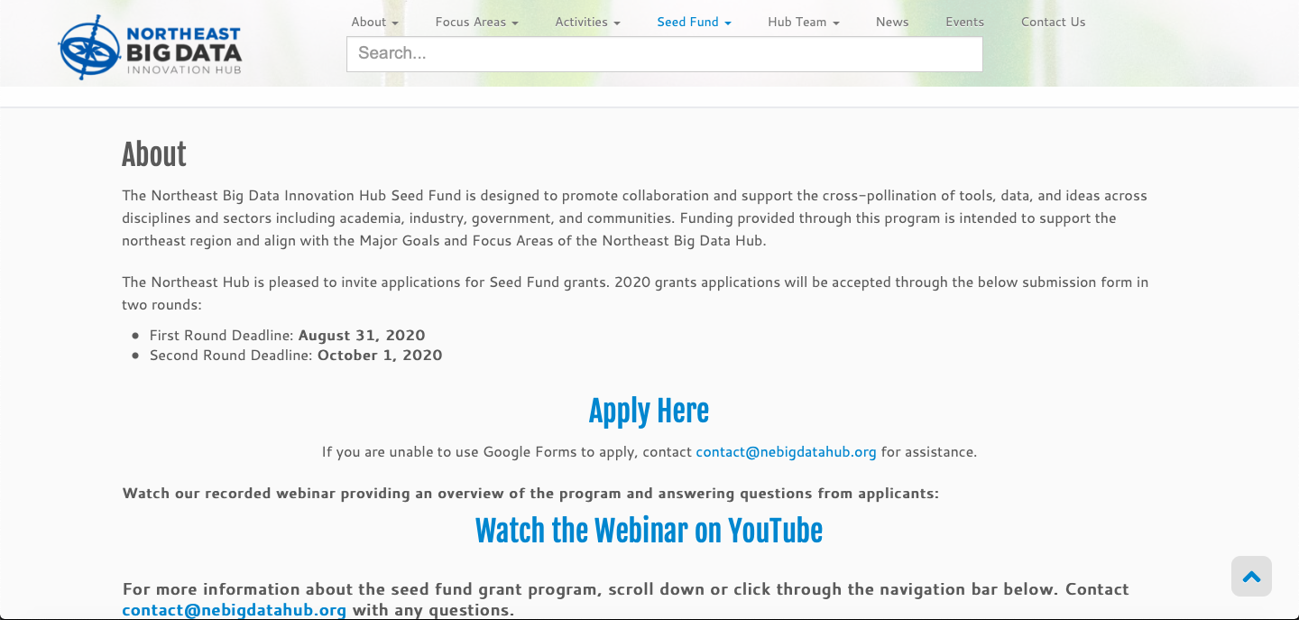

Slide 23
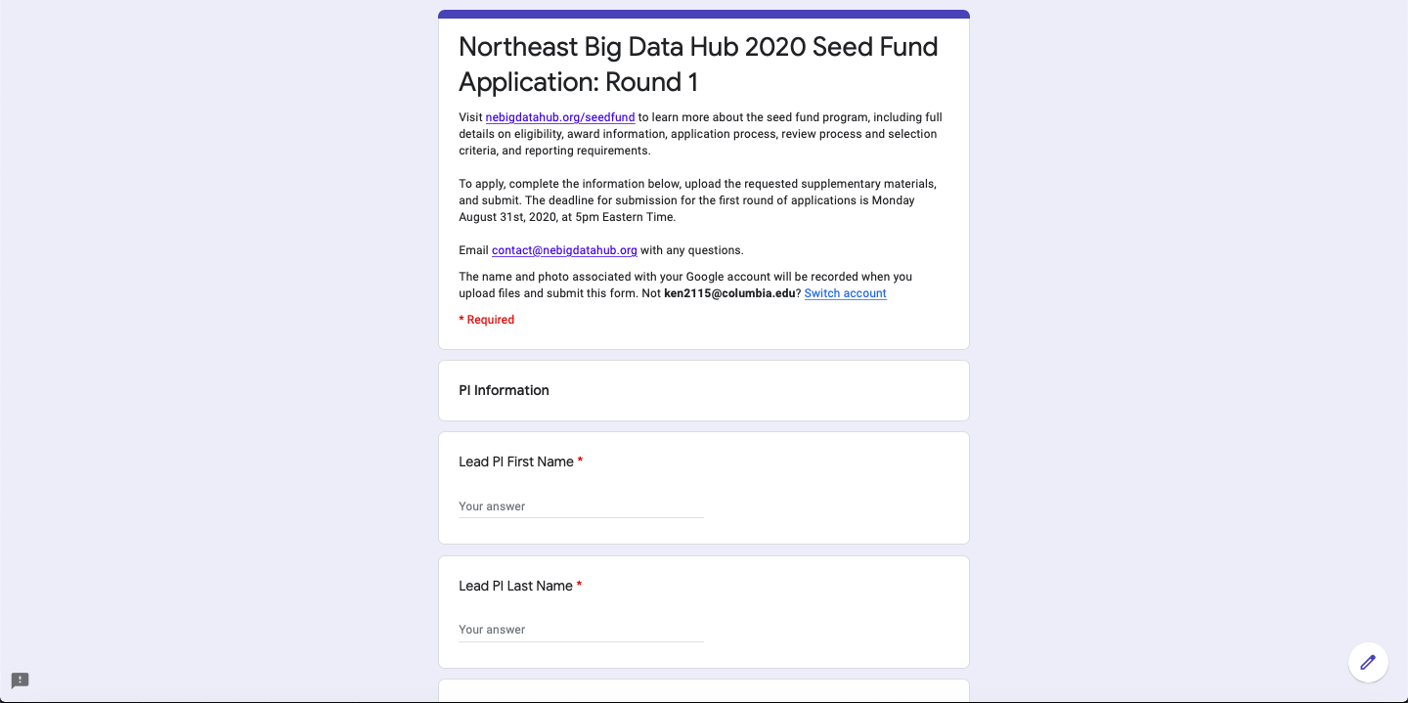

Slide 24
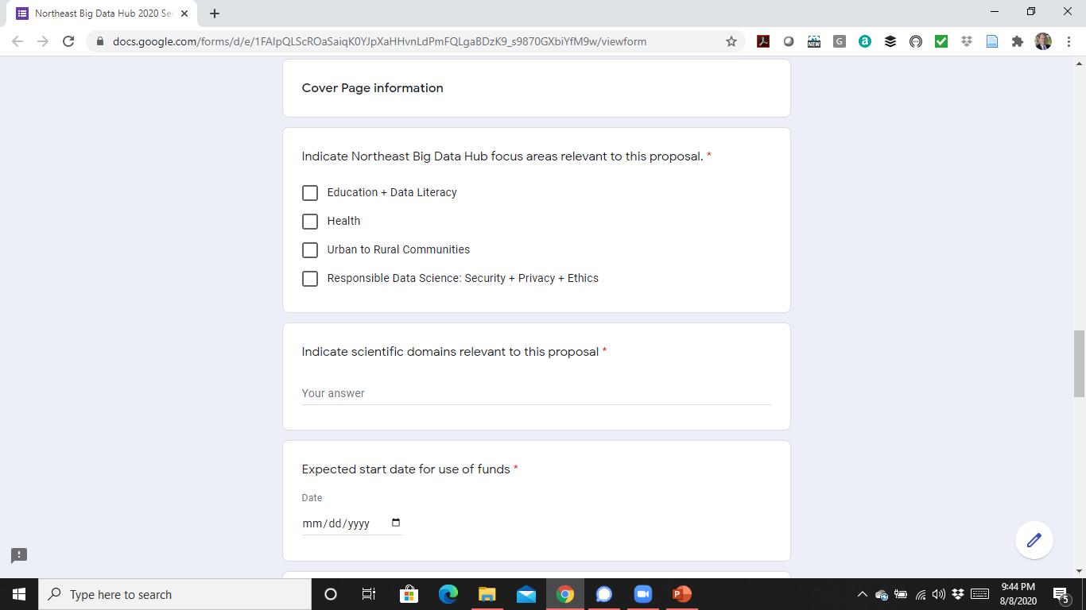

Slide 25
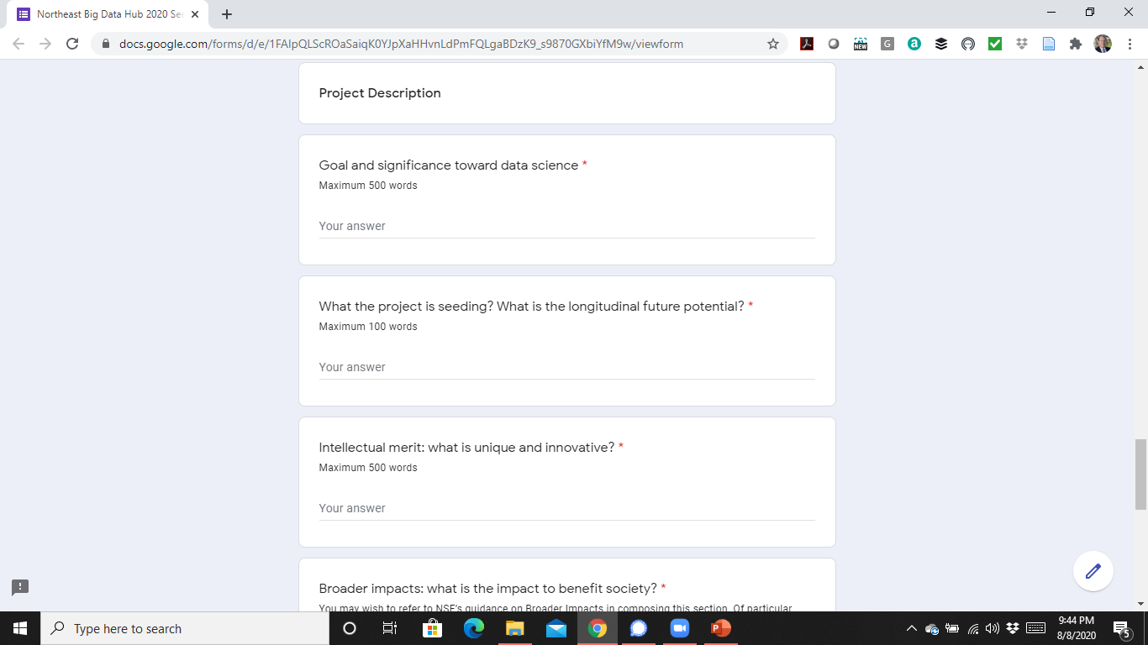

Slide 26
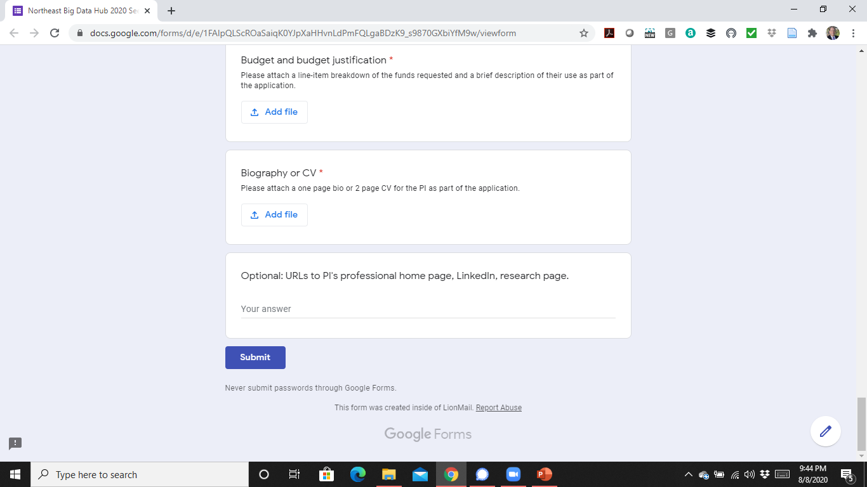

Slide 27
Northeast Student Data Corps

Slide 28
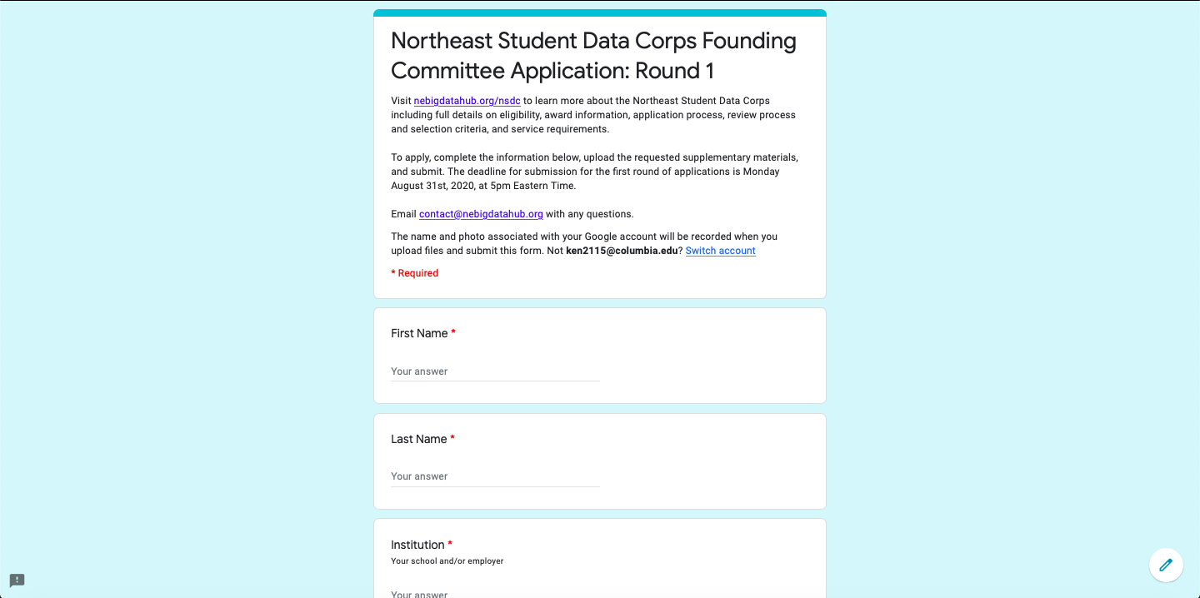

Slide 29
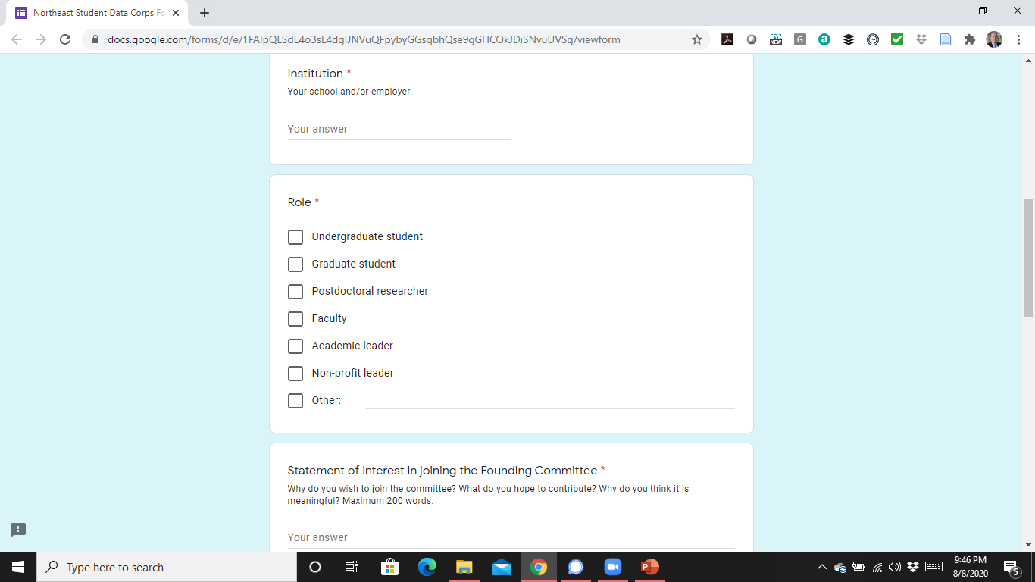

Slide 30
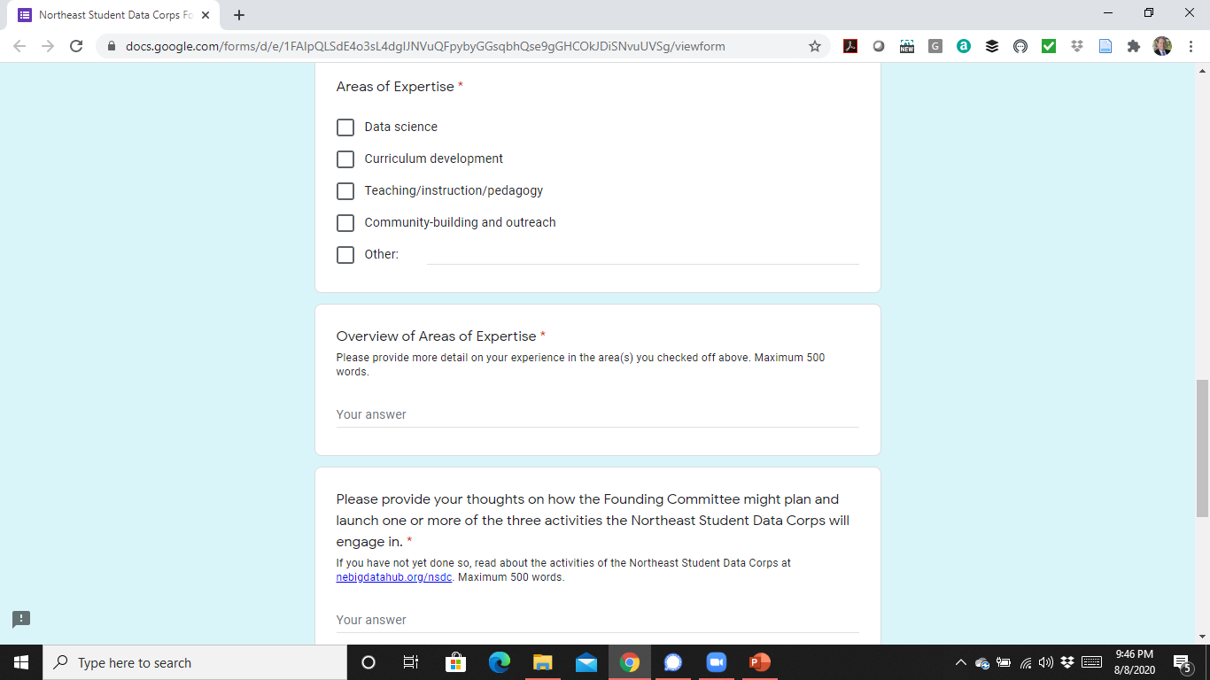

Slide 31
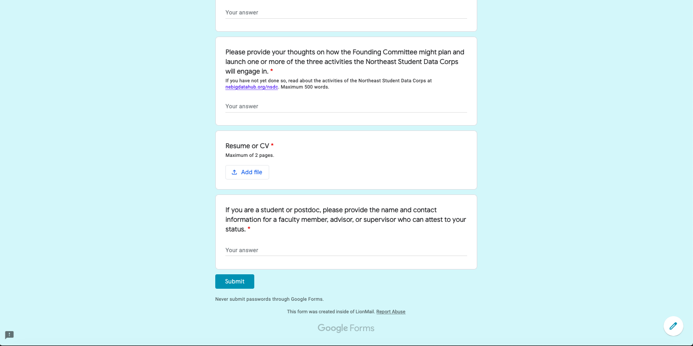

Slide 32
Q&A

