Slide 1
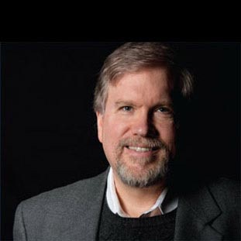
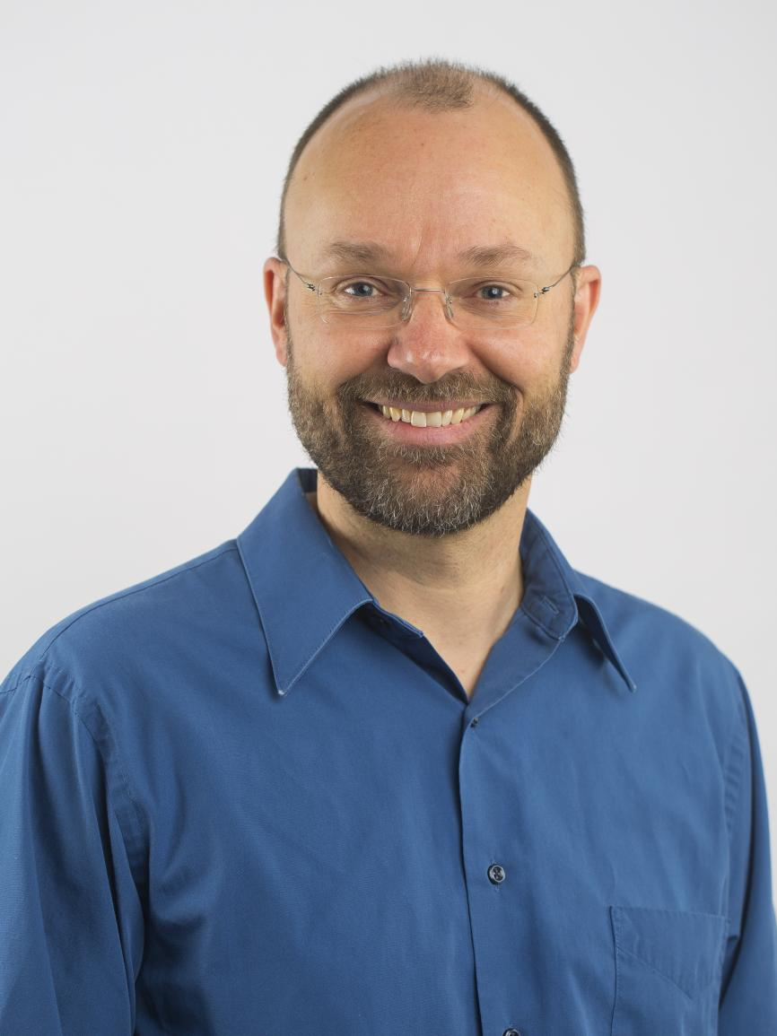
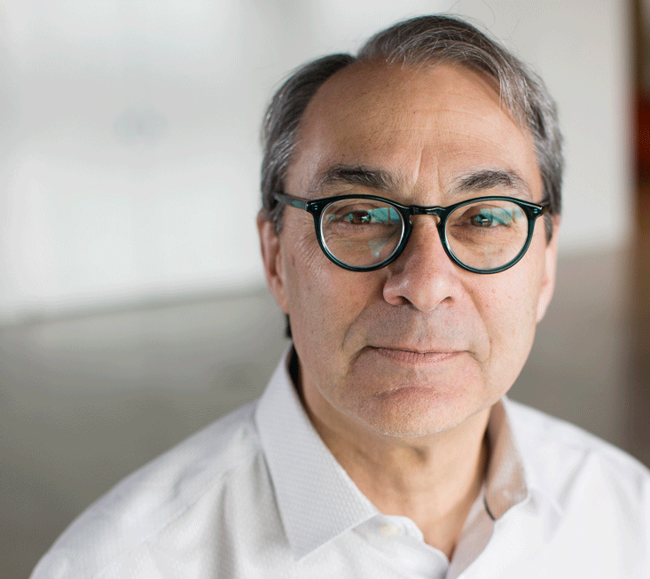
Panel Discussion:
Impact of Digital Media Across Sectors
Guru Banavar
Chief Technology Officer
Viome
Henry Kautz
Robin & Tim Wentworth Director
Goergen Institute for Data Science, University of Rochester
Andrew McCallum
Director, Center for Data Science, and Professor, University of Massachusetts Amherst
Moderator
Kathleen McKeown
Henry and Gertrude Rothschild Professor of Computer Science, Columbia University
Alfred Spector
Chief Technology Officer
2Sigma
Jeannette Wing
Avanessians Director
Data Science Institute, Columbia University

