Slide 1
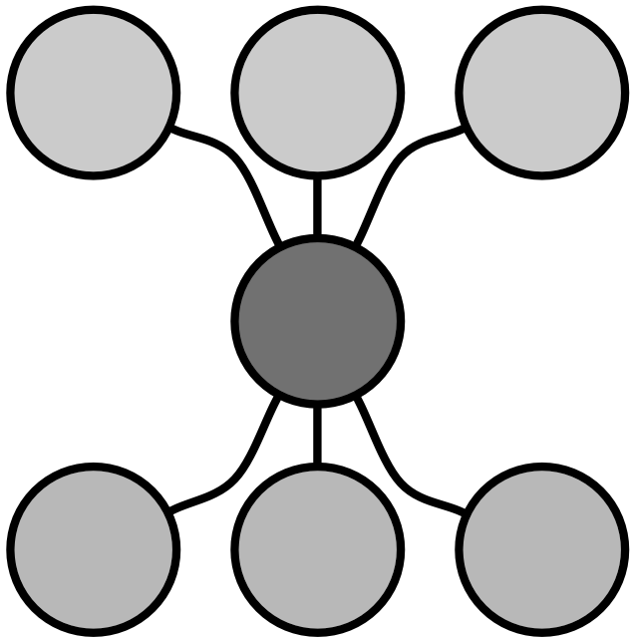


Building a search engine to find environmental and phenotypic factors associated with disease and health
Chirag Lakhani
Chirag J Patel
Northeast Big Data Innovation Hub Workshop
03/27/28
  chirag@hms.harvard.edu
  @chiragjp
www.chiragjpgroup.org

Slide 2
Phenotype
Genome
Environment
P = G + E
Type 2 Diabetes
Cancer
Alzheimer’s
Gene expression
Variants
Infectious agents
Nutrients
Pollutants
Drugs

Slide 3
G
We are great at G investigation!
over 2400
Genome-wide Association Studies (GWAS)
https://www.ebi.ac.uk/gwas/

Slide 4
E: ???
Nothing comparable to elucidate E influence!
We lack high-throughput methods and data to discover new E in P…
until now!

Slide 5
How can we drive discovery of
environmental factors (E) in disease phenotypes (P)?
Enhance accessibility of clinical and
environmental data, and analytic artificial intelligence tools!

Slide 6
Noémie Elhadad, PhD
Columbia

Slide 7
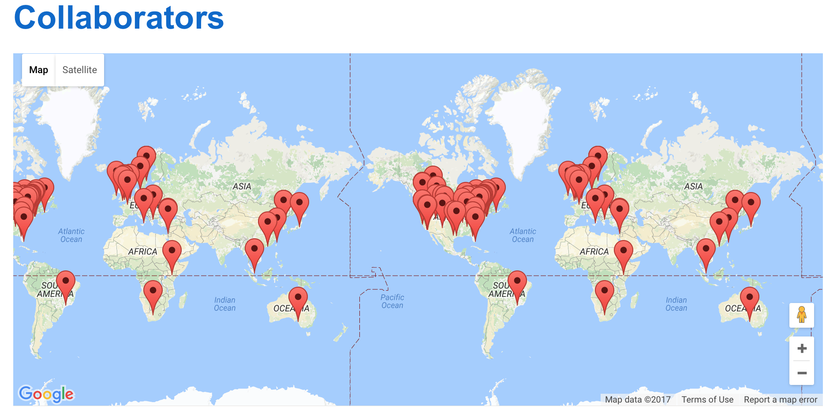
Capitalize on digitalized health record data
(from around the world)!
High-powered dataset(s) for discovery.

Slide 8
Where do we get disease P data?
Health record data from your doctor!
Longitudinal data on millions of patients
  diagnoses, prescriptions, lab reports, notes
Sitting there in institutional IT infrastructure
OHDSI provides a unified model to access data across institutions, enhancing the scientific process!

Slide 9
Where do we get environmental (E) data?

Slide 10


Examples of sources of disparate external exposome datasets available in the Exposome Data Warehouse (ExposomeDW)
  Geological
    NASA - Cloud and Atmosphere Profiles
    NOAA Climate Data
  Pollution
    EPA Air Quality Surveillance Data Mart, or AirData,
  Socio-Economic
    US Census American Community Survey (ACS)
  Epidemiological
    CDC Wonder, USDA Food Atlas

Slide 11
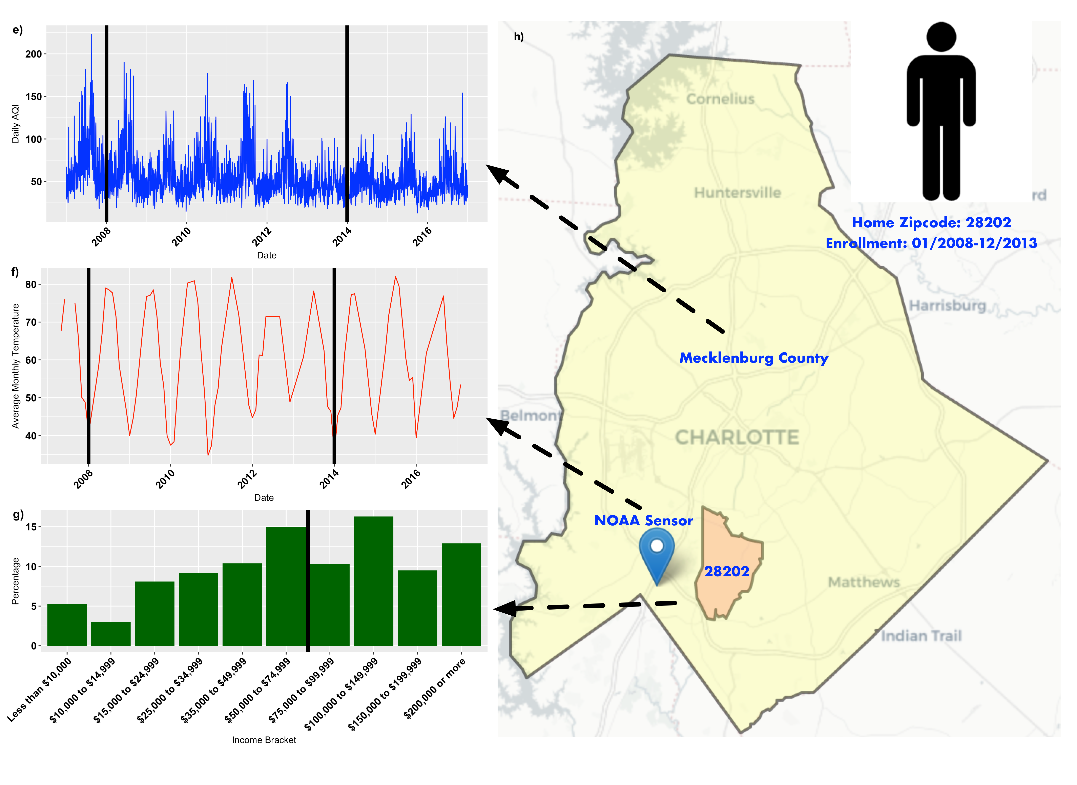
ExposomeDW integrates data across different geographical and temporal modalities
EPA
NOAA
ACS

Slide 12
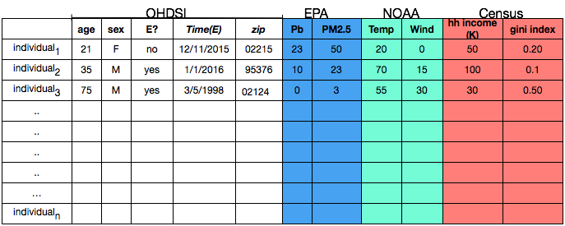
millions of patients

Slide 13
Will it work? yep!

Slide 14
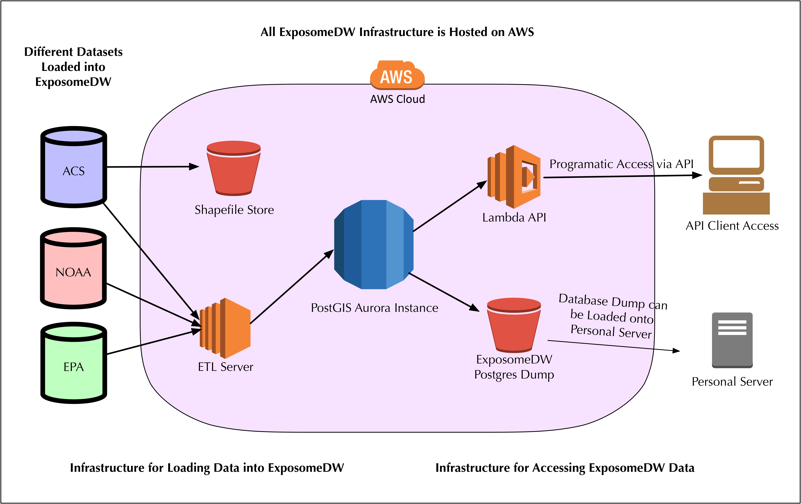
Developed infrastructure to store and access geotemporal environmental datasets

Slide 15
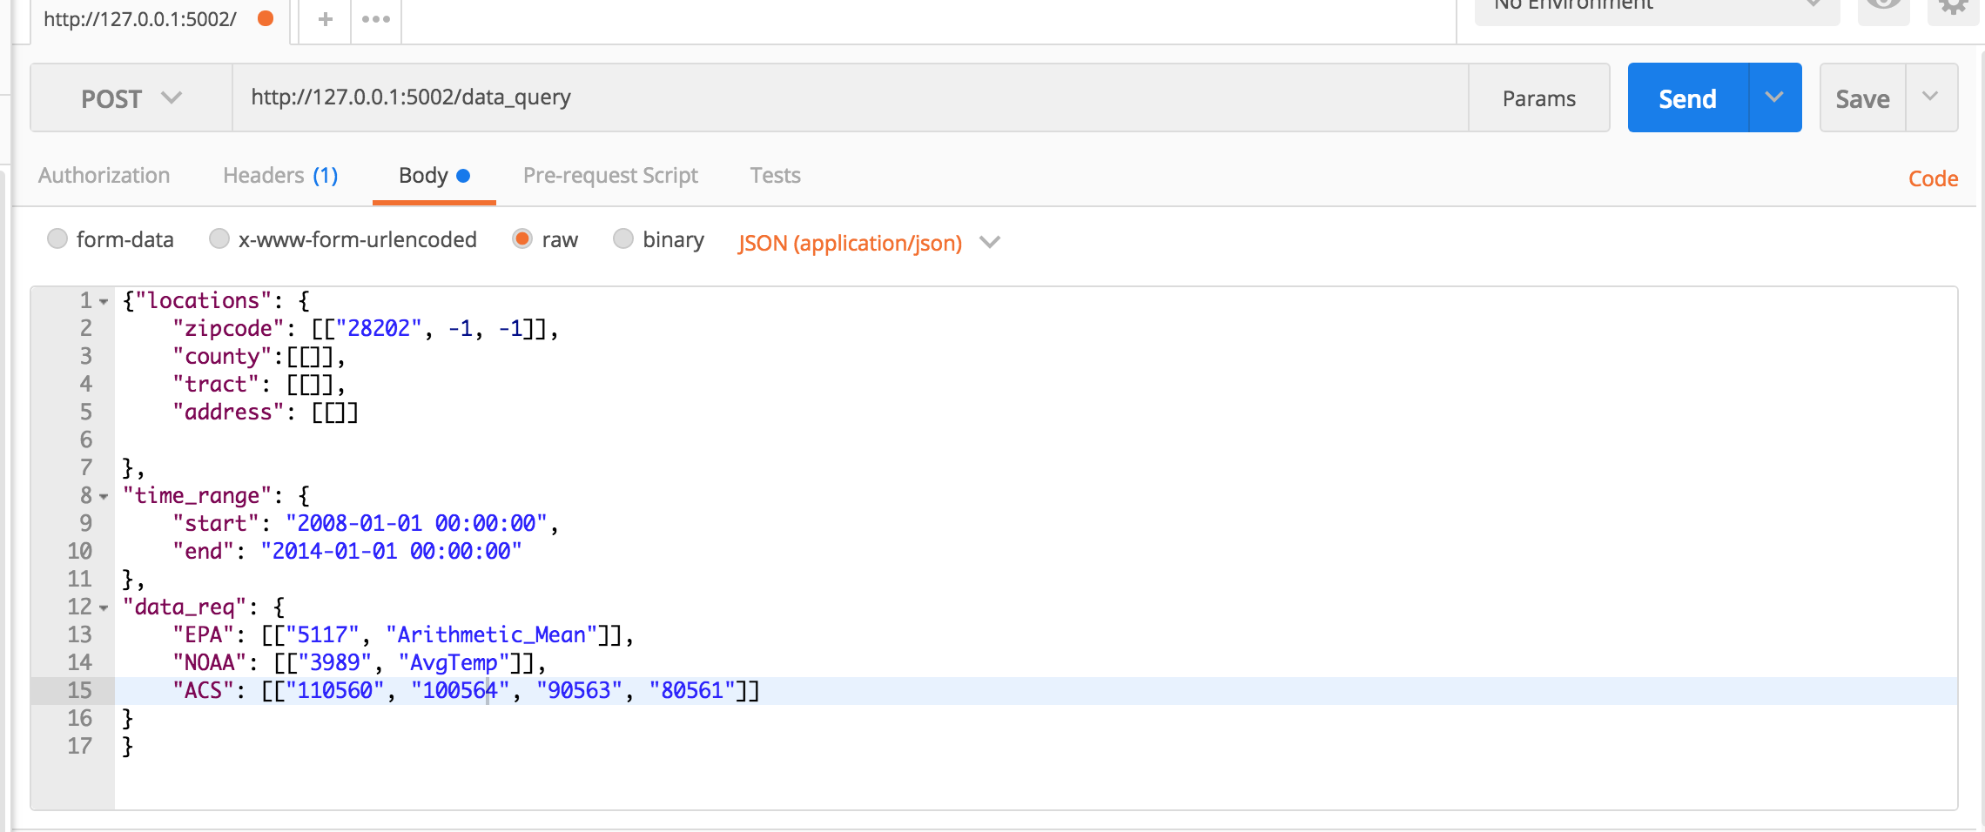
API enables simple programmatic access of ExposomeDW
API Input

Slide 16
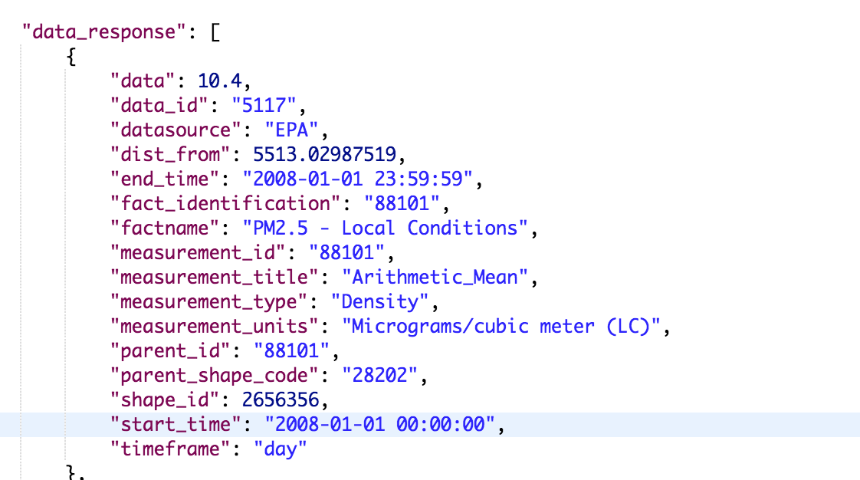
Extraction of EPA PM 2.5 Data from API

Slide 17
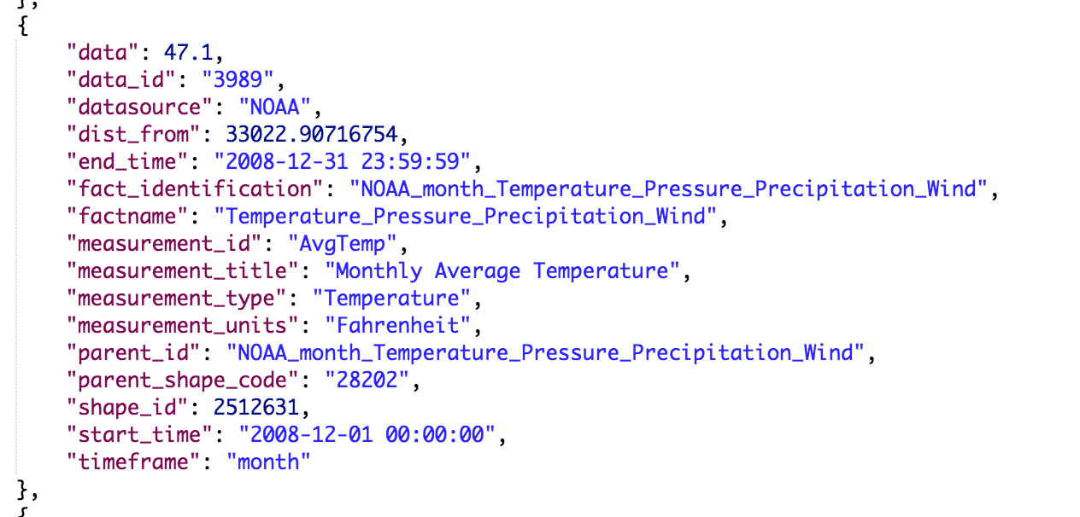
Extraction of NOAA Monthly Average Temperature Data from API

Slide 18
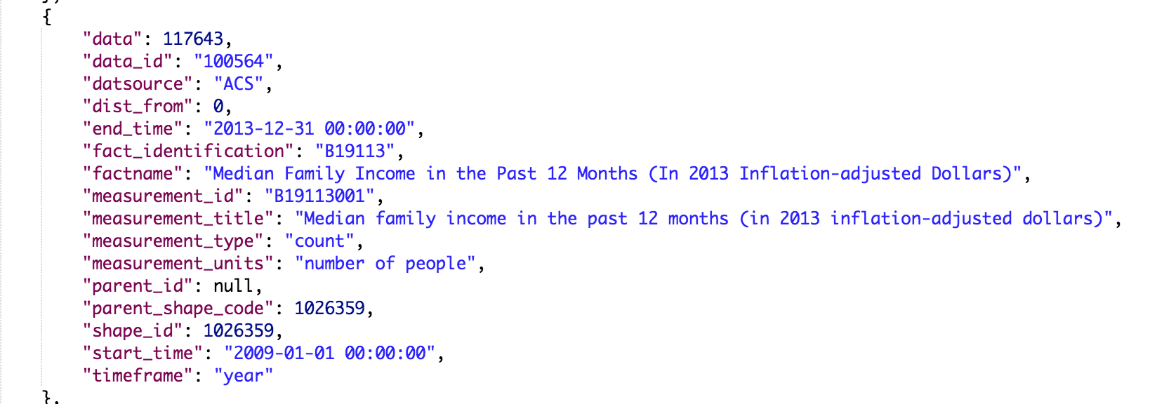
Extraction of ACS Median Family Income Data from API

Slide 19
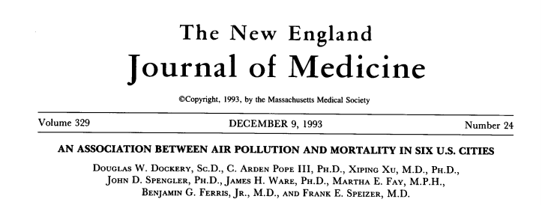
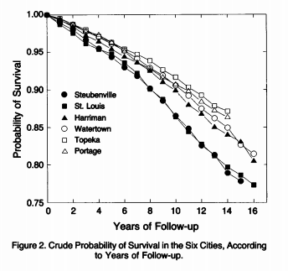
lower pollution
higher pollution

Slide 20
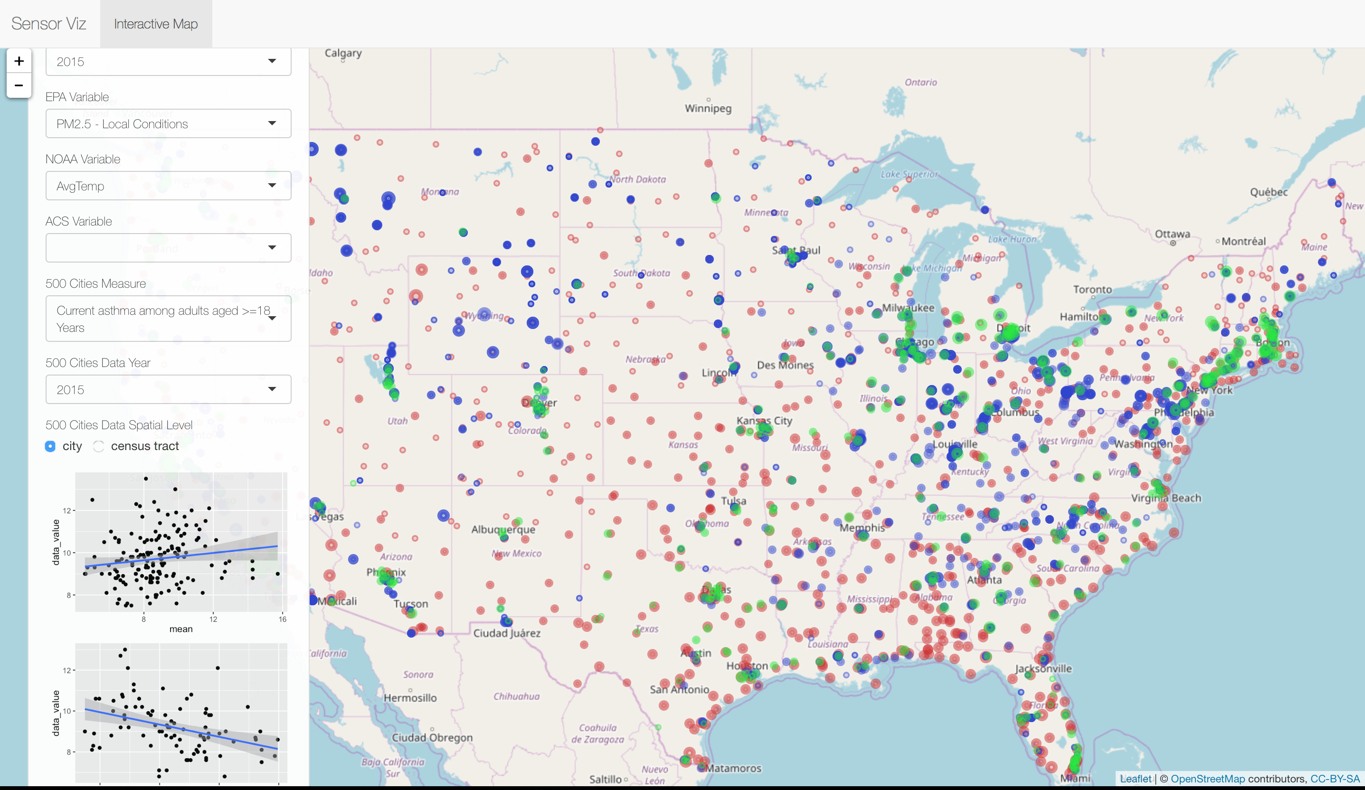
API will facilitate mashups of data such as CDC 500 Cities Data and ExposomeDW

Slide 21
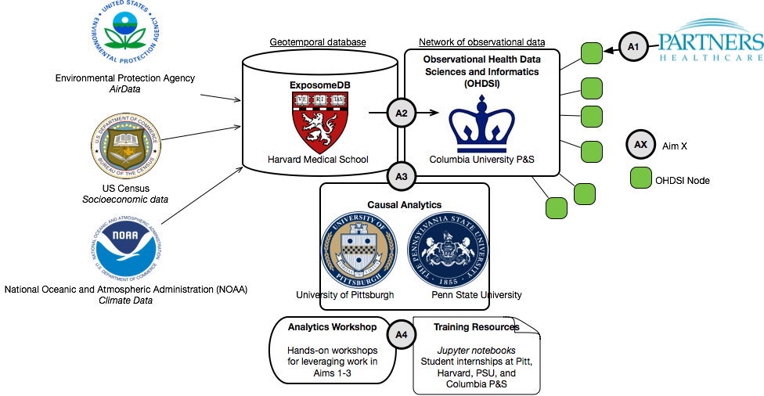
Integrating the ExposomeDW with OHDSI and causal modeling tools to drive and demonstrate discovery.

Slide 22





We will harness tools in machine learning extract signal from noise!
bayesian networks
PM2.5
air pollution
SES
asthma
socio-economic
ºF
Greg Cooper, MD, PhD
Pittsburgh
weather
case-crossover
Vasant Honavar, PhD
Penn State
Sci Rep 2016

Slide 23
Come to our afternoon breakout session
Introduction of ExposomeDW Data model
Hands-on exploration of ExposomeDW through SQL access
Introduction and exploration of ExposomeDW API
Exploration of 500 Cities Shiny App

Slide 24
Enhance accessibility of large open data and tools to
drive discovery of
environmental factors (E) in disease phenotypes (P)
Noémie Elhadad, PhD
Columbia
Greg Cooper, MD, PhD
Pittsburgh
Chirag Patel, PhD
Harvard
Vasant Honavar, PhD
Penn State

Slide 25


Thanks
RagGroup
Chirag Lakhani
Shreyas Bhave
Andrew Deonarine
Braden Tierney
Rolando Acosta
Noémie Elhadad (Columbia)
Vasant Honavar (PSU)
Greg Cooper (Pitt)
George Hripcsak (Columbia)
Harvard DBMI
Isaac Kohane
Susanne Churchill
Nathan Palmer
Sunny Alvear
Michal Preminger
René Baston
Katie Naum
Kathleen McKeown
NIH Common Fund
Big Data to Knowledge
  Chirag J Patel
  chirag@hms.harvard.edu
  @chiragjp
www.chiragjpgroup.org

