Slide 1
Algorithmic Bias in Health Care Delivery–Opportunities and Challenges
Norma A. Padrón, PhD
Associate Director –Population Health Research
MLHS Center for Population Health Research at LIMR
Thomas Jefferson University
New York, 2018

Slide 2
Outline
About me and prior work in applied research
The increasing complexity of health care delivery
Investment in R&D in Health Services Delivery
Algorithmic Bias
Opportunities and challenges for applied R&D in Health Care

Slide 3
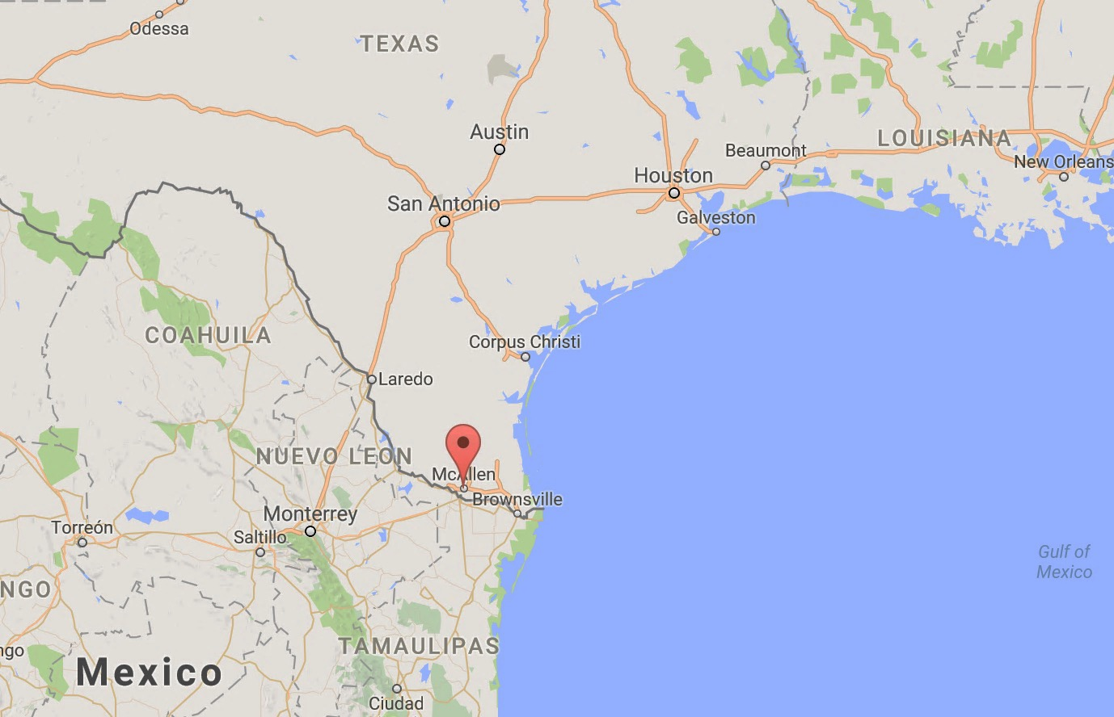
About Me

Slide 4
About Me
Associate Director –MLHS Center for Population Health Research
Assistant Professor –Thomas Jefferson College of Population Health
Chair –Industry Advisory Board of the National Science Foundation Center for Health Organization Transformation
Previously:
Assistant Professor of Health Economics –Icahn School of Medicine at Mount Sinai
Research Scientist –Center for Health Innovation, The New York Academy of Medicine

Slide 5
Some of my prior work
Collaborating with cities and states for the design, implementation and evaluation of policies to advance health
San Antonio, New York State and City, Philadelphia
New York State Health Foundation, Robert Wood Johnson Foundation
Engagement with local organizations and initiatives: East Harlem coalition, age-friendly NYC

Slide 6
Some of my prior work
Collaborations with payers and health plans to design and evaluate pilot interventions to address health needs of patients with multiple risks/conditions
Sickle cell disease, liver cancer and post-partum care setting

Slide 7
Some of my current work
The Center for Population Health Research (CPHR) at MLHS is a joint effort between Main Line Health, the Lankenau Institute for Medical Research and the Jefferson College of Population Health.
The central focus of CPHR is to advance population health research and implementation strategies across MLHS

Slide 8
Outline
About me and prior work in applied research
The increasing complexity of health care delivery
Investment in R&D in Health Services Delivery
Algorithmic Bias
Opportunities and challenges for applied R&D in Health Care

Slide 9
Increasing Complexity of Health Services Delivery
Service lines
Primary Care
CV
Cancer
MSSP
HQEP
Bundles
Commercial
Devices
Partnership
Bundles
Post Acute Strategies

Slide 10
Increasing Complexity of Health Services Delivery
Service lines
Primary Care
CV
Cancer
MSSP
HQEP
Bundles
Payment and Delivery Models
Commercial
Devices
Partnership
Bundles
Post Acute Strategies

Slide 11
Increasing Complexity of Health Services Delivery
Service lines
Primary Care
CV
Cancer
MSSP
HQEP
Bundles
Payment and Delivery Models
Commercial
Devices
Partnership
Bundles
Coordination and Management
Post Acute Strategies

Slide 12






Investments Needed to Compete in the ”New World” of Care Delivery
Integrated EMR
ACO
Regional scale for contractual leverage
Vehicle to support medical team model
Unscheduled, Convenient, Low Acuity Care
Urgent Care centers and “Day Hospital” centers
MLHC Primary Care
Distributed access to MLH PCPs across region
Post Acute Management
SNF management process
Regional patient access via ACO contracts
Shared learning and infrastructure for population health management
Clinically Integrated Network
Legal structure to share savings, infrastructure, data, with non-employed med staff
Shared learning and infrastructure for population health management
Telehealth, virtual visit platform
Retail Clinic joint venture
Increased access to PCP offices for unscheduled care
Resources to manage high risk (complex, elderly) patients
Patient engagement - My Chart portal
High user functionality across multiple platforms – for clinical and business management
Home resiliency strategies (Home Care, Home MD visits)

Slide 13
Health Care Delivery Imperatives are Inherently Data-Driven
From individuals to populations
Distribution of outcomes
Data-driven understanding
Data volume
From individual clinician to team-based
Diversity in field expertise
Multiple processes, metrics
Need for bridging and translating
Variety of data sources
From healthcare (volume) to health and care (value)
Patient-Centric
Data driven decision-making
Data velocity

Slide 14
Outline
About me and prior work in applied research
The increasing complexity of health care delivery
Investment in R&D in Health Services Delivery
Algorithmic Bias
Opportunities and challenges for applied R&D in Health Care

Slide 15
Investment in R&D for Health Services Delivery
Total spending in health care is now at 3.3 trillion (~18% GDP)
Investment in Medical and Health R&D $171.8 Billion (2016)
Health Services research accounted for .3% of national health expenditures
a 20-fold difference in comparison with total medical research

Slide 16
Investment in R&D for Health Services Delivery
Innovations in how health care is delivered (e.g., health insurance structures, interventions to encourage the use of appropriate care, and care coordination approaches) are rarely evaluated using rigorous methodologies.
Between 2009-2013 only 18 percent of studies on the U.S. health care delivery were randomized studies.
Concepts like patient-centric care, value-based care, care coordination and interoperability of IT systems though commonly used across systems, remain understudied.
Finkelstein, Amy, et al. "Using randomized evaluations to improve the efficiency of US healthcare delivery." J-PAL North America, Cambridge, MA (2014).

Slide 17
Moses H, Matheson DHM, Cairns-Smith S, George BP, Palisch C, Dorsey ER. The Anatomy of Medical Research US and International Comparisons. JAMA. 2015;313(2):174–189. doi:10.1001/jama.2014.15939

Slide 18
Outline
About me and prior work in applied research
The increasing complexity of health care delivery
Investment in R&D in Health Services Delivery
Algorithmic Bias
Opportunities and challenges for applied R&D in Health Care

Slide 19
Algorithmic Bias
the worry or finding that an algorithm is, in some sense, not merely a neutral transformer of data or extractor of information resulting in potential harms or undesirable outcomes according to societal, moral or otherwise preferred standards

Slide 20
Redesigning the process of delivery To address and prevent bias
Products + Replicability
Data gathering
Analysis

Slide 21
Goals for Tool-building and Applied R&D
Cumulative knowledge: Research and data products as resources
Efficiency and speed
Improved capacity: Strengthen existing and establishing new local partnerships
Collaboration
Bringing frontier research and evidence to practice and application
Rigor and relevance

Slide 22
Redesigning the process of delivery To address and prevent bias
5 core tenets:
Rigor and relevance
Efficiency and speed
Collaboration
Improved capacity
Cumulative knowledge
Glasgow, Russell E. et al. “National Institutes of Health Approaches to Dissemination and Implementation Science: Current and Future Directions.” American Journal of Public Health 102.7 (2012): 1274–1281. PMC. Web. 26 Feb. 2018.

Slide 23
Redesigning the process of algorithmic design for health care delivery
Data from Whom?
Who will the users be?
Where are the available data assets be aggregated and maintained a resource for automation?
What questions are relevant and to address existent and prevent potential harm from algorithmic bias?

Slide 24



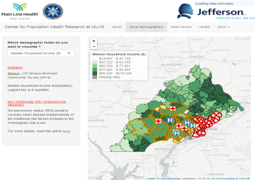





Example- Process
Data gathering
(csv, shp)
Data cleaning & Analysis
Prototype tool
Knowledge repositories
Data, and informed design
Aggregating Data and iterating design
Summarizing all relevant information
Prototypes, Interactive Visualizations
All-team access, lessons learned shared
Reuse, reuse, reuse

Slide 25
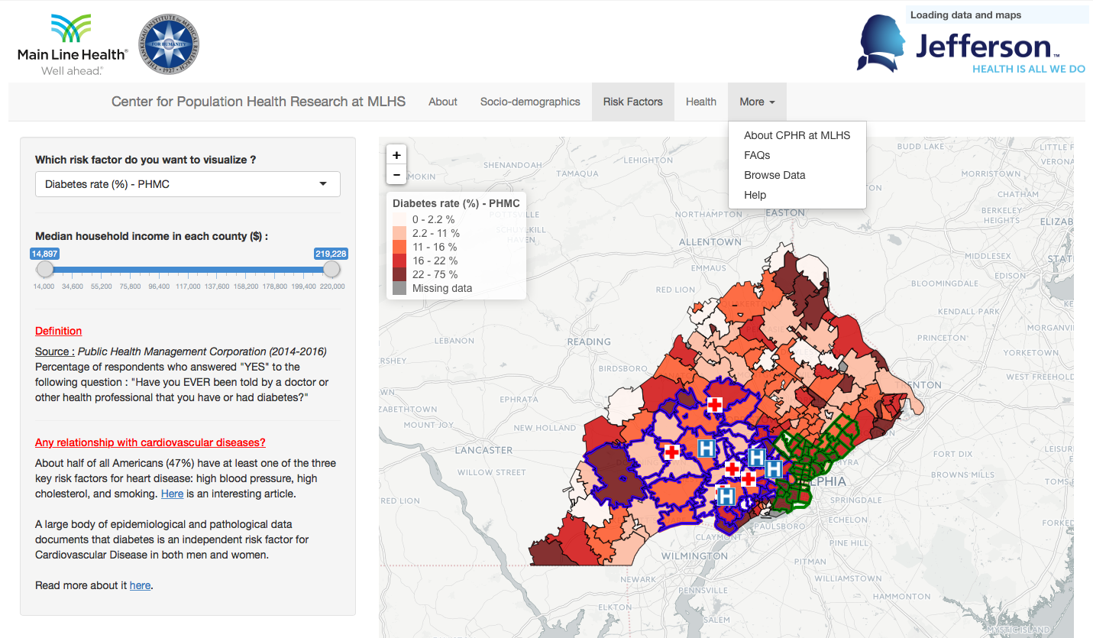
Population Health Dashboard
View only zip codes whose income is in the selected range
Select one of these tabs
Select one factor
Additional tabs for more details
Additional information Definitions and Evidence Base from Academic Literature
Interactive map
https://cphratlimr.shinyapps.io/CPHR_PopulationHealthDashboard/

Slide 26
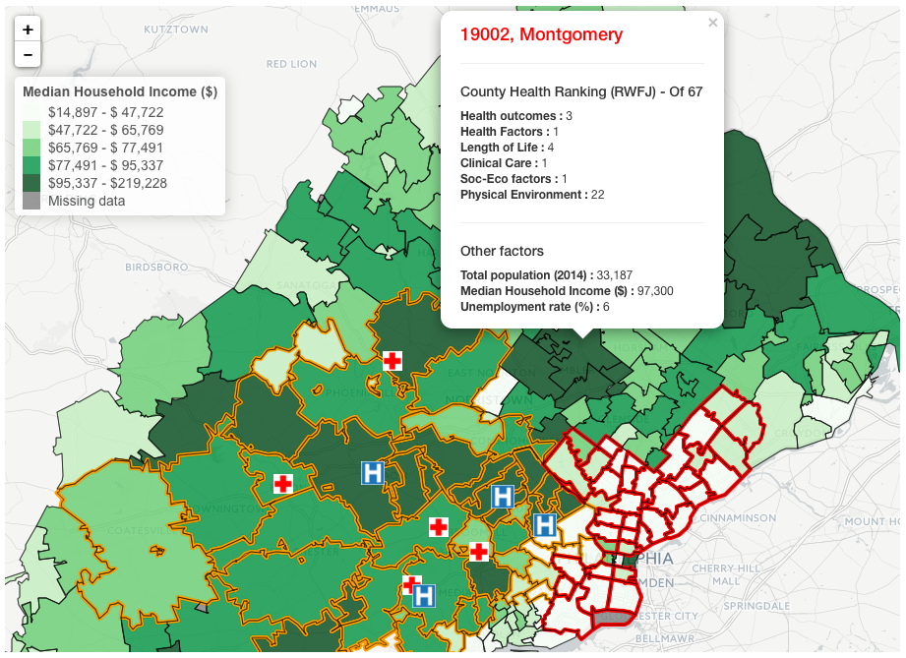


Population Health Dashboard
Legend. Colors may represent quintiles, bins or categories
RWJF Health scores for each county
When you select a Social determinant of health, this information changes
Regions where MLH operates
Planning Districts from Philadelphia Community Health Assessment
Main Line Health
Hospitals
and centers
https://cphratlimr.shinyapps.io/CPHR_PopulationHealthDashboard/

Slide 27
Final Thoughts

Slide 29
Thank You!
T: @NormaPadron_
E: PadronN@mlhs.org

