Slide 1
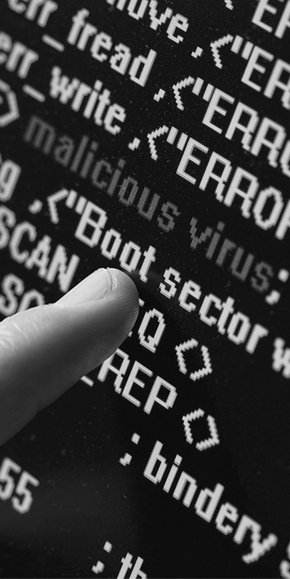
Cross-organization Big Data Cyber Attack Awareness
NSF Big Data Spoke Planning Project
in collaboration with NSF Northeast Big Data Hub
John Yen
College of Information Sciences and Technology
The Pennsylvania State University
Northeast Big Data Hub Workshop
February 24, 2017

Slide 2
Project Team
John Yen, PSU
Peng Liu, PSU
Vijay Atluri, Rutgers
George Cybenko, Dartmouth
Andrew Sears, PSU
Don Welch, PSU
Nabil Adam, Rugers
Robert Erbacher, Army Research Office/Lab
Mudhakar Srivatsa, IBM
Vasant Honavar, PSU
Adam Smith, PSU
Kathleen McKeown, Columbia
Rene Baston, Executive Director, Northeast Big Data Hub
Katie Naum, Project Coordinator, Northeast Big Data Hub

Slide 3
Goals of the Spoke Planning Project
Identify obstacles for network security analysts in different organizations to share cyber attack information currently not available
Develop one or multiple approaches to address the obstacles
Demonstrate feasibility of the approach
Submit a Spoke proposal based on the approach

Slide 4
Existing Resources for Sharing Cyber Threats Information
Resources and Platforms | Online Community | Threat Intelligence or Signatures | Historic Data for Researchers | Near Real-time Cyber Attack Information for Analysts
Cyber Threat Alliance (CTA) |  | CryptoWall ransomeware
VirusTotal.com | VirusTotal Community | Search for virus scan report for a given URL/IP address
The Swiss Security Blog |  | Ransomeware tracker, ZeuS tracker, SSL Blacklist, SpyEye tracker, Feodo banking Trojans Tracker
Educause | Guides of cyber security for higher education
BTAA (formally CIC, Big Ten + Univ. of Chicargo) | Listserv for CISO, analysts | Establishing agreements for sharing threat information
EDUCAUSE | Online Forums and Blogs
REN-ISAC (Research and Education networking information Sharing and Analysis Center0 | Listserv for members E-mail based incident report and alerts
MS-ISAC | Limited Listserv usage | Reports on known compromised hosts
Shadowserver |  | Daily vulnerability testing service; Information on honeypots
FIRST |  | Require fees; starting a project for accessing incident reports from CSIRTs
National CSIRT (Computer Security Incident Response Team) | Collaboration wiki
Team Cymru |  | Requires fees; Service to provide daily feed of malware signatures; botnet; botnet C2; and URLs involved.
Malware-traffic-analysis.net | Blogs about malware | Most blog entries contain pcap files and/or malware samples
Isc.sans.edu/diaryarchive.html | Forums, Blogs, and Podcasts | Statistics of threats by categories, countries, and time
Blog.dynamoo.com | Posts to share threats (e.g., malware spams)
Spamcop.net | Receive reports on spams, alert ISP, publish blocking list
Facebook ThreatExchange |  | Share threat signatures among members
Financial Services Information Sharing and Analysis Center (FS-ISAC) | Alert feed to members
NIST National Cybersecurity Center of Excellence (NCCoE) | Blog and use cases
The New Jersey Cybersecurity and Communications Integration Cell (NJCCIC) | Issue vulnerability and threat alerts
DHS Information Marketplace for Policy and Analysis of Cyber-risk and Trust (IMPACT) |  |  | Datasets for researchers through an application process
DHS United States Computer Emergency Readiness Team (US-CERT) | Issue vulnerability and threat alerts, with recommended solutions | Standard: Trusted Automated eXchange of Indicator Information (TAXII), STIX (threat), CybOX (observable)
DHS Industrial Control Systems Cyber Emergency Response Team (ICS-CERT) | Issue alerts regarding critical infrastructure
DHS Automated Indicator Sharing (AIS) |  | Sharing threat indicators
DHS Daily Open Source Infrastructure Report | Daily open source reports on critical infrastructures
InfraGrad | Daily reports and news on critical infrastructures
The High Technology Crime Investigation Association (HTCIA) | Yearly reports on cyber crime investigation
High Tech Crime Consortium (HTCC) | A Listserv for international members regarding digital, cyber, or online crimes
Security Management of ASIS International | A portal for cybersecurity news, blogs
International Information System Security Certification Consortium (ISC)² | (ISC)² Blog with categorization

Slide 5
Identify Obstacles/Objectives for Cross-organization Sharing of Near Real-time Cyber Attack Information
Requires a Deep Level of Trust
Needs to Add Critical Values to Existing Tools
Needs to Protect Sensitive Information and Privacy
Needs to Be Compliant with Rules and Regulations
Needs to Facilitate (not Complicate) the Workflow of Analysts

Slide 6
Activities to Develop Trust
Identify key stakeholders of institutions
Office of Information Security: CISO, Network Analysts
Office of Risk Management
Office of General Counsel
Provost/VP Office
Conduct multiple meetings and telecons to explain our vision
Invite them to attend a Spoke Planning workshop to meet other stakeholders from other institutions

Slide 7
The BD Spoke Planning Workshop
Held on November 11th
Attended by representatives of all key stakeholders from four organizations (Penn State, Rutgers, Dartmouth, Columbia)
Gave a hands-on demo of a simple cross-organization cyber attack information sharing tool.
Using the tool to elicit feedback through panel discussions
A Panel of Analysts
A Panel on Concerns of Information Sharing
Adapted the afternoon panels to focus on issues raised

Slide 8
Summary of Feedback
Analysts would like to know “what the other analysts knew about ongoing attacks”
1-1 peer exchange can be extended to broadcast within the trusted community
Should aim to leverage distributed Big Data about network flows and related information

Slide 9
Goal of Spoke Proposal
Enable organizations to share cyber attack patterns that involve multiple steps
Add values to existing tools
Sensitive information can be abstracted to less sensitive ones, but still useful to other organizations
Can facilitate distributed Big Data analytics of network flows and related information
Enable collaborative and coordinated cyber defense across multiple trusted organizations

Slide 10
Leverage
BigTen Alliance (including Univ. of Chicargo) had a parallel effort to share Indicators of Compromise (IOC)
NIST standards for threat signatures (STIX) and exchange framework (TAXI)

Slide 11
Current Planning Activities
Developing a representation of cyber attack patterns
Developing agreements between the four organizations (Penn State, Rutgers, Dartmouth, and Columbia)
Developing a pilot study to demonstrate feasibility
Developing the Spoke proposal

