Slide 1
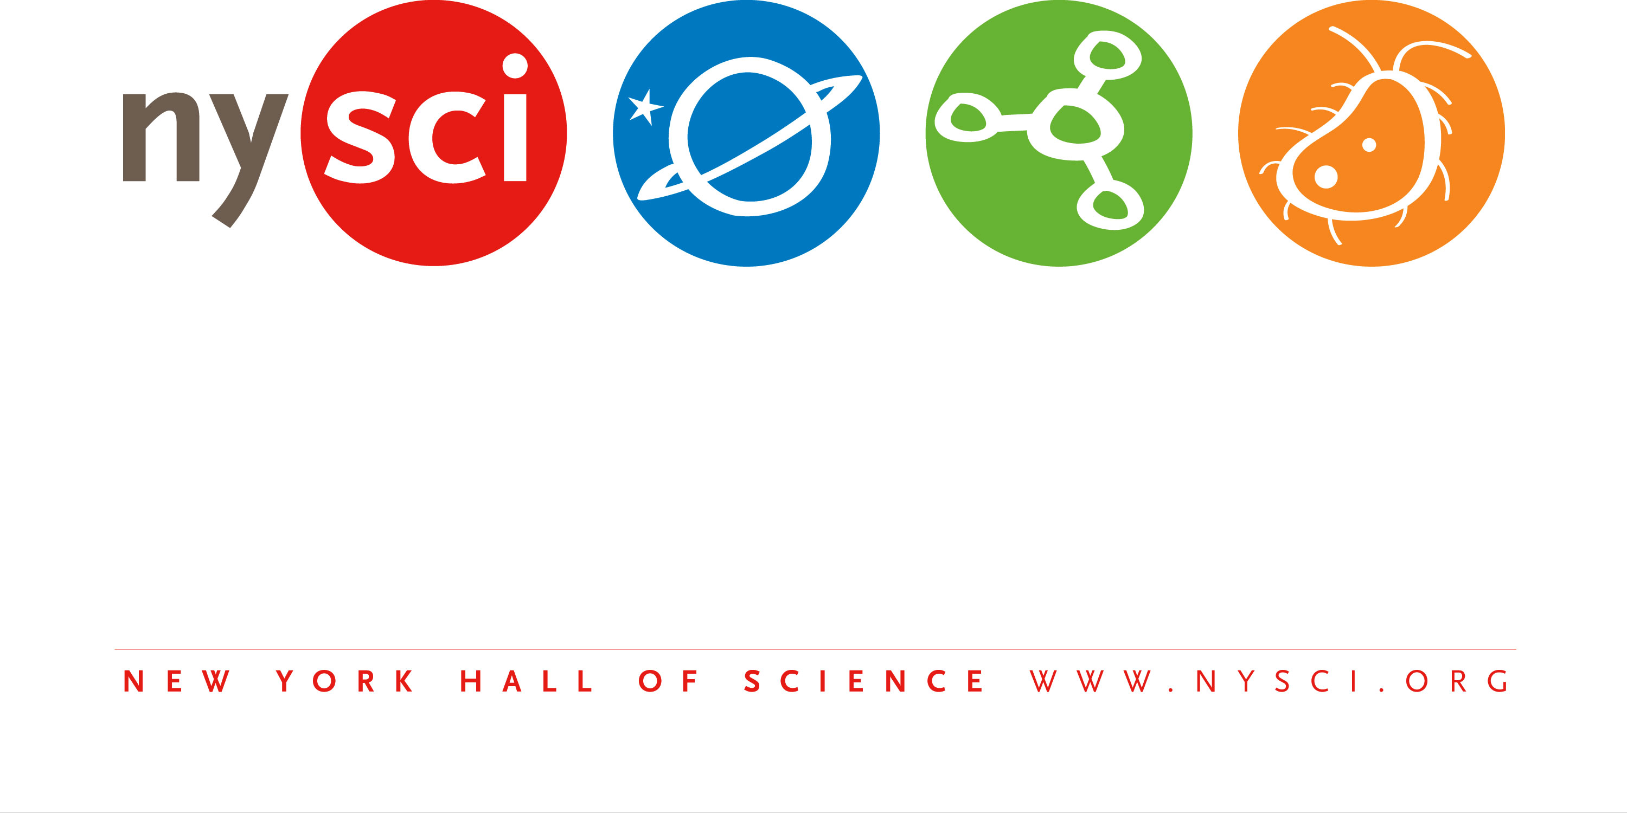

Slide 2
Northeast Big Data Innovation Hub
Big Data Literacy
Notes:
So I’m here from the New York Hall of Science to talk about Big Data Literacy and how we are hoping to address the need to bridge the gap between data-driven science and technology practice and the public understanding of big data and big science.

Slide 3
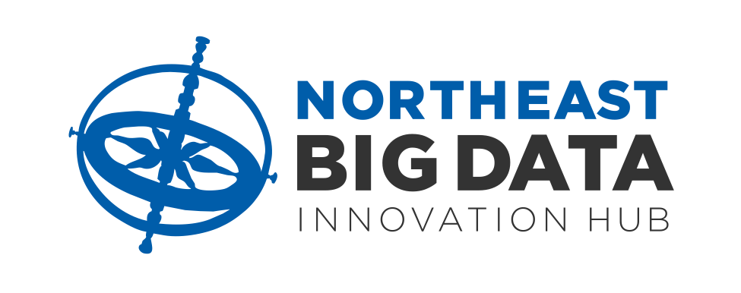
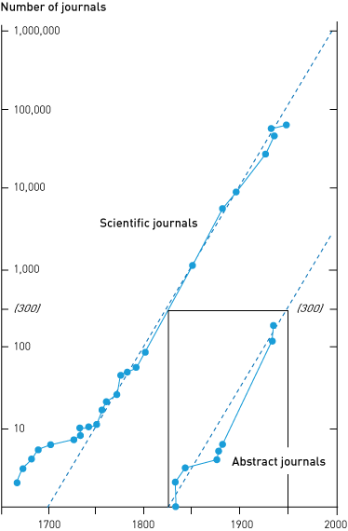
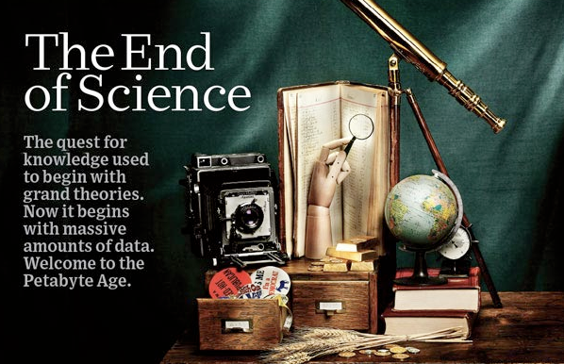
The End of Science?
Graph: Price, 1961 / Graphic: Wired, 2007
Notes:
First I’d like to provide a little context for this need. As all of you are aware, we live in an age in which traditional science, in fact virtually every sector, indeed every aspect of human culture is flooded with data. Believe it or not, this transformation was preceded by a period in which the future of science was in doubt. At the 6th International Congress on the History of Science, Derek DeSolla Price predicted the exponential growth of science would make research become so complex and costly, we would soon exhaust our ability to support science as an enterprise. That was in 1950.

Slide 4
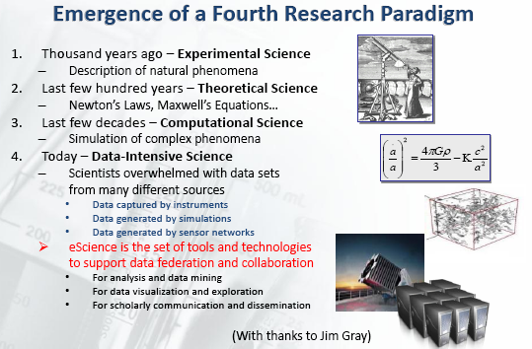
Data Driven Science
The Data Revolution
Now we are drowning in data
eScience: “The 4th Paradigm”
Graphic: Microsoft, 2009
Notes:
But by the turn of the millennium our ability to acquire process and store data accelerated rapidly, largely due to advances in computer power and cheap and automated data capture systems for everything from DNA sequencing to remote sensing. We are now gathering data at such a fantastic rate that we are drowning in it. Science and engineering have been transformed and we are replacing Kuhn’s law about scientific paradigmatic shifts taking a generation with a kind of “Moore’s law for data-driven science,” an exponential growth in what Jim Gray called the 4th Paradigm of Science. In an era in which computer users world-wide generate enough digital data every 15 minutes to fill the U.S. Library of Congress, our ability to gather data has vastly outstripped our ability to analyze it all.

Slide 5
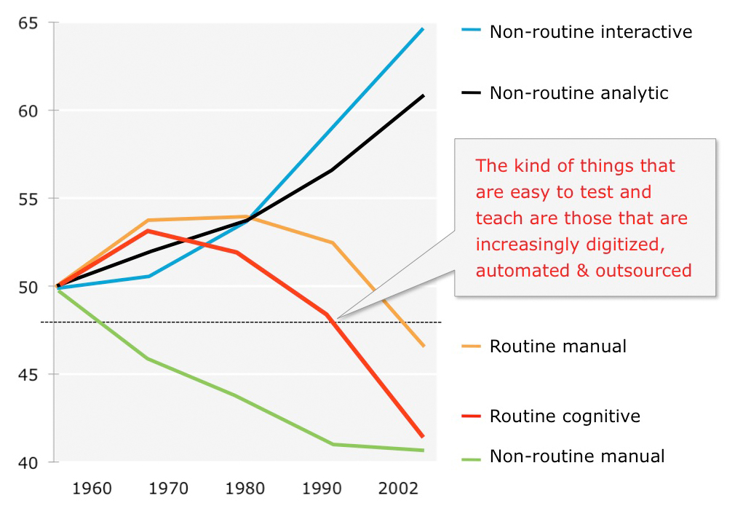
Transformation of the Workplace
Graph: Autor, Levy, & Murnane, 2003
Notes:
And the science and technology community are in a great hurry to catch up with machine learning, optimization, crowdsourcing, Map/Reduce. AI and neural computing, and new (or old depending on how you look at it) statistical techniques like TDA. And the rest of human civilization is largely just along for the ride, or more accurately, left in the dust. Its kind of like being in a space race against ourselves.
And the kinds of skills demanded by everything from startups to Fortune 500 companies, to research labs have dramatically shifted away from a focus on individual compartmentalized skills in hierarchies; to nimble, highly creative, collaborative, interdisciplinary and analytical skills. The kinds of questions we ask of ourselves, the degree of complexity of nature at all scales, and the complexity of the problems policymakers, industry and citizens are called upon to solve are increasingly interdisciplinary, complex and data-driven. The routine, manual, and repetitive tasks are either completely automated, or no longer relevant.

Slide 6
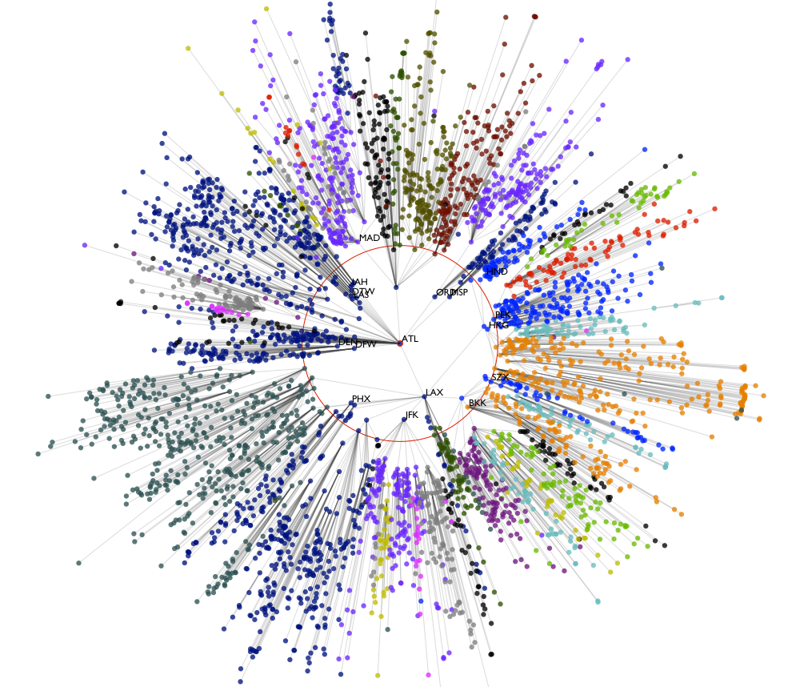
Closing the Gap
Graph: Landstorfer, 2013
Notes:
But we have the opportunity to transform human knowledge along with big data to bring the public along, which is not only the most ethically responsible thing to do, it is the only way this process can continue at such a rapid pace. Without a big data knowledgeable public, policy and education sectors, we are building ourselves a house of cards that will fall or be severely hampered purely through a lack of skills and intellectual prowess. This was the impetus for us to put a stake in the ground around big data literacy and start a process to build capacity that can scale throughout all big data domains. To close the gap between all of you and everybody out there.

Slide 7

Big Data Literacy: Building Capacity for Regional Collaboration in Closing the Big Data Divide
Notes:
So here is the title of our project, the goal of which is to articulate and propose a program of work to NSF that would address this gap and begin a path toward a big data literate society. It starts with getting a sense of what kinds of resources, educational programs, curricula, knowledge and needs are out there now.
In an ideal world, we would find many amazing resources and programs that would just need to be brought together with the public in better ways. And we would already be cultivating a generation of data literate individuals who can pursue academic and work careers in big data and advance our work in ways we can currently only imagine. But indications are that there are likely inadequate resources out there that help the public understand what big data is, how it works, what the effect is on their lives and the lives of the people around them and across the globe.
And there do not appear to be adequate academic programs to support workforce development and align the skills and competencies of our citizens with the needs of the scientific and technological workplace.

Slide 8
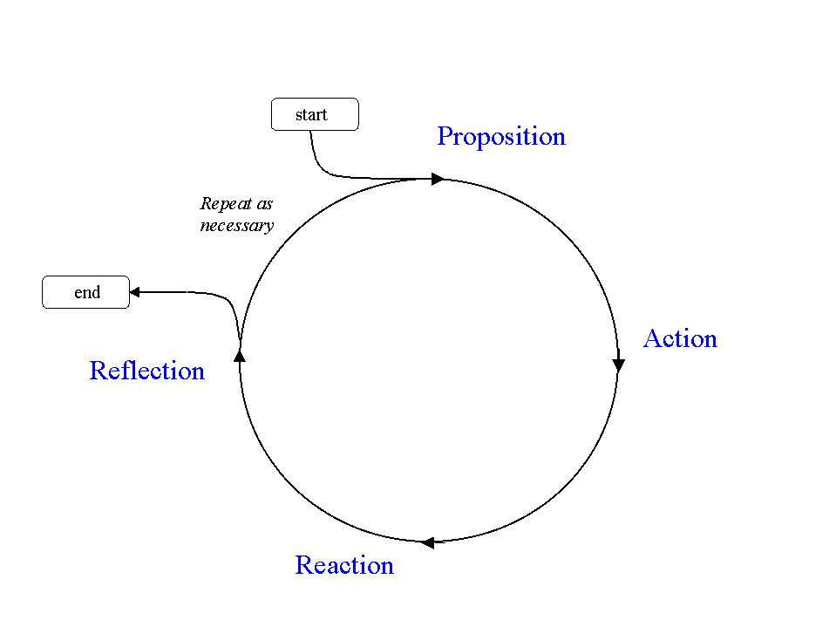
Collaborative Inquiry
Graphic: Alexander, 1998
Notes:
To figure out if our intuitions are correct, we started a collaborative process by assembling an inquiry group from NEBDIH members to research and explicate the state of big data learning, then bring them together with a group of experts to validate conclusions and look at what it will take to fill the gap between this snapshot and big data practice across all settings and domains of work. Collaborative Inquiry is a kind of action research that starts by circumscribing the problem, in this case defining the state of big data literacy, then take action based on the initial proposition, research and develop a snapshot of the resources, programs and projects that exist to support the understanding of big data across audiences and learning settings, convene to debate the validity and significance of these results, then reflect on the implications and impact on the original question to determine whether the process needs revision.
This process will define the “What it takes” part that we will propose to NSF as the work of this Spoke, which will function more as a set of parallel fibers along the rest of the network edges that connect the work of the NEBDIH.
Assuming we get support for this spoke (or even if we don’t ) we will be calling on you to participate in fostering improved understanding in an era of big data.

Slide 9

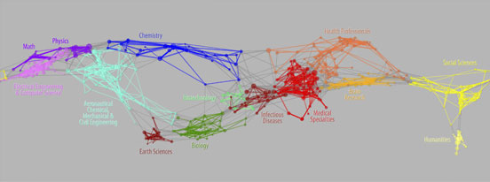
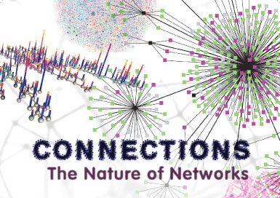
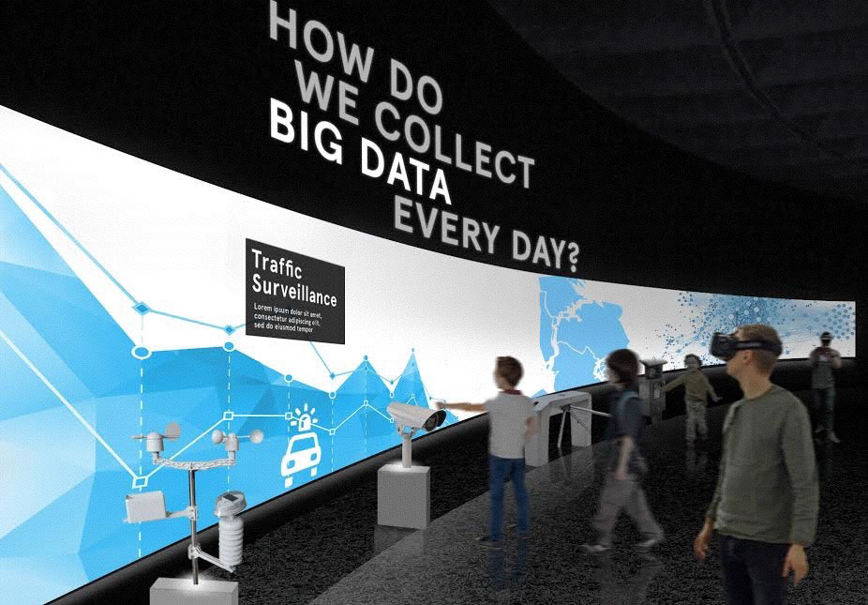
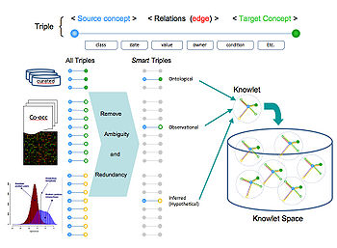
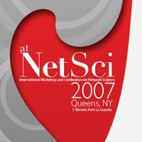
Current Work
Complex Networks
Scientometrics
Developmental Skills
Data Driven Sciences
Smart Cities
Graph: Börner, Klavans, Patek, Zoss, Biberstine, Light, Larivière, & Boyack, 2012
Notes:
Before I close, I would like to just give you a sense of what the New York Hall of Science is already doing in big data and big science that led us to this point. This work includes:
- Teaching and learning in the science of complex networks, including the first museum exhibition, international conferences and workshops, a high school research program for disadvantaged teens, annual international symposia, a set of agreed upon essential network literacy concepts, translated into 19 languages. And we are now working on teacher training programs, and will be cosponsoring our 3rd one this summer.
Early and continued involvement in scientometrics and Sematic Web development, including international workshops and magnet conferences, partnering with the development of traveling science mapping exhibitions, and research in data visualization and understanding
A series of workshops to study data literacy skills in very young children and an exhibition on big data for the public
Programs, exhibitions and outreach on data-driven sustainability, ocean & estuary science and climate sciences.
And work at the intersection of communities of need and Smart Cities. And yes we put in a Smart and Connected Communities proposal last week.
Through an official spoke, and our involvement in the NEBDIH we hope to amplify our efforts, draw in additional partnerships and support, and scale this work globally.

Slide 10
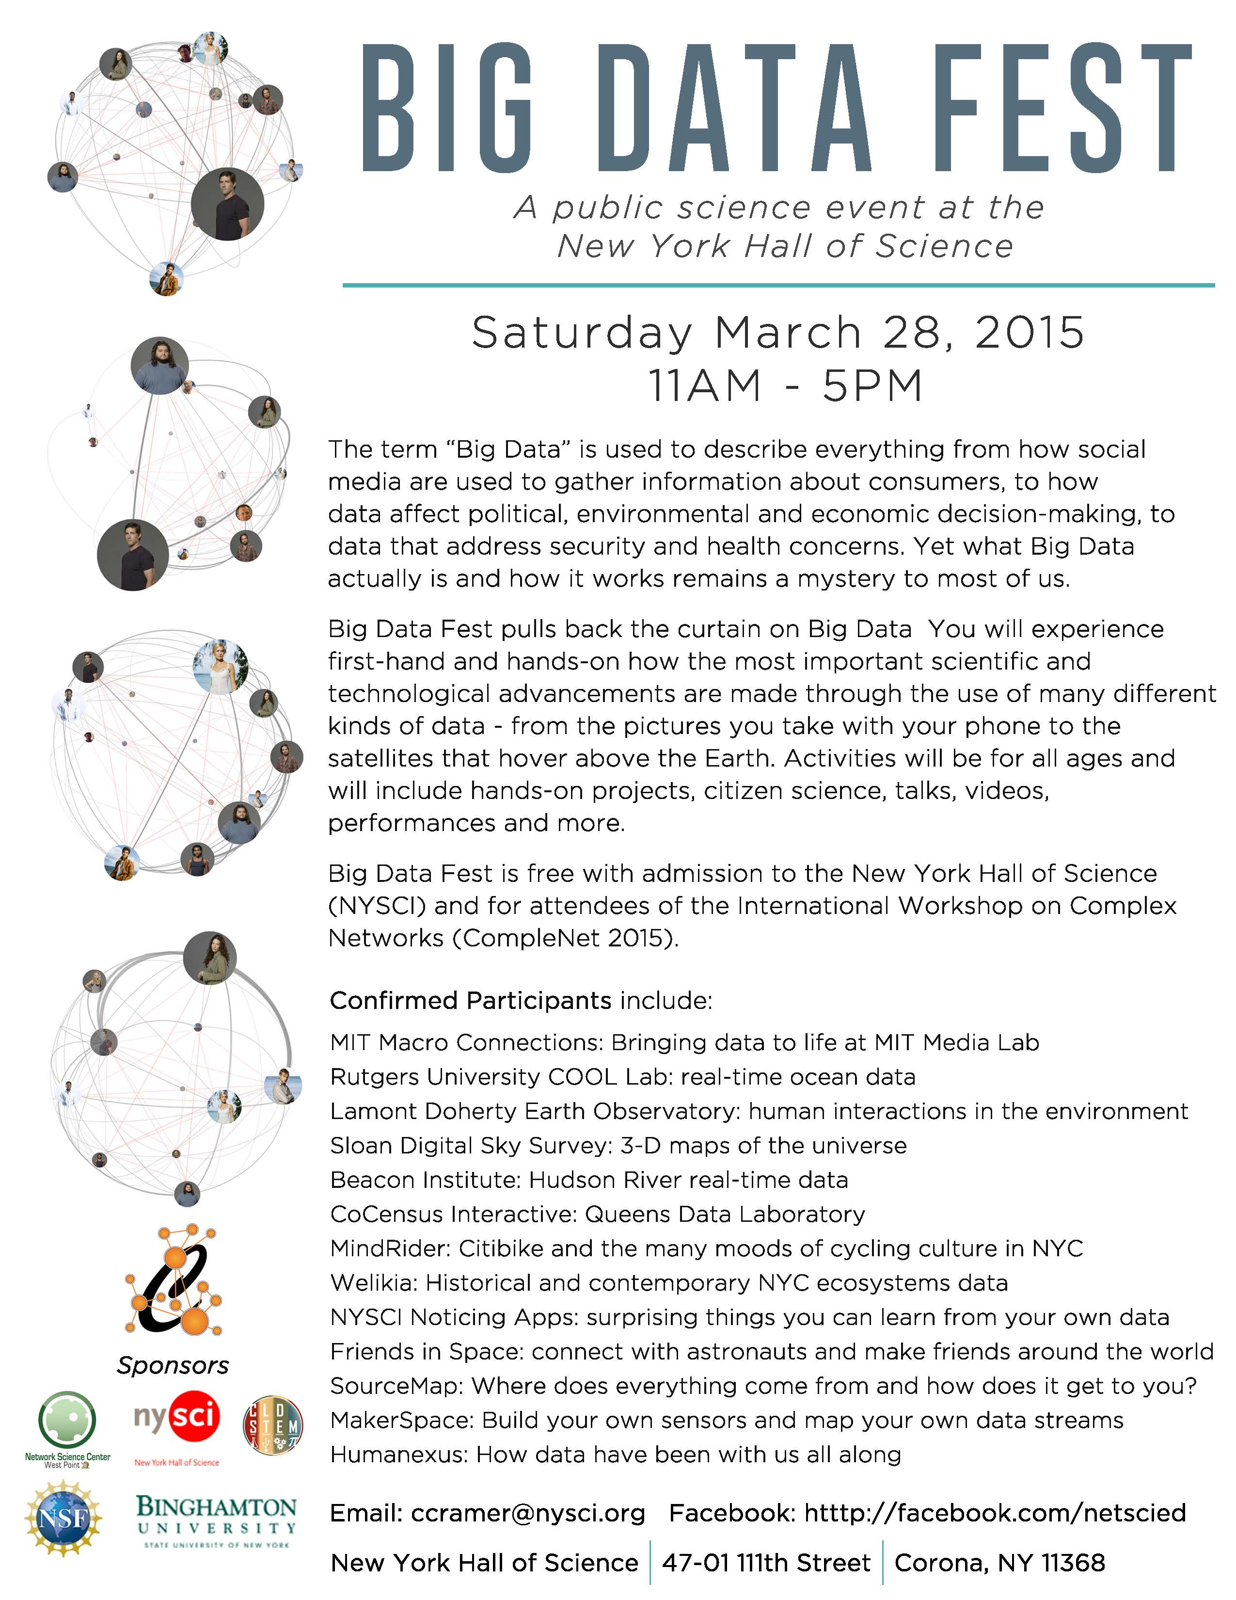
Notes:
We also held possibly the first public festival for big data in 2015

Slide 11

Support
Funding provided by the NSF CISE –
IIS award 1636736
Additional Support from the Northeast
Big Data Innovation Hub
Notes:
Finally, I would like to acknowledge support for this project under the National Science Foundation Computer & Information Science & Engineering research area Division for Information and Intelligent Systems and additional support from the Hub.

Slide 12
