Slide 1
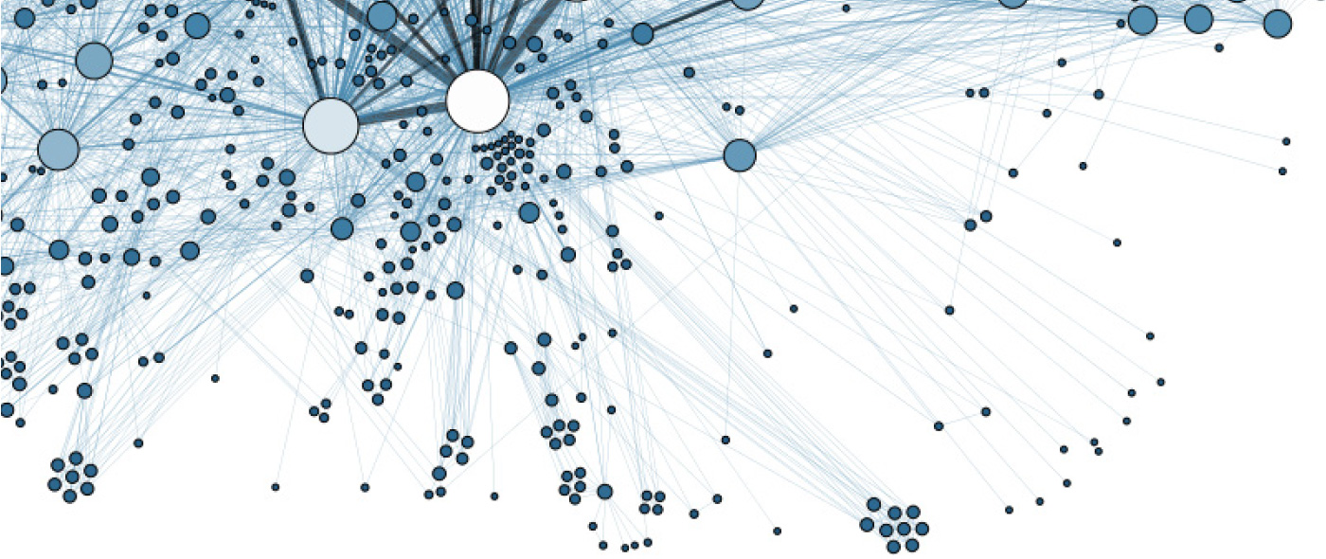

Data Sharing Spoke
Northeast Big Data Innovation Hub
Carsten BinniG (Brown), Jane Greenberg (Drexel),
Tim kraska (Brown), Sam Madden (Mit)

Slide 2
Why Is Data Sharing Important!
Different Reasons
Combining Data
Sharing with Experts
…
Promise: Better Insights
into “Big Data”

Slide 3
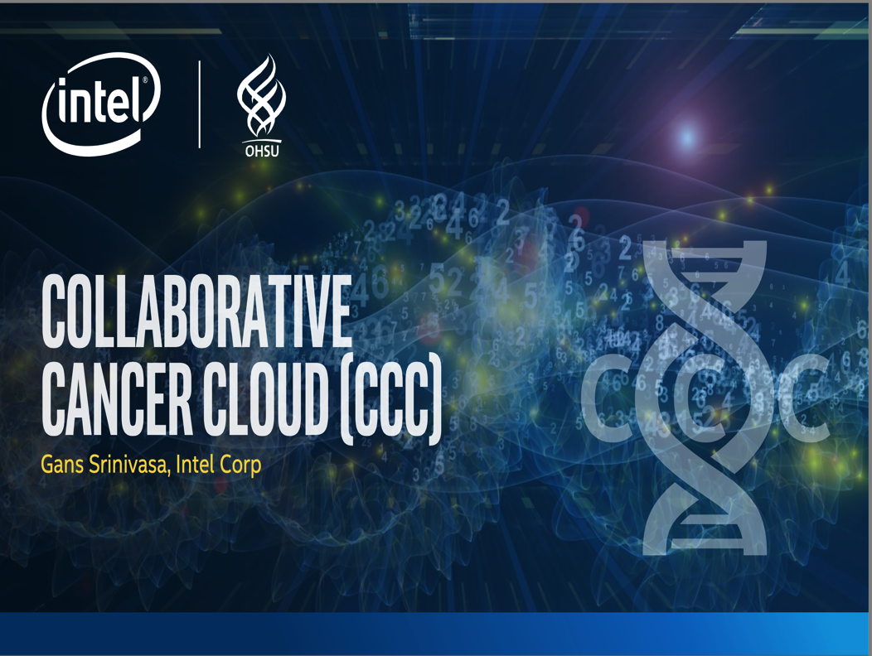
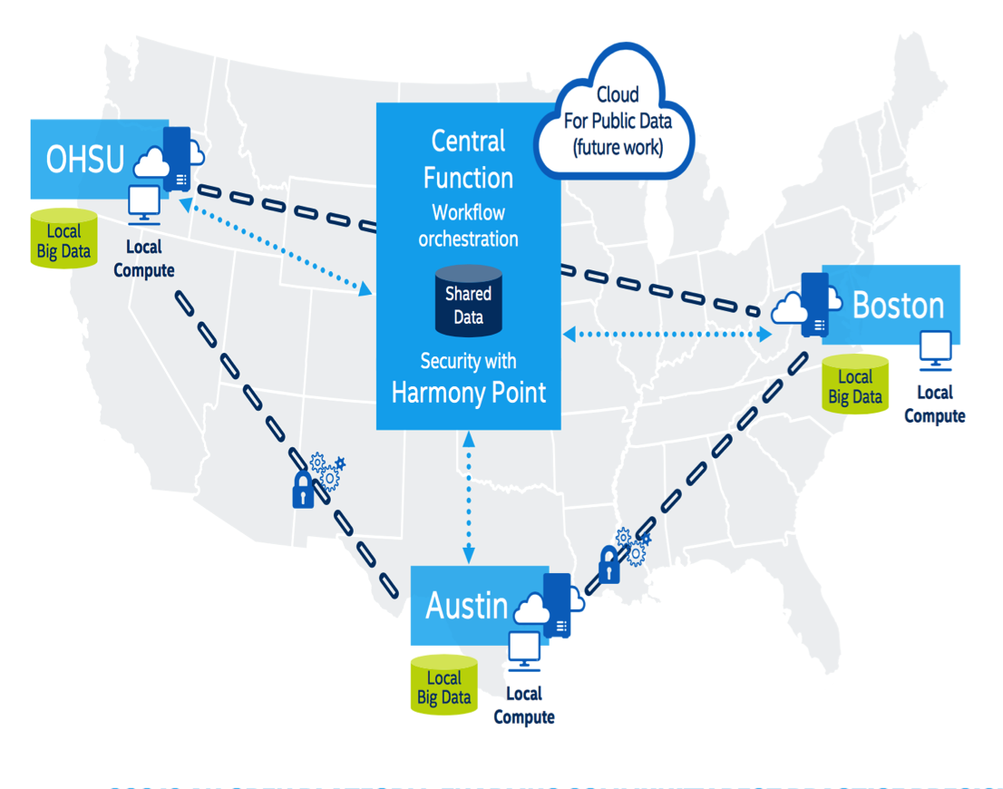
Combining Data:
Collaborative Cancer Cloud
Secure genomic data sharing across our three institutions
Notes:
Indeed, Dana-Farber is one of three partners in the Intel CCC pilot; the other two are Oregon Health & Science University (OHSU) and the Ontario Institute for Cancer Research (OICR). All three of these partners are working together on a variety of projects (including, notably, research to identify previously unknown cancer-causing mutations) and coding new tools to aid their efforts, using the CCC.
The partners seem well-matched for each other collaboratively.
"We are working with Intel, OICR, and OHSU to develop a one-year pilot project to demonstrate secure genomic data sharing across our three institutions," explained Cerami. "Each of our institutions currently perform some type of genomic sequencing on patients, and the goal of the pilot project is to pool genomic data across all three centers and make it available for joint computation.

Slide 4
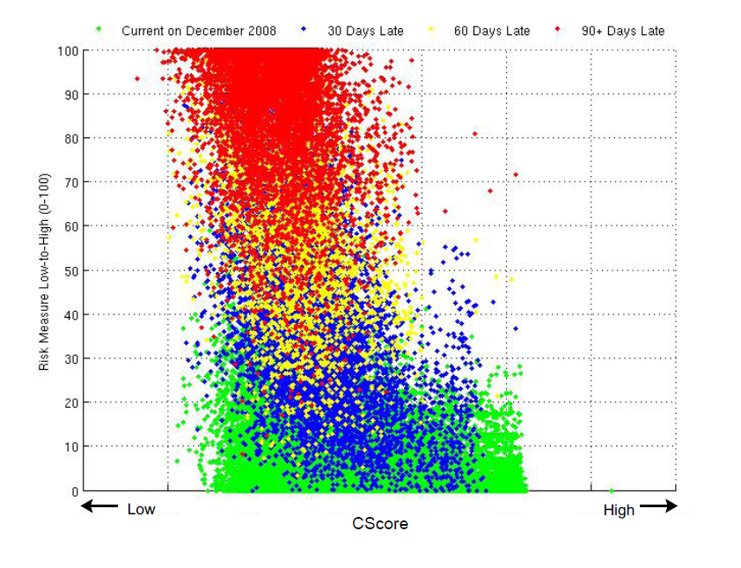
Sharing Data with Researchers:
Financial Data
Challenge: Consumer credit risk analysis and forecasting
Approach: Machine learning
1% sample,10Tb
This graph:2008Q4
Current
30-days late
60-days late
90+ days late
Machine-Learning
Score
Andrew W. Lo et al.
(MIT Sloan School)
FICO Score
Machine-learning detects potential defaults more accurately than FICO scores!
Notes:
The best-known and most widely used credit score model in the United States, the FICO score is calculated statistically, with information from a consumer's credit files
Risk Measure vs. CScore

Slide 5

BUT Data Sharing is HARD!

Slide 6

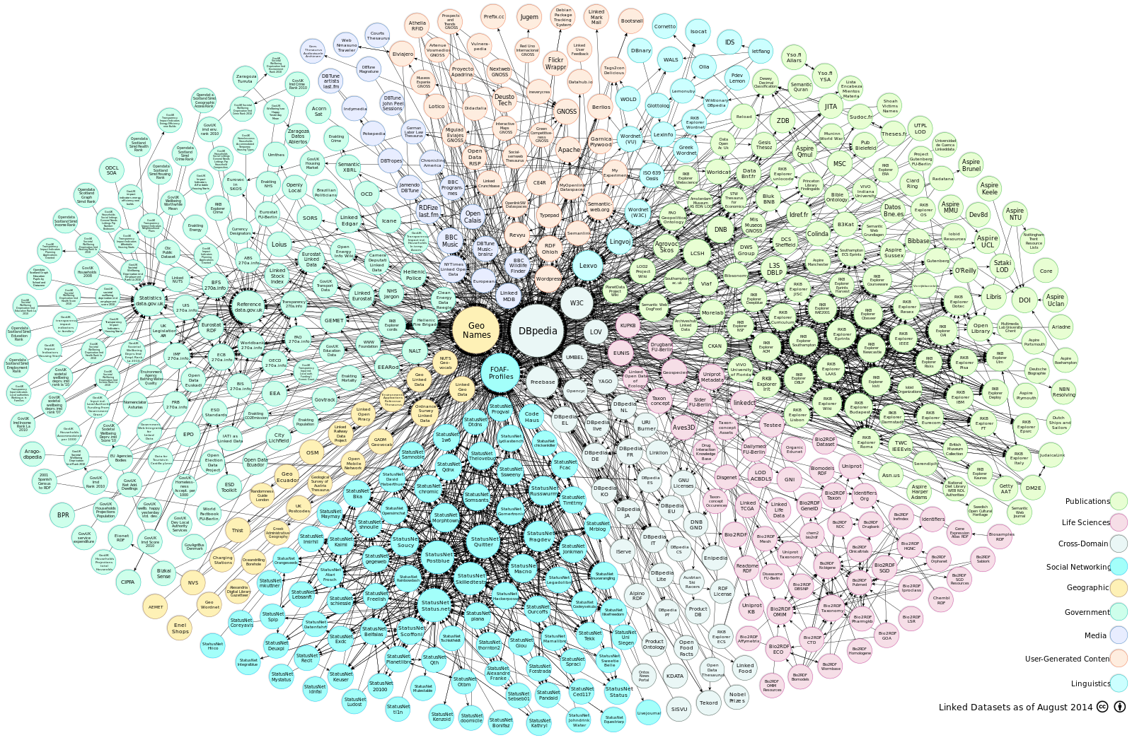

Why Not Open Data?

Slide 7
Barriers To Data Sharing
Must go beyond “creative commons”
Incentives – why would someone go to all the effort to share their valuable data?
Concerns over sensitive information (e.g., PII)
Regulations governing use of data in different domains
Not just “throwing it over the wall”!
  Do not want to loose control over data
  Can I get my data back?
  Has to be updated, requires training, redacted etc.

Slide 8

Sharing Data Today
No data sharing without a legal agreement
Involve lawyers to create individual agreement -> often prevents sharing!

Slide 9
Data Sharing Spoke: Goals
Data-sharing Licensing Framework / Generator
Data-Sharing Platform (Enforce Licenses)
Metadata (Search Licenses & Data)
Principle: Solve the 80% case!

Slide 10


Goal: Licensing Framework
Standard terms that researchers, lawyers, and compliance teams conform with
Controlled access
Tracking of access
Usage rights (e.g., publication, copying)
Duration of use
Warrantees of correctness/completeness/availability
Other requirements and regulations

Slide 11
Licenses: First Results
Data-Sharing Workshop 2016 (Metadata Research Center @ Drexel):
Approx. 60 participants form industry + academia
Hear from the trenches
What works? What doesn’t? What are the biggest barriers? (What are the non-barriers?)
Brainstorm solutions: would standardized licenses, use-cases/best practices help? Would better technologies help?
Forge a path forward, together
Agenda and Report: http://cci.drexel.edu/mrc/news/
2016-11-bigdatahubworkshop/

Slide 12
Licenses: First Results
Collected sharing agreements from academic institutions
Compile list of standard terms for
General (Time period, Use of data, ...)
Privacy & Protection (PII, Security, Training)
Access (Who?, How?)
Responsibility (Indemnity clause, Ownership, Rights)
Compliance (Background checks, Right to audit, ...)
Data Handling (Allowed Methods of Data Transfer, ...)

Slide 13
Goal: hosted data-Sharing platform
Suitably aggregated, de-identified, and fingerprinted data
data user
Traninig
ShareDB
data
Access log
data owner

Slide 14
Is this possible: Technology ⨝ Sharing Agreements
Tech
Access control & rights management
Expiration
Logging & auditing
Provenance/Fingerprinting
De-identification
“Noising”
Aggregation
Agreement Clauses
Controlled access (who & where)
Tracking of access
Usage rights (e.g., publication, copying)
Duration of use
Warrantees of correctness/completeness/availability
Other requirements and regulations

Slide 15
Is this possible: Technology ⨝ Sharing Agreements
Tech
Access control & rights management
Expiration
Logging & auditing
Provenance/Fingerprinting
De-identification
“Noising”
Aggregation
Agreement Clauses
Controlled access (who & where)
Tracking of access
Usage rights (e.g., publication, copying)
Duration of use
Warrantees of correctness/completeness/availability
Other requirements and regulations

Slide 16
Is this possible: Technology ⨝ Sharing Agreements
Tech
Access control & rights management
Expiration
Logging & auditing
Provenance/Fingerprinting
De-identification
“Noising”
Aggregation
Agreement Clauses
Controlled access (who & where)
Tracking of access
Usage rights (e.g., publication, copying)
Duration of use
Warrantees of correctness/completeness/availability
Other requirements and regulations

Slide 17
Is this possible: Technology ⨝ Sharing Agreements
Tech
Access control & rights management
Expiration
Logging & auditing
Provenance/Fingerprinting
De-identification
“Noising”
Aggregation
Agreement Clauses
Controlled access (who & where)
Tracking of access
Usage rights (e.g., publication, copying)
Duration of use
Warrantees of correctness/completeness/availability
Other requirements and regulations

Slide 18
Is this possible: Technology ⨝ Sharing Agreements
Tech
Access control & rights management
Expiration
Logging & auditing
Provenance/Fingerprinting
De-identification
“Noising”
Aggregation
Agreement Clauses
Controlled access (who & where)
Tracking of access
Usage rights (e.g., publication, copying)
Duration of use
Warrantees of correctness/completeness/availability
Other requirements and regulations

Slide 19
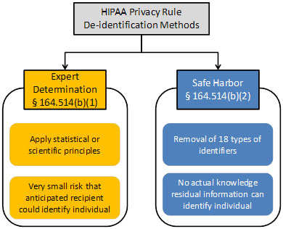
Platform: First Results
De-identification is a major obstacle for data sharing (e.g., HIPAA, FERPA, …)
Goal: Automatic De-identification
Detect sensitive columns
(rule catalog, user-defined,
machine learning, …)
Automatically de-identify
Notes:
Health Insurance Portability and Accountability Act ( HIPAA)
Family Educational Rights and Privacy Act (FERPA)

Slide 20
HIPAA: Interactive DE-identification
data user
ShareDB
data
data owner

Slide 21




HIPAA: Interactive DE-identification
data user
ShareDB
data
data owner

Slide 22
HIPAA: Interactive DE-identification
De-identified data
data user
ShareDB
data
data owner

Slide 23
NEXT Steps
Next Data Sharing Spoke Workshop (Fall 2017)
Collect more agreements and create license framework 0.1
Extend tooling support (watermarking, etc.)
Metadata support

Slide 24
Questions?

