Slide 1

Data-Driven Education
Beverly Park Woolf, Ivon Arroyo,
Neil Heffernan, Ryan Baker
University of Massachusetts - Amherst
Worcester Polytechnic Institute
University of Pennsylvania - Philadelphia
Supported by
National Science Foundation #1636847

Slide 2
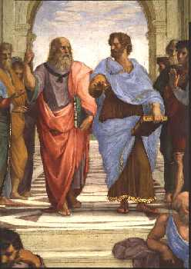
The School of Athens, fresco by Raphael (1509 -1511) in the Vatican. Plato (left) and Aristotle (right) hold bound copies of their books.

Slide 3

One Goal: Provide millions of schoolchildren with access to the personal services of a tutor as well informed as Plato or Aristotle.

Slide 4
NSF Big Data Spoke Award
Train researchers and educators in techniques and tools that personalize education and make predictions over large data sets.
Use competitions, hackathon and workshops as part of this process.
Topics to be taught include:
Data Mining
Artificial Intelligence
Machine Learning
Learning Sciences

Slide 5
Example Big Data From PSLC
The percentage of errors made by students on their first attempt. Learning curves for individual topics. Knowledge components indicate student learning, categorized by little learning (e.g., square area; rectangle area); no learning (e.g. triangle area); and still too many errors (e.g., circle-circumference).

Slide 6
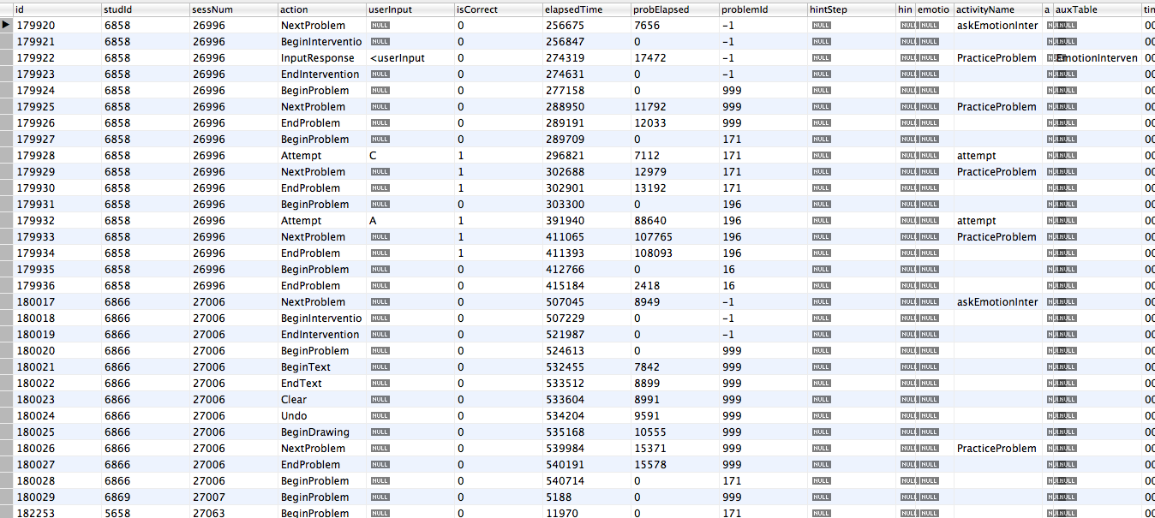
Large Data Sets
EventLog Table of a Math Tutoring System. 571,776 rows, just in a year’s time.

Slide 7
Educational Big Data
NSF funded DataShop, LearnSphere hosts tens of millions of data points from hundreds of thousands of students using a variety of online learning systems.
Includes log data of student interactions, test data, field observation data stored in fully de-identified form, with all identifiers secured.

Slide 8

Model the Student
Model the Domain
Personalize Tutoring
Assess Learning
We are able to:
Change curricula in real-time, based on student needs;
Provide added material for low achieving students.
Results: students learn better,
learn more and learn faster with these systems.

Slide 9
Workshops: Topics to Teach
How and when to use key methods.
Methods being developed as well as standard data mining’ strengths and weaknesses for different applications.
How to answer education research questions and drive intervention and improvement in education.
Validity and generalizability; how trustworthy and applicable are the results.

Slide 10
3 Workshops
Computer Supported Collaborative Learning;
Full day, Philadelphia, Pa. June 18-19, 2017
Artificial Intelligence in Education
Half day Wuhan, China, June 28-29, 2017
Educational Data Mining
Wuhan, China, June 25-28, 2017

Slide 11
Workshops: RESEARCH QUESTIONS
What kinds of questions are worth asking/answering
What do teachers and students want to know?
What do researchers in Learning Sciences want to know?
What are techniques to answer big questions to big data

Slide 12
Topics to Teach
Visualization of single variables
Decision trees, Bayesian Networks, Regression
Pre-processing techniques, Visualization of single variables, Decision trees, Bayesian networks, Regression
Google Refine http://code.google.com/p/google-refine/
Fathom (http://www.keycurriculum.com/products/fathom)
Rapid Miner (rapidminer.com)
IBM SPSS Statistics, Version 20
Tinker Plots (http://www.keycurriculum.com/products/tinkerplots)
Many Eyes and IBM Visualization Tools (www-958.ibm.com/)
TETRAD Causal Modeling Software

Slide 13
Competitions
Use existing Big data base to:
predict who goes to college and what students will study.
Longitudinal Data
NSF supported longitudinal research at WPI
Middle-School students have been tracked for
10 years. Results of mathematics actions and college attendance.
Invite people to Kaggle competitions to predict student progress.

Slide 14
Datathons
Weekend hackathons in which participants are encouraged to enhance existing educational software, including MathSpring and ASSISTments.
They will
Design improved animated learning companions,
Develop visualizations of hints and messages
Develop adaptively sequences problems adjusted to students’ recent levels of ability and effort exerted.

Slide 15
Data-Driven Education
Three grand challenges in education:
• Predict future student events from existing large-scale longitudinal educational data sets involving the same thousands of students
• Help teachers make sense of dense online data to influence their teaching
• Provide personalized instruction based on using big data that represents student skills and behavior and infers students’ cognitive, motivational, and metacognitive factors in learning

Slide 16


