Slide 1
René Bastón, Executive Director
Kathy McKeown, PI
Coordinated by Columbia University

Slide 2
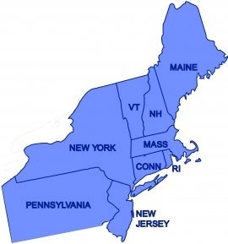
NE Regional Big Data Innovation Hub
Provide frameworks for public-private, multi-sector collaborations to address high-priority challenges with data-driven solutions
Columbia (PI)
CA, CT, IL, MA, MD, ME, NJ, NY, NH, PA, RI, TX, VA, WA
…D.C., and QUÉBEC!
Notes:
13 States, Quebec, D.C.
ME (Leigh Peake, Gulf of Maine Research Inst)

Slide 3

Not Just About Technology

Slide 4
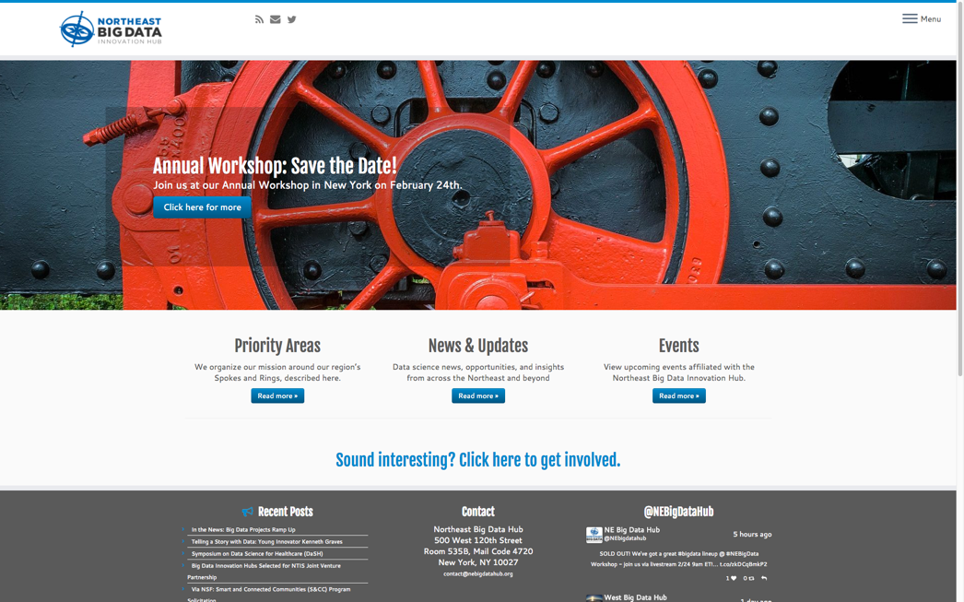
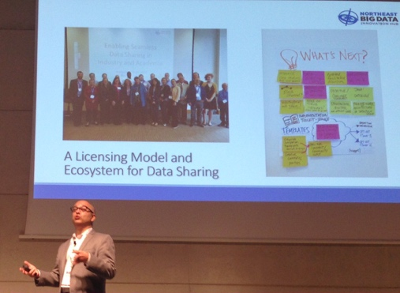
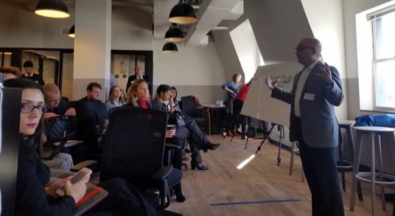
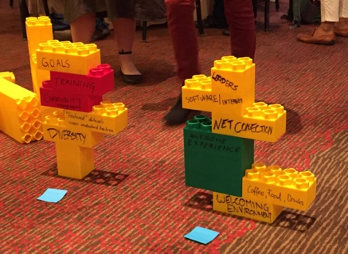
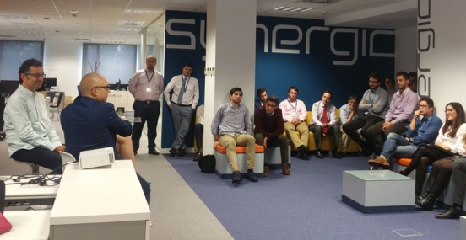
Year 1 - By the Numbers
Community/Communications:
Events: Convened or participated in 18 events; over 2700 people
Website Relaunch: Blog, Newsletter, Twitter; ~4600 visitors/month
Altogether, 10s thousands reached

Slide 5







Year 1 - By the Numbers
Funding and In-Kind Contributions
$4.5 million
9 New Projects
3 Spoke Projects
4 Planning Projects
Innovator Internships
BD-Map

Slide 6
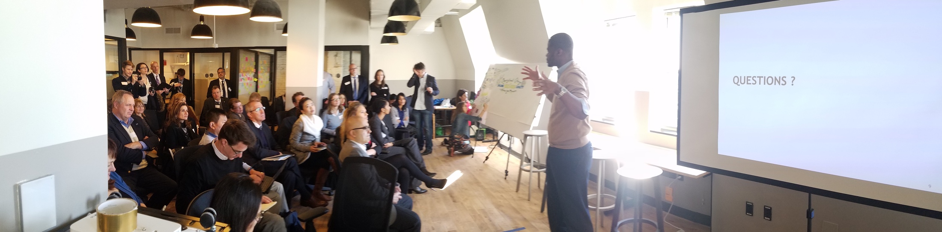

Events
Organizational Change: Building Data Science Capacity to Advance Your Mission, D.C.
Enabling Seamless Data Sharing in Industry & Academia, PA
AAAI Fall Symposium – Accelerating Science; a Grand Challenge for AI, VA
Big Data Week Spain, Madrid / Barcelona
Cross-Organization Big Data Cyber Attack Awareness (CROSSBAR), VA
Data Science for Healthcare Annual Symposium, CT
West Hub Events: All Hands Meeting, CA
Health: Data Science Applications to Biomedical & Health Sciences, NY
Executive Training in Data Science Meetup, NY
I Love it When You Call Me Big Data, PA
Midwest Hub All Hands Meeting, IL
Big Data PI Meeting, VA
NE Hub 1st Annual Meeting, NY
NDS Consortium Workshop, NC
CASC Spring 2016 Meeting, VA
Wolfram Data Summit, D.C.
International Data Week, CO
SuperComputing 2016, UT
Notes:
The event convened over 125 thought leaders and datapractitioners from industry, academia, nonprofits, and government to share lessons learned and best practices. Lightning talks from the Chief Analytics Officer of New York City, Chief Innovation Officer of Internet2, and Executive Vice President of RTI International were punctuated by “vote-with-your-feet” focused discussion and facilitated activities to capture participants’ challenges and opportunities for collaboration.

Slide 7




Pounding the Pavement
Northeast Road Trip
9 cities, so far
Discovering Stakeholder Needs
Identifying Data Resources in the NE
Exploring Membership, Consortia, and Partnership / Collaboration Models

Slide 8

Exploring New Initiatives
Big Data Map: Assets Platform (BD-MAP)
Big Data Resources
Hypothes.is; Pitt Super Computing Center; and XSEDE
Cross Sector Consortia

Slide 9




































Cross-Sector Outreach

Slide 10






























Cross-Sector Outreach

Slide 11













Cross-Sector Outreach

Slide 12






Cross-Sector Outreach
International Educational Data Mining Society

Slide 13
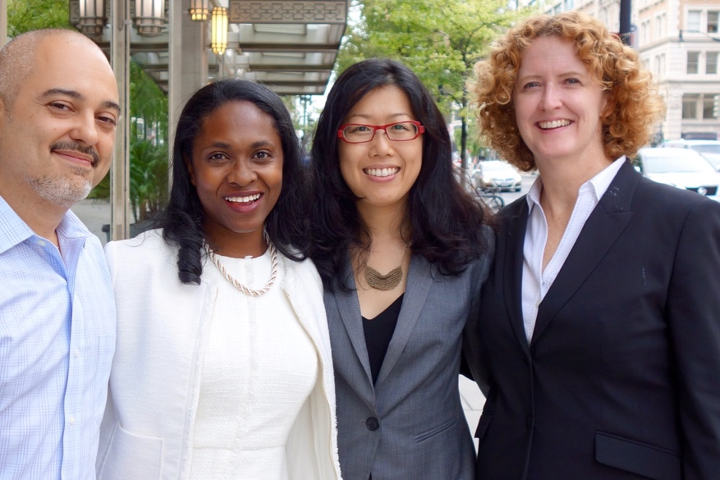
Cross-Hubs Coordination
Cloud Vendors
DOT / SHRP2 Opportunity
NTIS Joint Venture Partnership
NSF Directorate and Federal Agency Outreach
National Big Data Infrastructure

Slide 14
Funding / In-Kind
$4.5 Million in Additional Resources and Awards
Graduate Student Supplementation Awards (BD-MAP) ($80,000)
Computing Community Consortium Early Career Data Scientist Grant ($300,000)
Microsoft Azure Cloud Credits ($750,000)
Spoke Projects ($3.3 million)
National Technical Information Service Joint Venture Partnership

Slide 15
Spoke Awards
7 NSF Spoke Awards

Slide 16

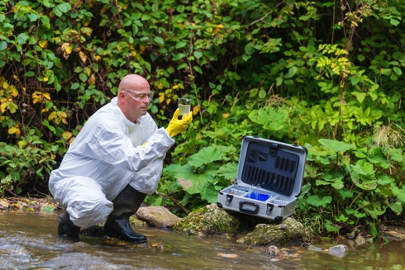
Integration of Environmental Factors and Causal Reasoning Approaches for Large-Scale Observational Health Research
Notes:
7 Projects

Slide 17
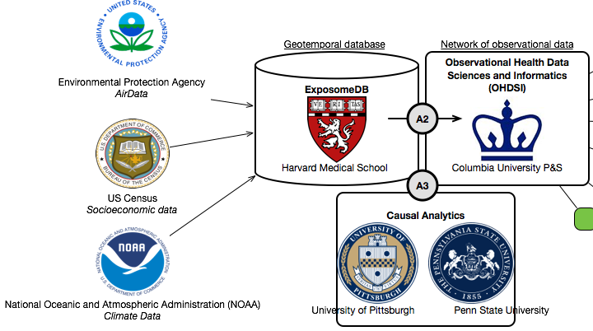
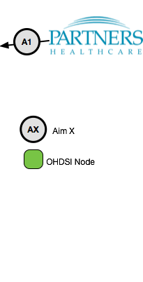
National Aeronautics and Space Administration
Cloud/Atmosphere Profiles
U of Pitt Penn State
Centers for Disease Control
Epidemiological

Slide 18
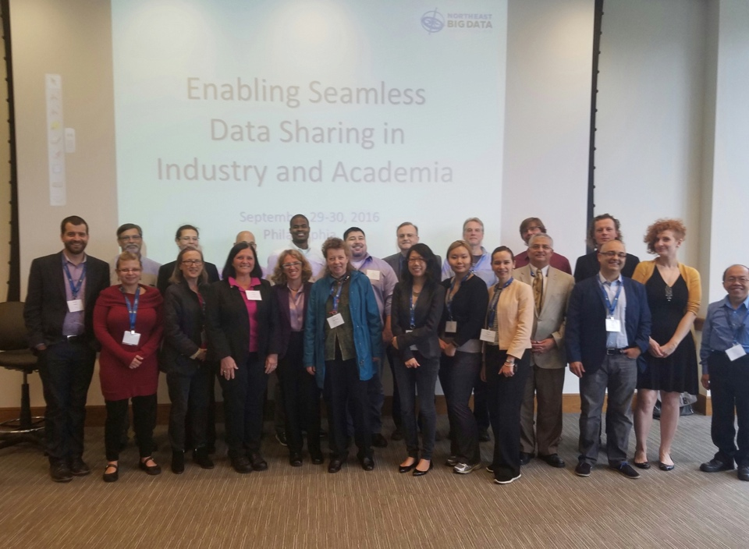
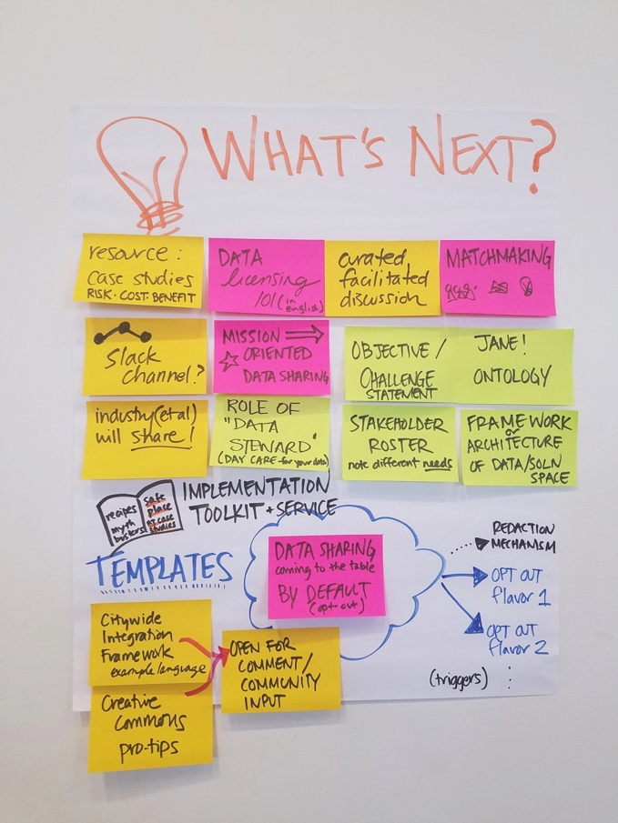
A Licensing Model and Ecosystem for Data Sharing

Slide 19

Grand Challenges for Data-Driven Education

Slide 20
What’s Next?

Slide 21
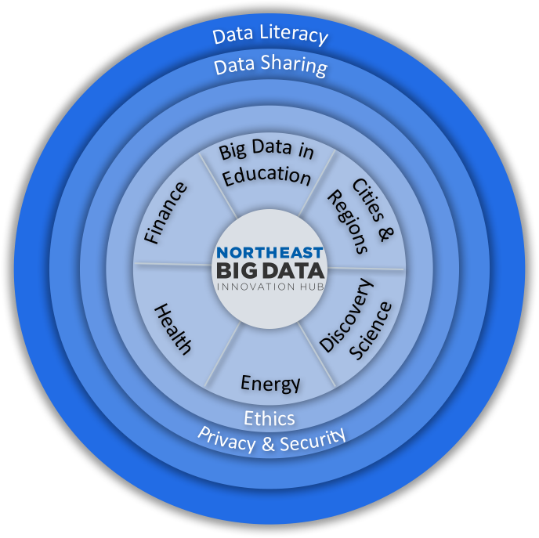
Spokes & Rings
Advancing existing Spoke and Planning Projects
Assisting with next NSF solicitation

Slide 22





Next Steps & New Directions
Innovator Internships
BD Resource Map Pilot
Consortia Models
Transportation
Cybersecurity Insurance
Expanded Access to Data
Cross Hub Communications Plan
Ad Hoc Workgroups

Slide 23

Executive Education Pilot
Bridging the Big Data Knowledge Gap
A short course targeted at Executives
Goal: Help decision-makers understand how to effectively use data-driven tools for decision support

Slide 24
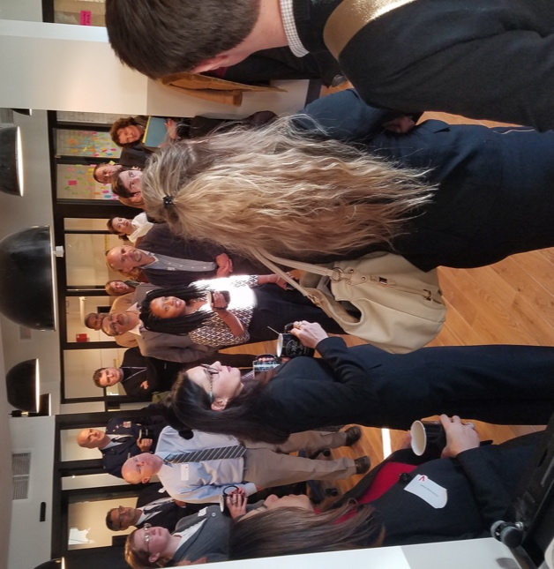
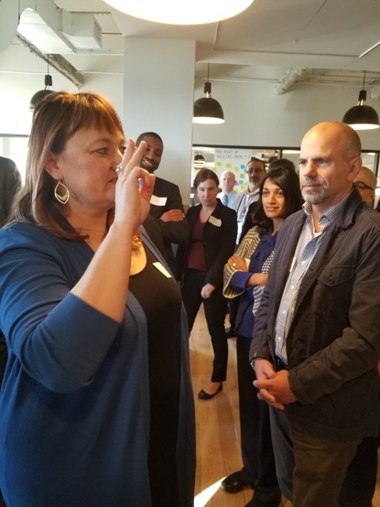
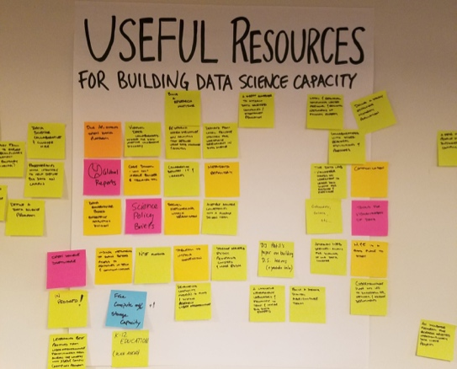
Community Engagement
Steering Committee Workgroup
Expanding engagement and activities in priority areas
Exploring new areas in which NE Hub can help
Expanding the number of participants across NE Hub

Slide 25
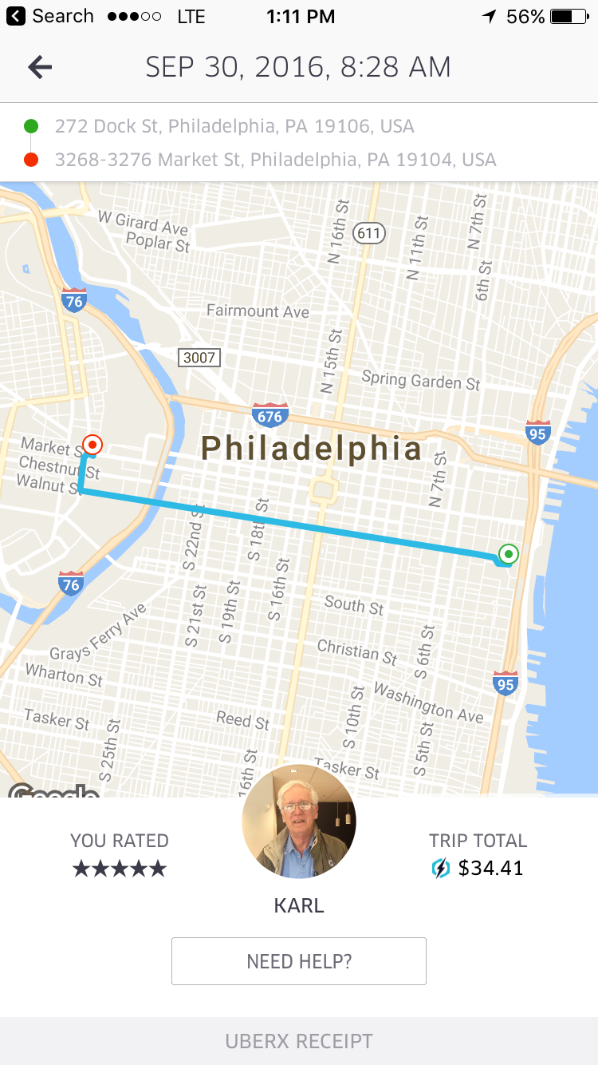

Slide 26


Call to Action
Feedback
Advocacy
Engagement

Slide 27



Sponsors

Slide 28
For More Information
nebigdatahub.org
rb70@columbia.edu
contact@nebigdatahub.org
@NEBigDataHub
#BDHubs | #NEBigData
tinyurl.com/NEBDHubList

